Slide 1
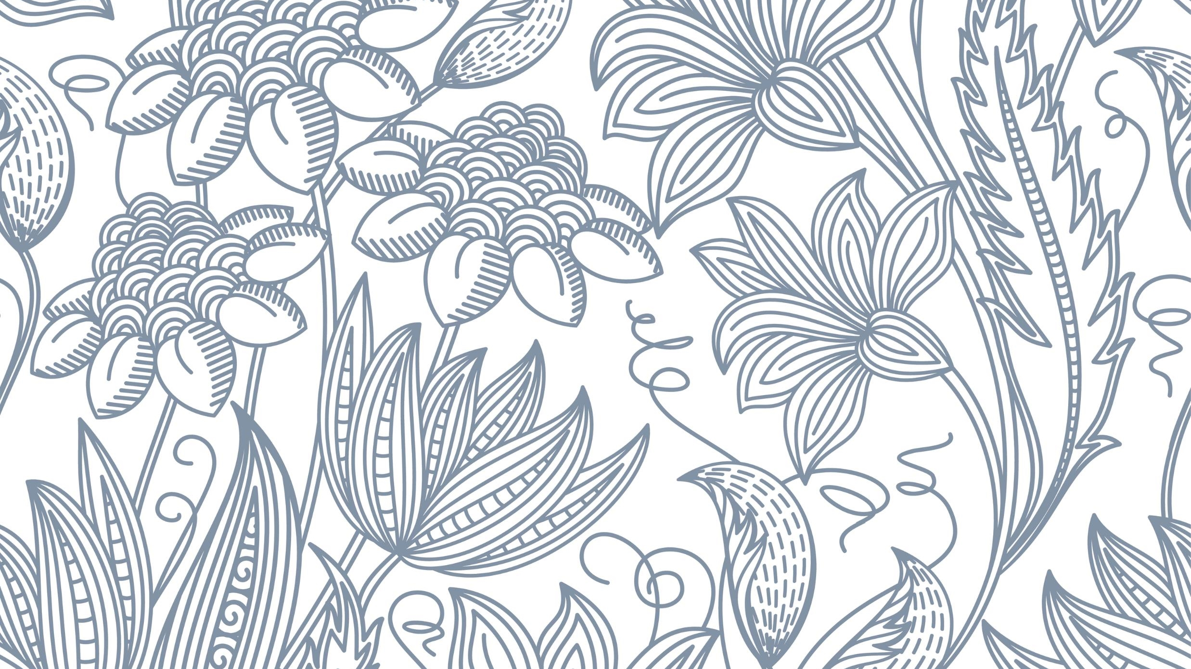
Social Media, celebrities, and brand image
Hannah Knight

Slide 2
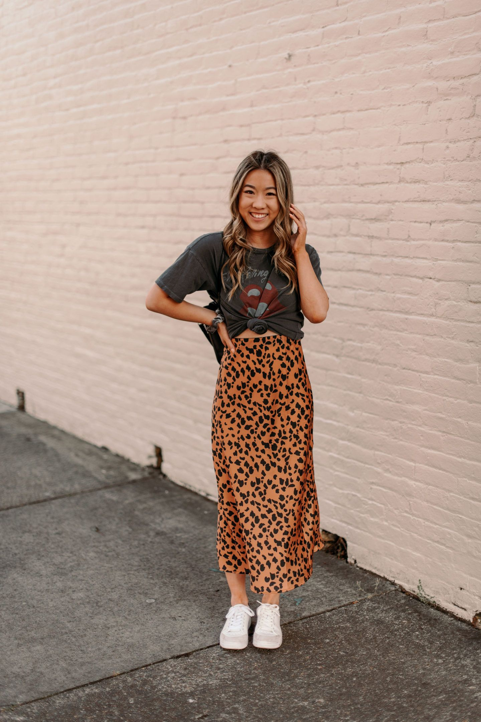
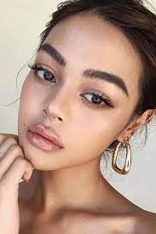
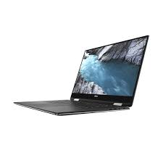
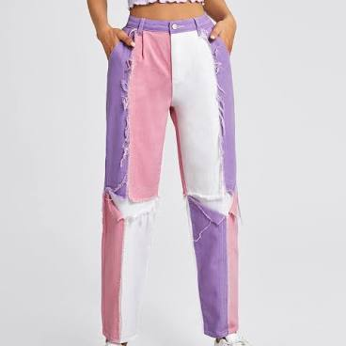
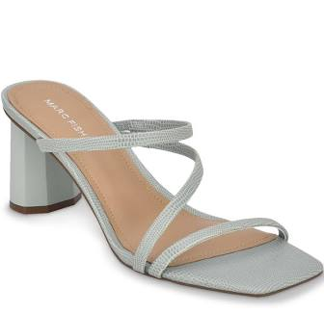
Trends in 2026
Our world changes in the blink of an eye. Before you know it something you love is already out of style. Looking forward to 2026, I believe that our world will be very different. This does not just apply to the fashion industry but to the automobile and technology industries too.
Trend forecasting for 2026:
More than half of the cars will be fully electric
Ultra thin phones and laptops
Color blocking in clothing
Natural looking makeup
Low heels will replace stilettos
Midi skirts with graphic tees
These are just a few items that I see being around in 2026. I think that many styles will come and go but I believe that these will for sure stick around.

Slide 3
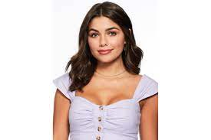
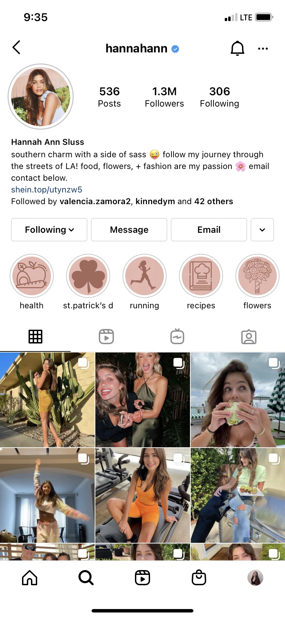
Celebrities Influence
It is no secret that celebrities have a massive influence on trends. They use social media to get their message through to consumers. Whether they are doing ads for companies, or just giving their opinions, they have an impact on what is worn and trending.
Hannah Ann Sluss: She was on The Bachelor season 24 and ended up getting the final rose. She did not end up with Bachelor, Peter Webber, but she did end up with a huge social media following. She has 1.3 million followers on Instagram and is now an influencer who does ads for different companies such as Alo Yoga, Revolve, Lively, and many more. She is a successful influencer because she was liked when she was on the Bachelor and that carried over to her social media accounts. She is a respectful and professional person who has not been involved in any scandals or sticky situations.

Slide 4
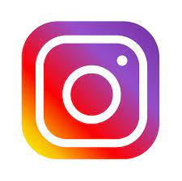
Influence of Social Media
In today’s world, social media is the number one way that trends are spread around the world. Users see pictures and videos of people around the world and take after them. Social media makes it so easy for a fashion trend to be spread. With new features on social media apps, shopping and following trends is now easier than ever.
Instagram: This is arguably the most influential social media site. When someone posts a photo wearing specific items of clothing, they can tag the store/company it was purchased from. Another feature on Instagram that makes it very easy to start new trends is being able to link items in the Instagram Stories. A lot of times influencers will link the items they are talking about in a story so that it is very easy for the consumers to find the exact item. This leads to more purchases of these certain items, thus, starting trends.

Slide 5
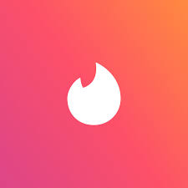
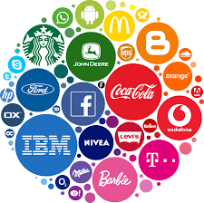
Brand Image
The goal of any successful company is to have a good brand image. They want their consumers to see them as a good, reliable company. Establishing brand image is one of the most important factors when starting a business, and one of the best ways to do that is through social media. Establishing a strong social media presence is just the first step of creating a strong online brand image. Having an aesthetically please page, responding promptly to direct messages, and actively posting are just the main components of creating a brand image. If you do all of these things, consumers will realize that your company is dedicated to its customers and can be a trustworthy company to conduct business with.
Fashion trends can impact brand image because a company needs to be up to date with the trends to have a good brand image. They need to have a current logo that is not outdated and represents their company well. One company that comes to mind when I think of a positive brand image is Tinder. They have a fun logo that is up to date. They are also very active on social media, especially twitter. They interact with other people on Twitter which makes them likeable to many people.

Slide 6
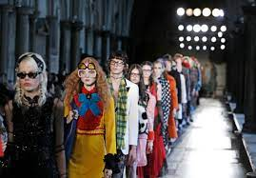
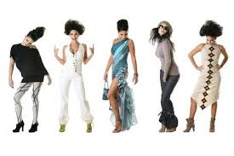
Cultural Zeitgeist
The role of dress can shape cultural interactions by being a topic of discussion. They way you dress can say a lot about you and your culture. This can bring up discussions with people you may not already know, creating cultural interactions.
The cultural zeitgeist has a big impact on fashion. The cultural “spirit of the times” is how people dress, act, and carry themselves in a particular time period. The zeitgeist sets the mood for that time period, and people dress to match that. Fashion trends can also have an impact on the zeitgeist. It is a two-way street full of fashion trends, communication, and influence. When a trend starts, it can impact the way people act and carry themselves. That is an example of cultural zeitgeist being influenced by trends.

Slide 7
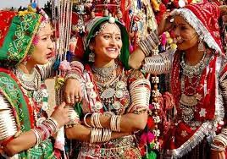
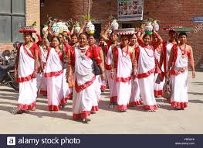
Artistic and Cultural Influences
Fashion can be influenced by almost anything. Two popular ways of influencing fashion is through art and culture. Art can influence fashion through music, paintings, and sculptures. Today, music has a huge impact on the way we dress. People like to dress to match their music taste. Paintings can impact the way we dress too. It was more of an influence back in the 1800s and 1900s but is still relevant today. Culture can affect the way we dress because it is tradition. There are so many cultures that have traditional dress that is still around today. Sometimes you are able to tell what culture people are a part of because of what they wear.
Almost anything can influence fashion. Social media, celebrities, culture, and art are just a few examples. We can see firsthand how fashion is influenced by anything and everything. The fashion world is a fast-paced always changing environment that is hard to keep up with.

