Slide 1
Fads, Fashions, and classics
Hannah Knight

Slide 2
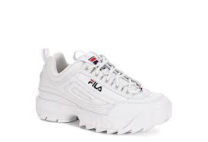
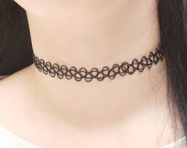
Fads
Fads are something that fade out of style just as fast as they came into style. It is often something that gets very popular very quick but does not stick around for long
Chunky Filas are one example of this. They got very popular in early 2020 and are now out of style already.
Another fad that I have lived through are chokers like the one pictured to the right. This was a fad in 2015-2016 but it did not last a long time. It was a trend for about 9 months to a year, and I do not see it ever coming back.

Slide 3
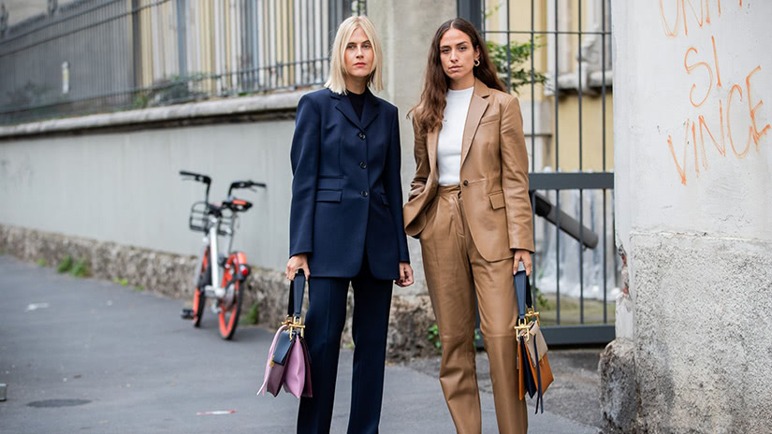
Fashions
Fashions are styles that are popular in the present or a set of trends that have been accepted by a wide audience
One example of a fashion is athleisure. Especially since the pandemic started, athletic clothes have become more widely accepted. There are comfy but can also be stylish which is why so many people love this stye.
Another example of a fashion is pant suits for women. This has become a big trend for women in the workplace. Many women love this style because it makes them feel powerful and confident.

Slide 4
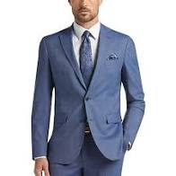
Classics
Classics are something that never really go out of style. They may be altered or change a bit over time, but it is something that will always be around
Denim jeans are an example of a classic. Over time the popular styles have changed from flare to straight to skinny and so on. I believe that some type of denim jeans will always be in style
Men’s suits are also an example of a classic. They have been in style for many decades. Like I mentioned with the jeans, the style of them has changed, but overall, the suit will always be something in a man's wardrobe.

