Slide 1
Outerwear Jackets, Coats, and Dresses
Hannah Knight

Slide 2
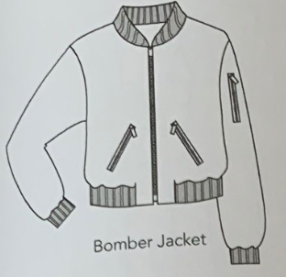
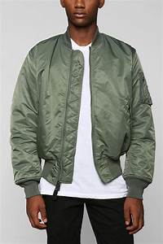
Bomber Jacket
A short jacket similar to a flight jacket, but with a thick lining typically of sheepskin.

Slide 3
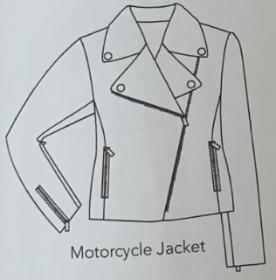
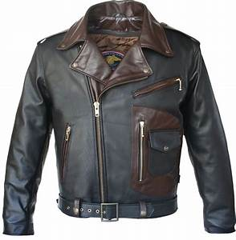
Motorcycle Jacket
a short, close-fitting leather jacket with zips and studs, often worn by motorcyclists

Slide 4
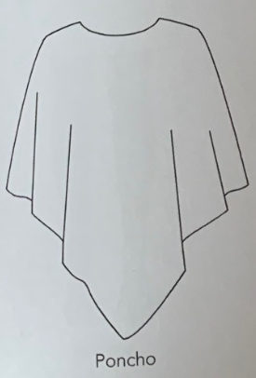
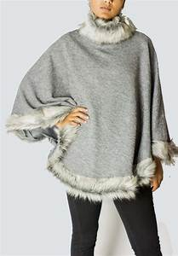
Poncho
Fashion item shaped like a square or small oblong
Blanket with hole in center for head. Frequently fringed
around the edges. Popular in late 1960s and after.

Slide 5
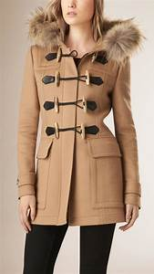
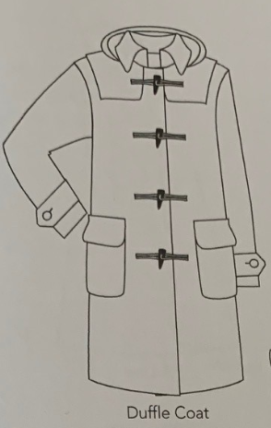
Duffle Coat
Car coat or a shorter-length coat fastened with toggles
Rather than buttons, introduced during World War II,
And worn by men in British navy.

Slide 6
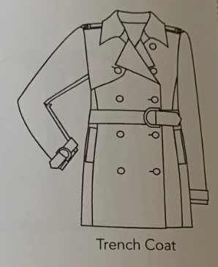
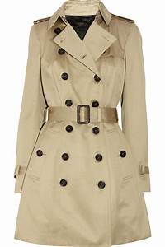
Trench Coat
Coat created by Thomas Burberry during WWI for
soldiers that was made of chemically finished,
water-repellent cotton gabardine. After the war the
style became an all purpose civilian coat made of a
water-reppellent fabric in double-breasted style with
a convertible collar, large labels, epaulet, fabric belt,
slotted pockets, and a vent in the back.

Slide 7
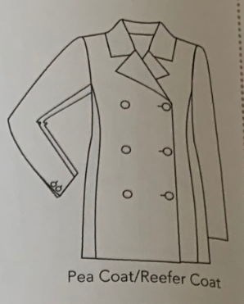
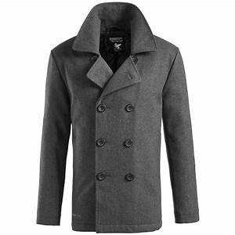
Pea Coat
Copy of U.S. sailor’s hip-length , straight,
double-breasted navy-blue, wool coat with
notched lapels, vertical slash pockets, and vent in
back.

Slide 8
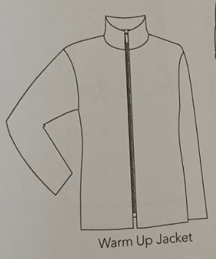
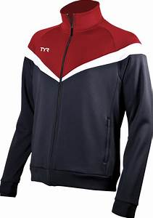
Warm Up Jacket
A jacket with an elasticated waist and a zipper up the front, worn by athletes while training; worn by others as a fashion accessory, usually carrying a team logo

Slide 9
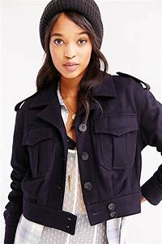
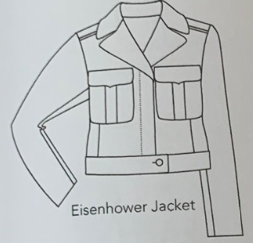
Eisenhower Jacket
Waist-length Army jacket worn in World War II, having two breast pockets, fitted waistband, zippered fly-closing and turn-down collar with revers.

Slide 10
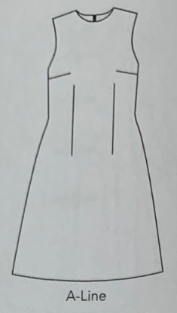
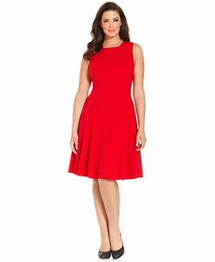
A-line Dress
Dress style which flares gently from under arms to hem of skirt, resembling the letter A. Usually made with narrow shoulders, a high round neckline, and is similar to Skimmer. Introduced in 1955 by Paris couturier, Christian Dior, (Calasibetta).

Slide 11
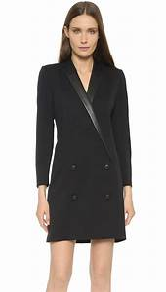
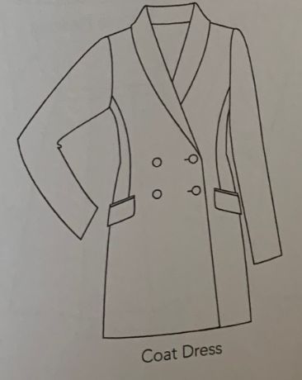
Coat Dress
Dress fastened down front neck to hem, like a coat, in single or double-breasted style, either belted or unbelted. A classic since the 1930s, (Calasibetta).

Slide 12
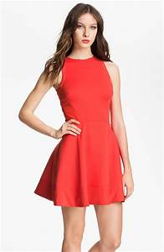
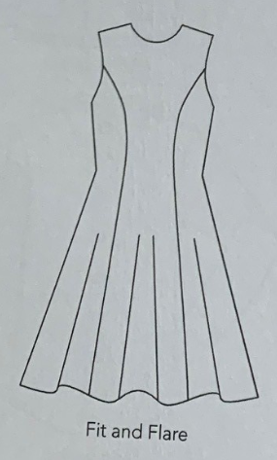
Fit and Flare Dress
Fitted dress with flared skirt, frequently made like a coat-dress, styled without a waistline seam and cut in six fitted panels from shoulders to hem. Original style was claimed to be designed by Worth and introduced about 1860 for Empress Eugenie. Worn intermittently since, particularly in the 1940s and early 1950s.

Slide 13
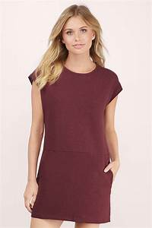
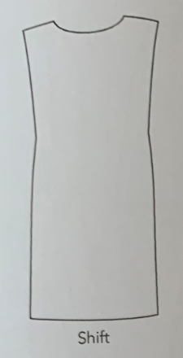
Shift
Straight-lined basic dress of 1960s, hanging away from body, similar to chemise dress of 1957. The shift dress introduced a diagonal upward dart from the side seam which improved the fit, (Calasibetta).

Slide 14
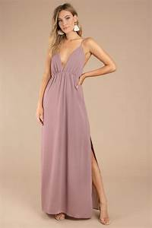
Maxi Dress
Ankle-length dress worn for day or evening. Introduced in 1969. First time since WWI that long dresses were worn as daytime dresses.

Slide 15
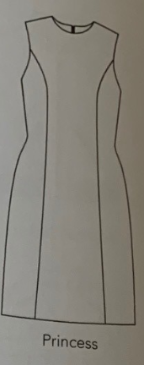
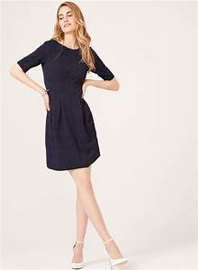
Princess Dress
Fitted waistline with no waistline seam. Garment is cut in panels from neck to hem and fit by shaping the vertical seams.

Slide 16
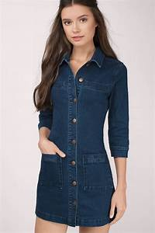
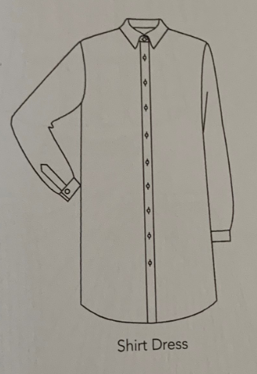
Shirt Dress
Straight-lined dress buttoned down the front cut similar to a man’s shirt, worn with or without a belt. Side seams are often slashed and the hem rounded, similar to the tail of a man’s shirt. Popularized in 1967, it was a variation of the classic coat-dress or shirtwaist, (Calasibetta).

Slide 17
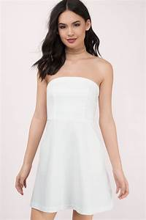
Strapless Dress
Décolleté dress ending just at top of bosom without shoulders or straps. Top
held in place by boning, by shirring with elastic thread or by using stretch
fabric.

