Slide 1
Evolution of Men’s Suits
Hannah Knight

Slide 2
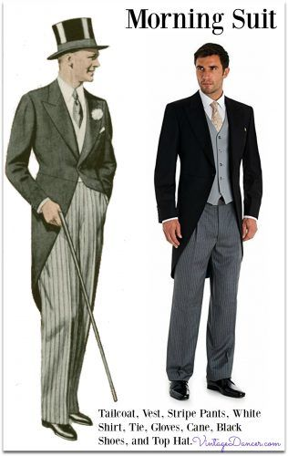
1900
Men’s suits in the 1900’s were called sack suits, ling, plain loose-fitting suit jackets with wide lapels and a one to three button closure
Wool was the main fabric
Common colors: dark navy, grey, green, ivory, and brown
Fancier looks were paired with a top hat and cane
https://vintagedancer.com/1900s/edwardian-mens-suits-coats/

Slide 3
1910
The men’s suits of 1910 were similar to those of 1900 except in 1912 there was a trend of purple suits
Fabric: wool for the nicest suits, a blend of wool and cotton for cheaper suits
These suits were very thick compared to today
In 1913 a new style was introduced; a box shaped jacket paired with a fitted high waist, creased leg at the front and back, and there was a cuff around the ankle to expose a colorful sock or boot top
https://vintagedancer.com/1900s/edwardian-1910s-historical-mens-fashion-and-clothing-an-overview/

Slide 4
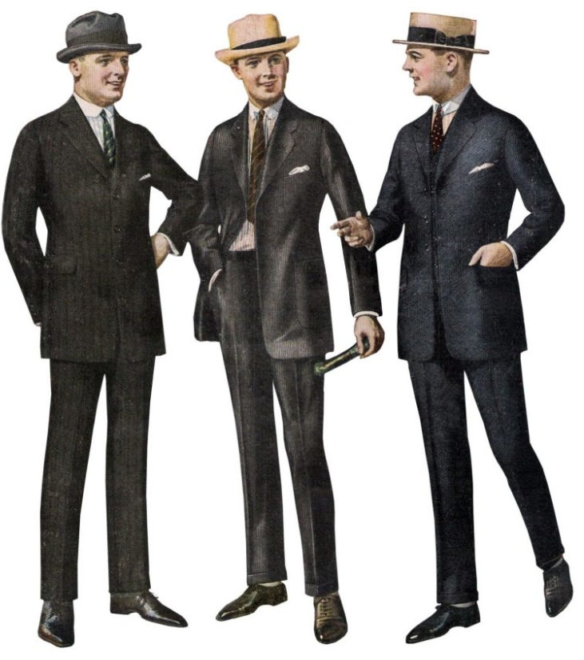
1920
Slim fit suits in bold patterns (stripes, plaid, and herringbone)
3 or 4 button closure, wide lapels, and flat front trousers
Common colors: grey, brown, and blue
Striped seersucker and ivory linen suits were cool and fashionable
https://vintagedancer.com/1920s/1920s-mens-suits/

Slide 5
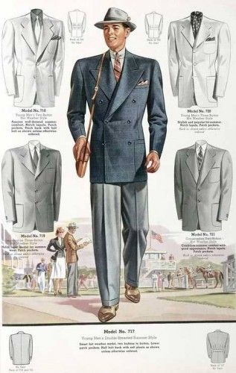
1930
Suits in this decade were very wide with broad shoulders, a long jacket, wide lapels, and a pinched in waist
Stripes, plaids, windowpane, tweed, and herringbone were all popular in all colors from neutral to jewel tones
Sport coats were also very common as well, a dark jacket over a lighter pair of trousers was very trendy
https://vintagedancer.com/1930s/1930s-style-mens-suits/

Slide 6
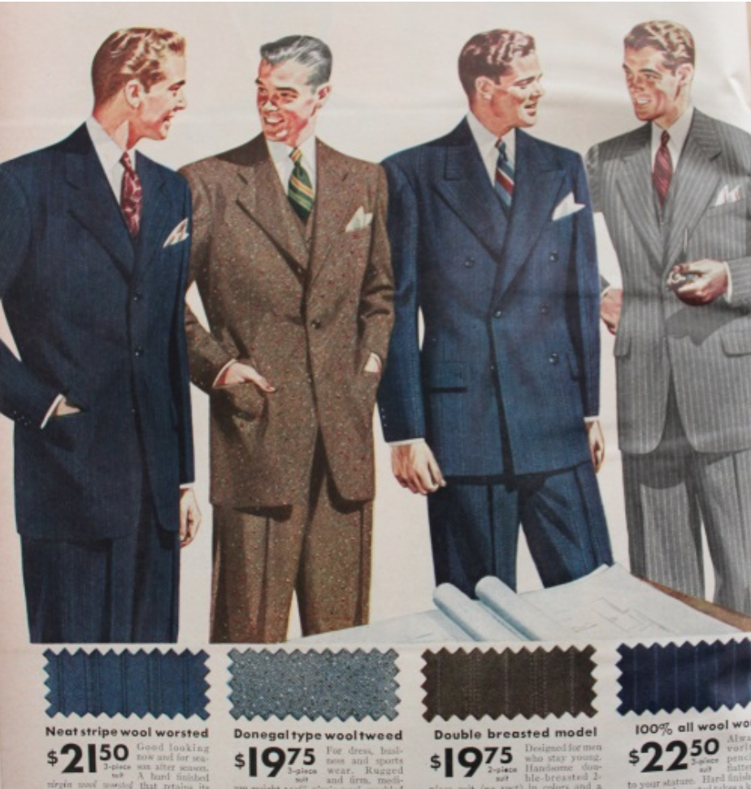
1940
The jackets in this decade were shorter, and pants were narrower with no pleats or cuffs
Both single and double breasted styles were popular
Wide chalk stripes were the most classic suit pattern of the time
These suits were thicker than today’s suits, but they used lighter fabric in the summer
Fabrics used: wool, and during the war synthetic rayon blended with wool was used
https://vintagedancer.com/1940s/1940s-mens-suit-history/

Slide 7
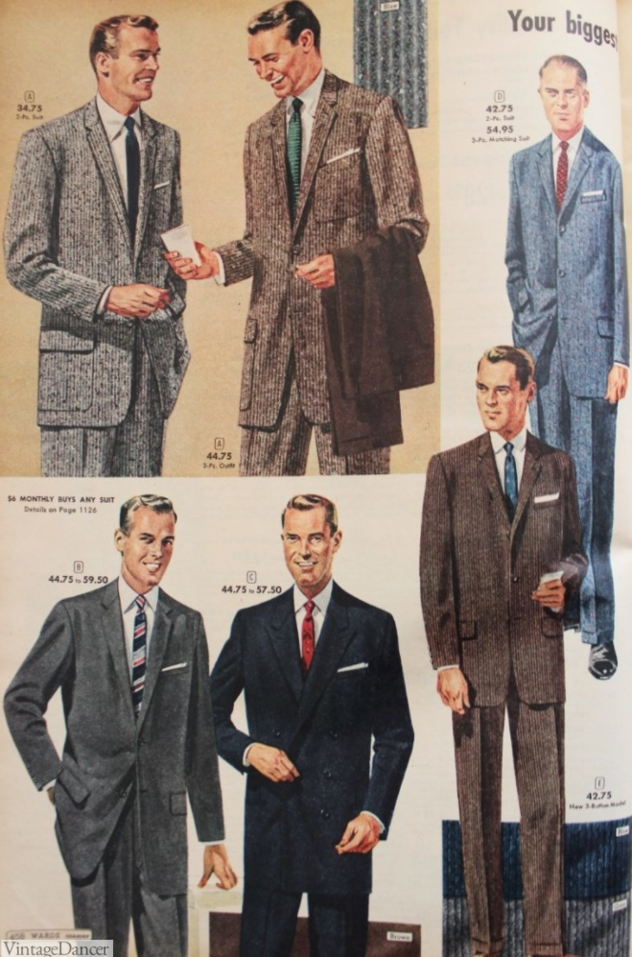
1950
Narrow ties were very popular in the 50’s and the suits were paired with heavy Oxford shoes
Fabrics used: wool, rayon, Orlon, and Arnel
Grey was the most worn color, but black, navy, and pinstripes were also popular
Sport coats were very acceptable and sometimes preferred
https://vintagedancer.com/1950s/1950s-mens-fashion/

Slide 8
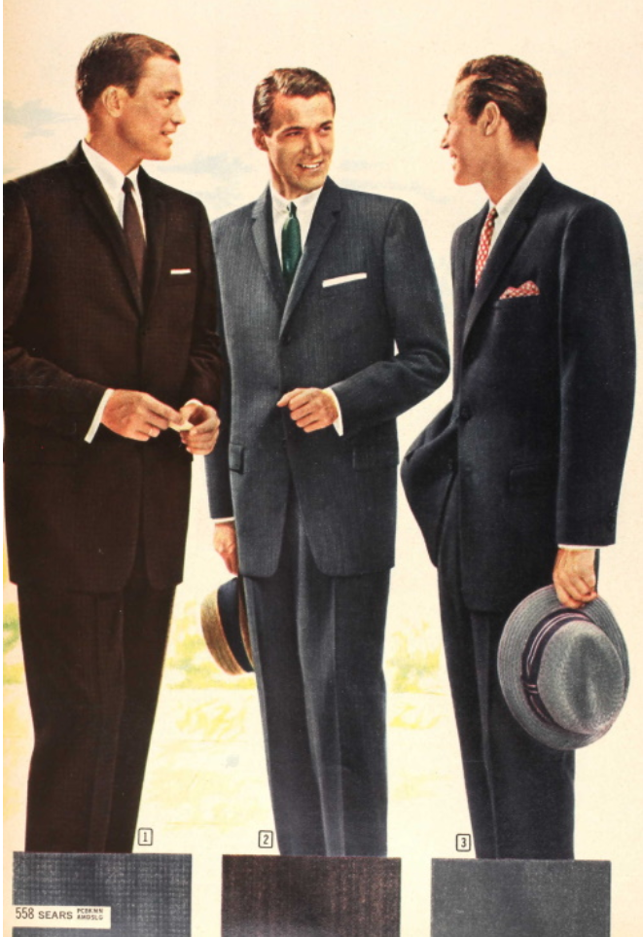
1960
Trends like skinny suits, knit ties, and classic footwear began in the 60’s
The suits slimmed down a lot in this decade, with narrow lapels, tailored waist, and a short jacket that was always single breasted
Vibrant colors were in along with stripes, plaids, and checks
Fabrics used: tweed, corduroy, cotton poplin, and seersucker
https://vintagedancer.com/1960s/1960s-mens-suits-sport-coats-history/

Slide 9
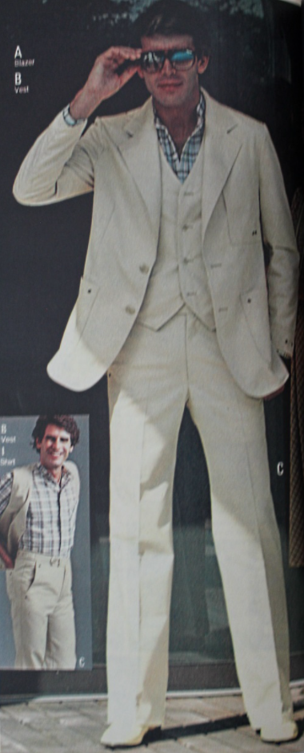
1970
Three-piece leisure suits were popular, with bold prints and body-hugging cuts
Bright colors were used
Bell bottoms worked for every look
Fabrics used: silk nylons, spandex, polyester, and jersey blends
https://vintagedancer.com/dancing/70s-disco-fashion/

Slide 10
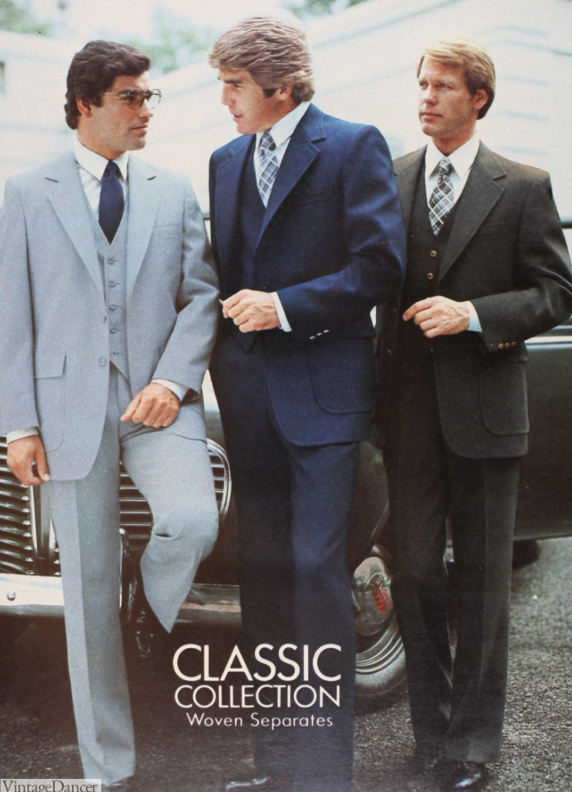
1980
Suits in the 80’s were cut full, with wide shoulders with shoulder pads
3 piece suits were still worn
Most suits were single breasted
Checks, plaids, pinstripes were popular
Bight and solid colors were equally popular in the summer
Fabrics used: polyester, wool and corduroy
https://vintagedancer.com/1980s/80s-mens-fashion-clothing-for-guys/

Slide 11
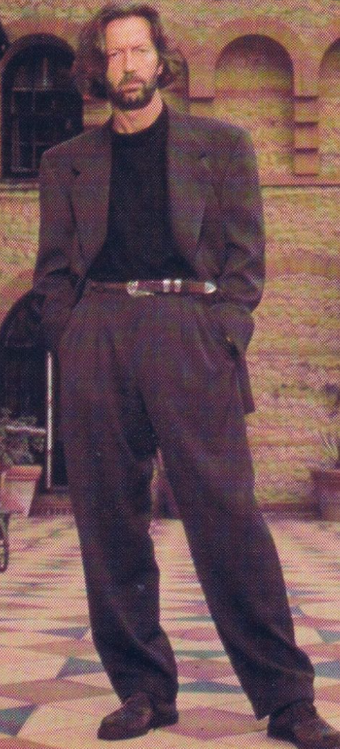
1990
In the 90s men did not wear suits as often as they used to
The oversized style of the 80s stuck around and pants were still wide
Ties also go a little bit wider and started to feature cartoon characters or sports teams
Pleats were more popular than ever to accommodate the rising obesity
https://www.gq.com/gallery/the-gq-history-of-the-suit-by-decade

