Slide 1
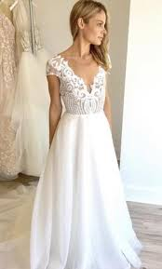
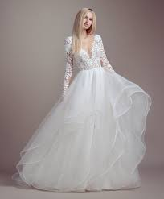
Hayley Paige
By: Hannah Knight

Slide 2
Date of Birth
Born in 1987 (only had year)
Bay Area, California
Has one sister
Dad is a doctor, mother is a interior designer

Slide 3
Bio of the Designer
Young Life
Spent most time in competitive gymnastics
Grandma taught her to sew
She would sketch and draw
Started to make her own dresses
Even though she loved design always thought she would be a doctor
Attended college at Cornell University

Slide 4
Bio of Designer
Young life
Dualed majored in pre-med and fiber science
Interned at Elle magazine
Participated in her senior runway show (2007)
After that she got offered a job by Jill Stuart

Slide 5
Bio of the Designer
Current Life
Owned a Business with her college friend
Gave up her half when Hayley Paige launched
2011 launched her own collection for CEO Joseph L. Murphy
Presented another collection under the Blush label
Then took on a bridesmaid line called Occasions
Most recently created a athleisure line

Slide 6
How Hayley Paige became a designer
Interned for Nina Garcia at Elle Magazine
COntinued and went to work with Jill Stuart
Began to style and design abroad

Slide 7
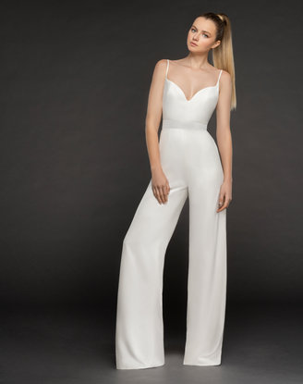
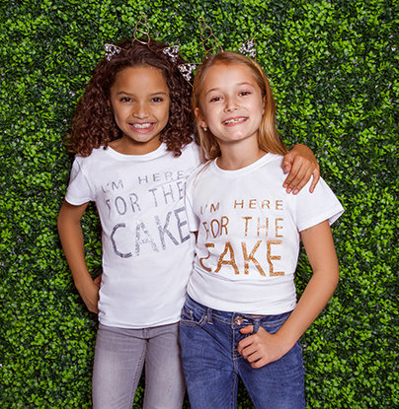
Type of clothing
Wedding Gowns
Bridesmaid dresses
Flower girl dresses
Occasion wear (jumpsuits
Athleisure
Bomber jacket
Robe
Sequin Shorts
Graphic Tee (youth and adult)

Slide 8
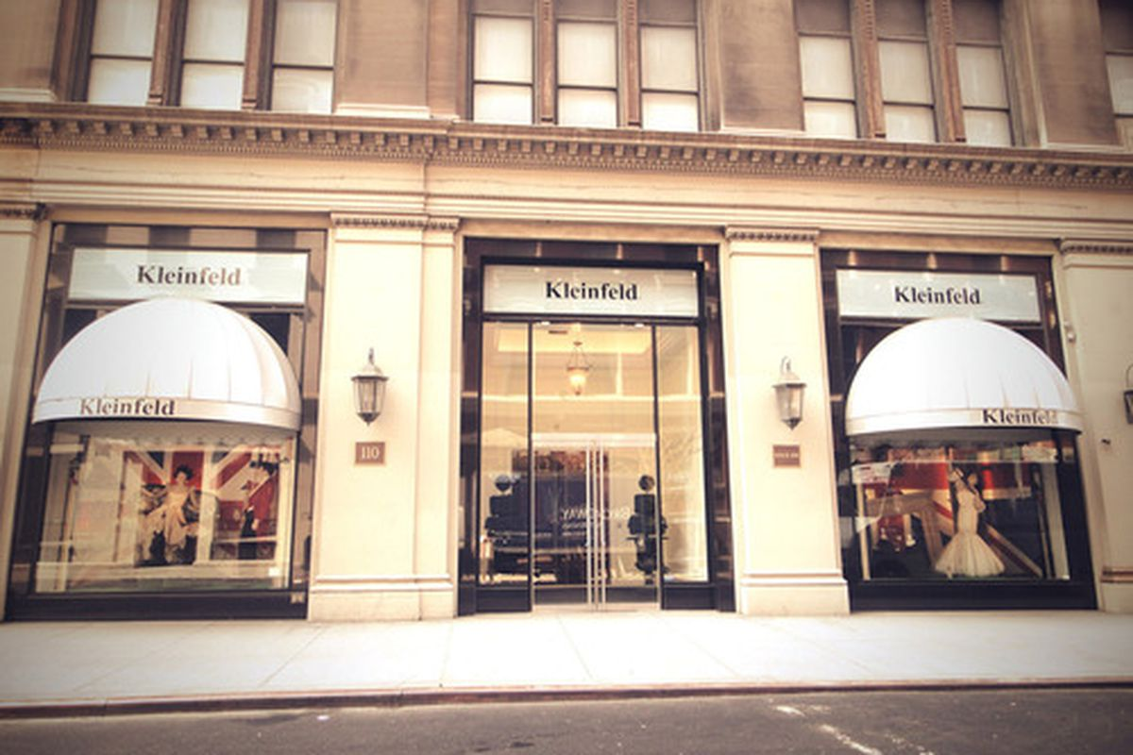
Where Hayley Paige dresses are sold
Kleinfeld
Nordstrom
JLM Couture
Bridals Boutiques

Slide 9
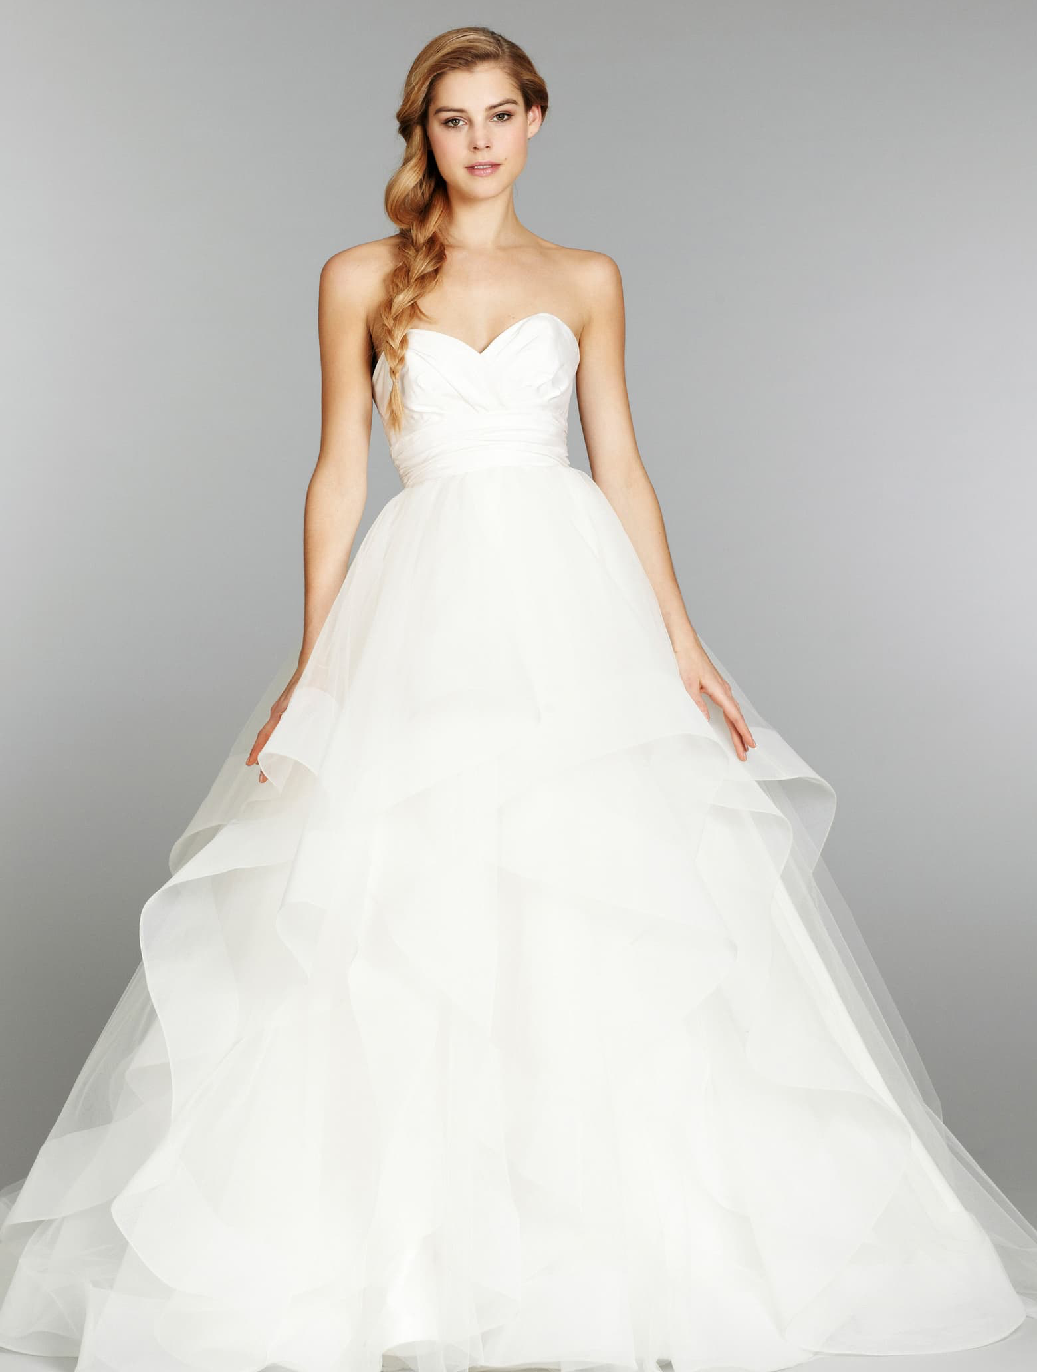
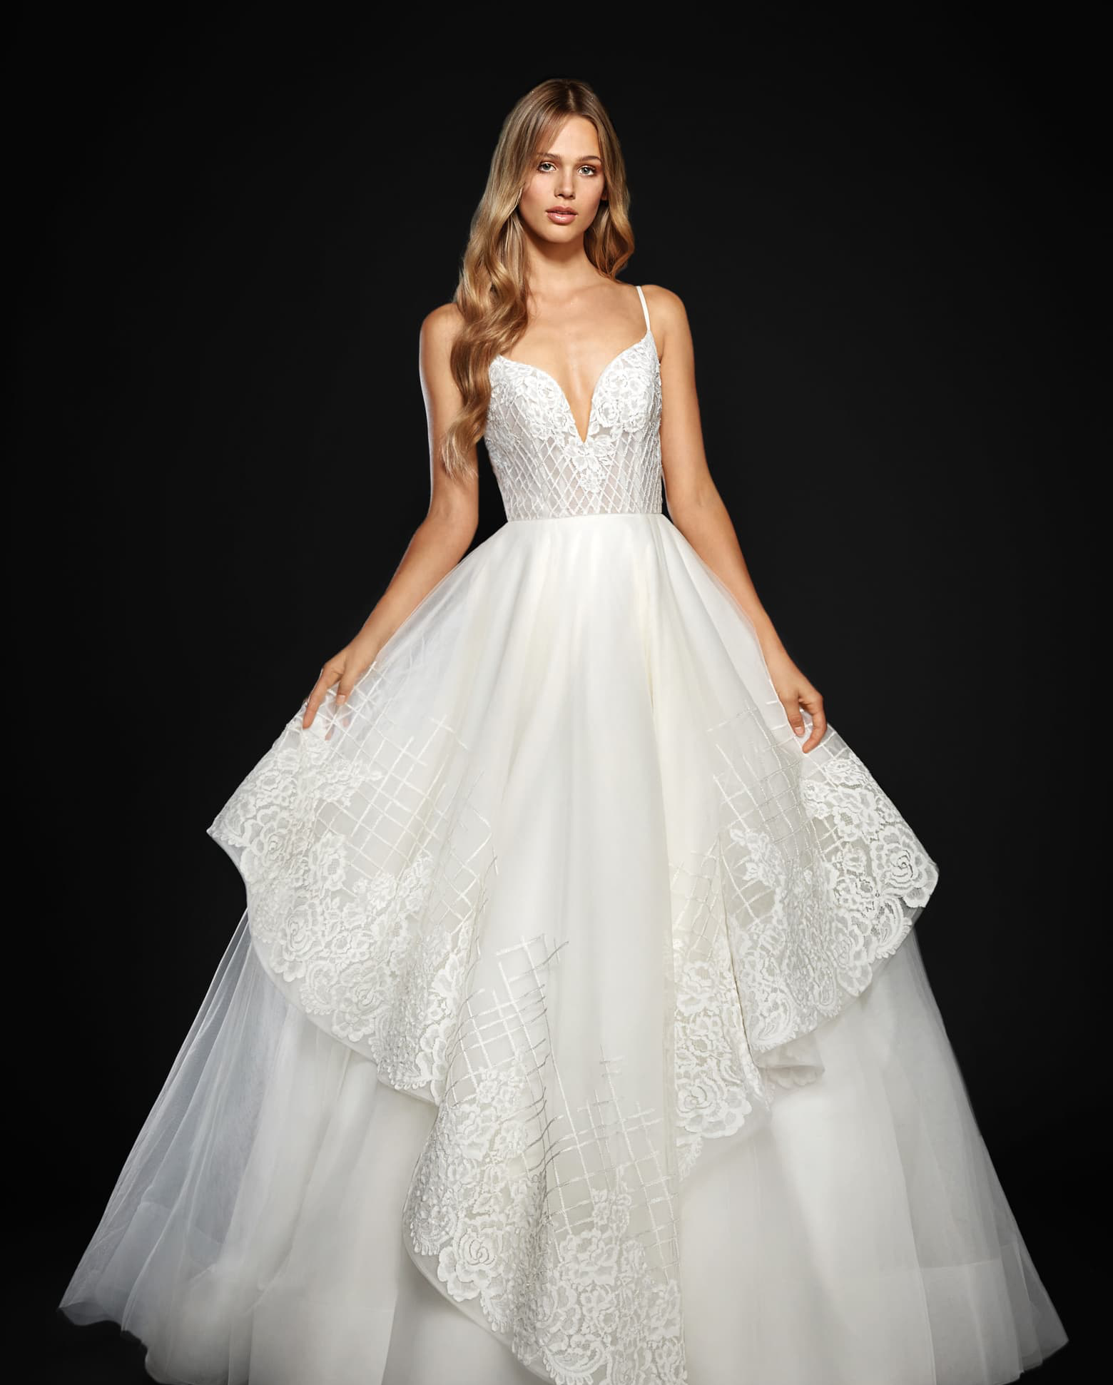
Price Range
Wedding dresses: $2,000- $6,000
$2750
$5675

Slide 10
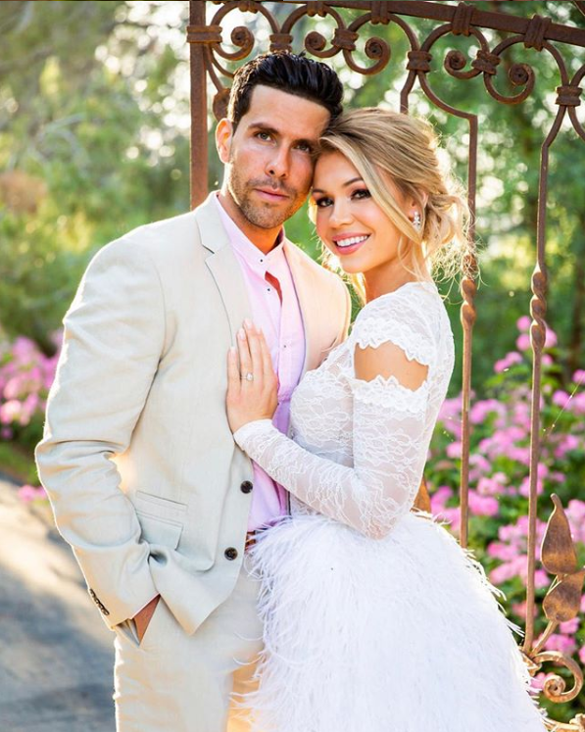
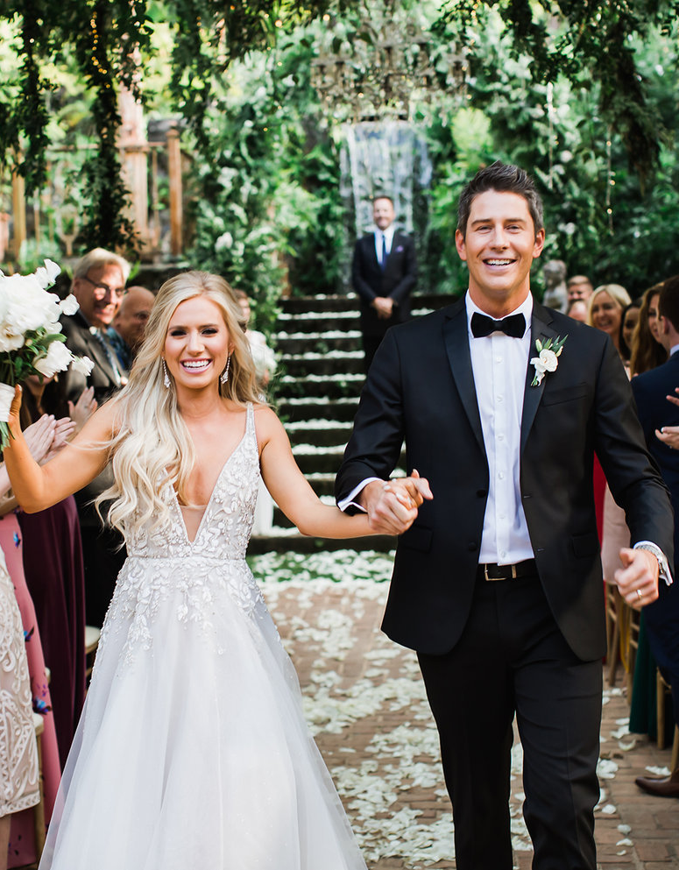
Celebrities wearing Hayley Paige
Annie LeBlanc
Singer
Lauren Burnham
Krystal Nielson
Carly Pearce
Singer

Slide 11
Philanthropies/Other Works
In 2017 she helped create an app called HOLY MATRIMOJI, an emoji app focused on wedding dresses. Users have access to wedding-centered emojis and GIFs that are full of Hayley’s personality and charm.
In early 2018, Hayley launched a series on TLC that took the viewers into her world. The first episode of the series shows how Hayley designed a dress for former bachelorette, Kaitlyn Bristowe.

Slide 12
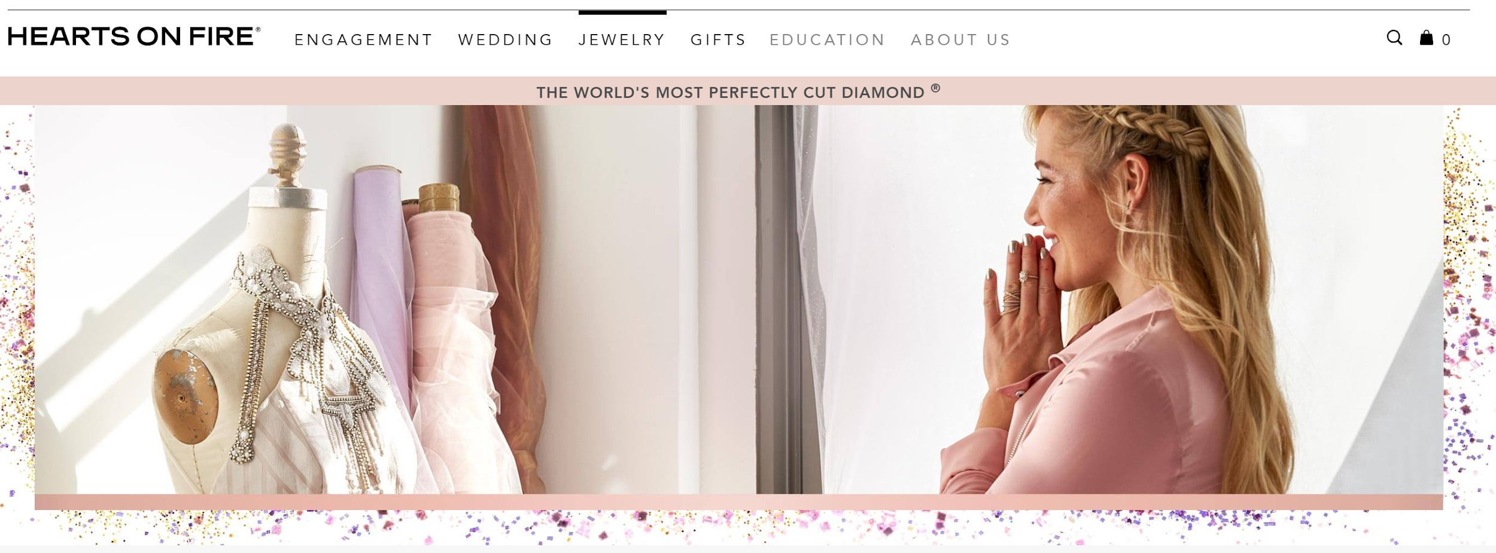
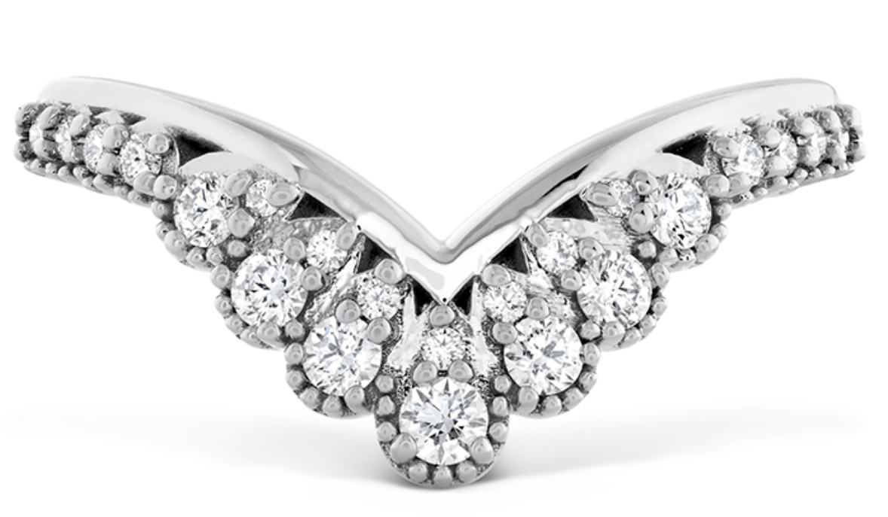
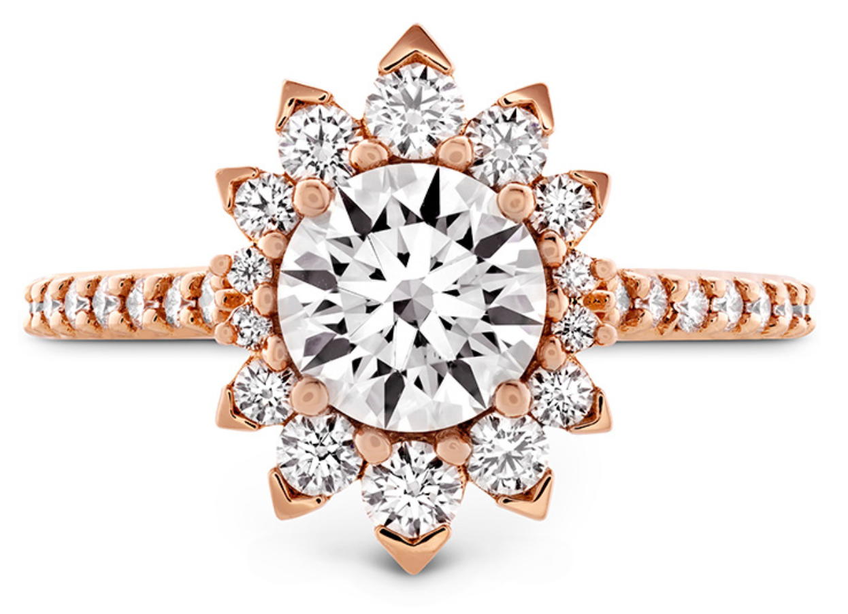
Fun Fact
Hayley has currently stated to design engagement rings and wedding bands with a jewelry brand, Hearts on Fire.

