Slide 1
T-Shirt Analysis
Hannah Knight

Slide 2
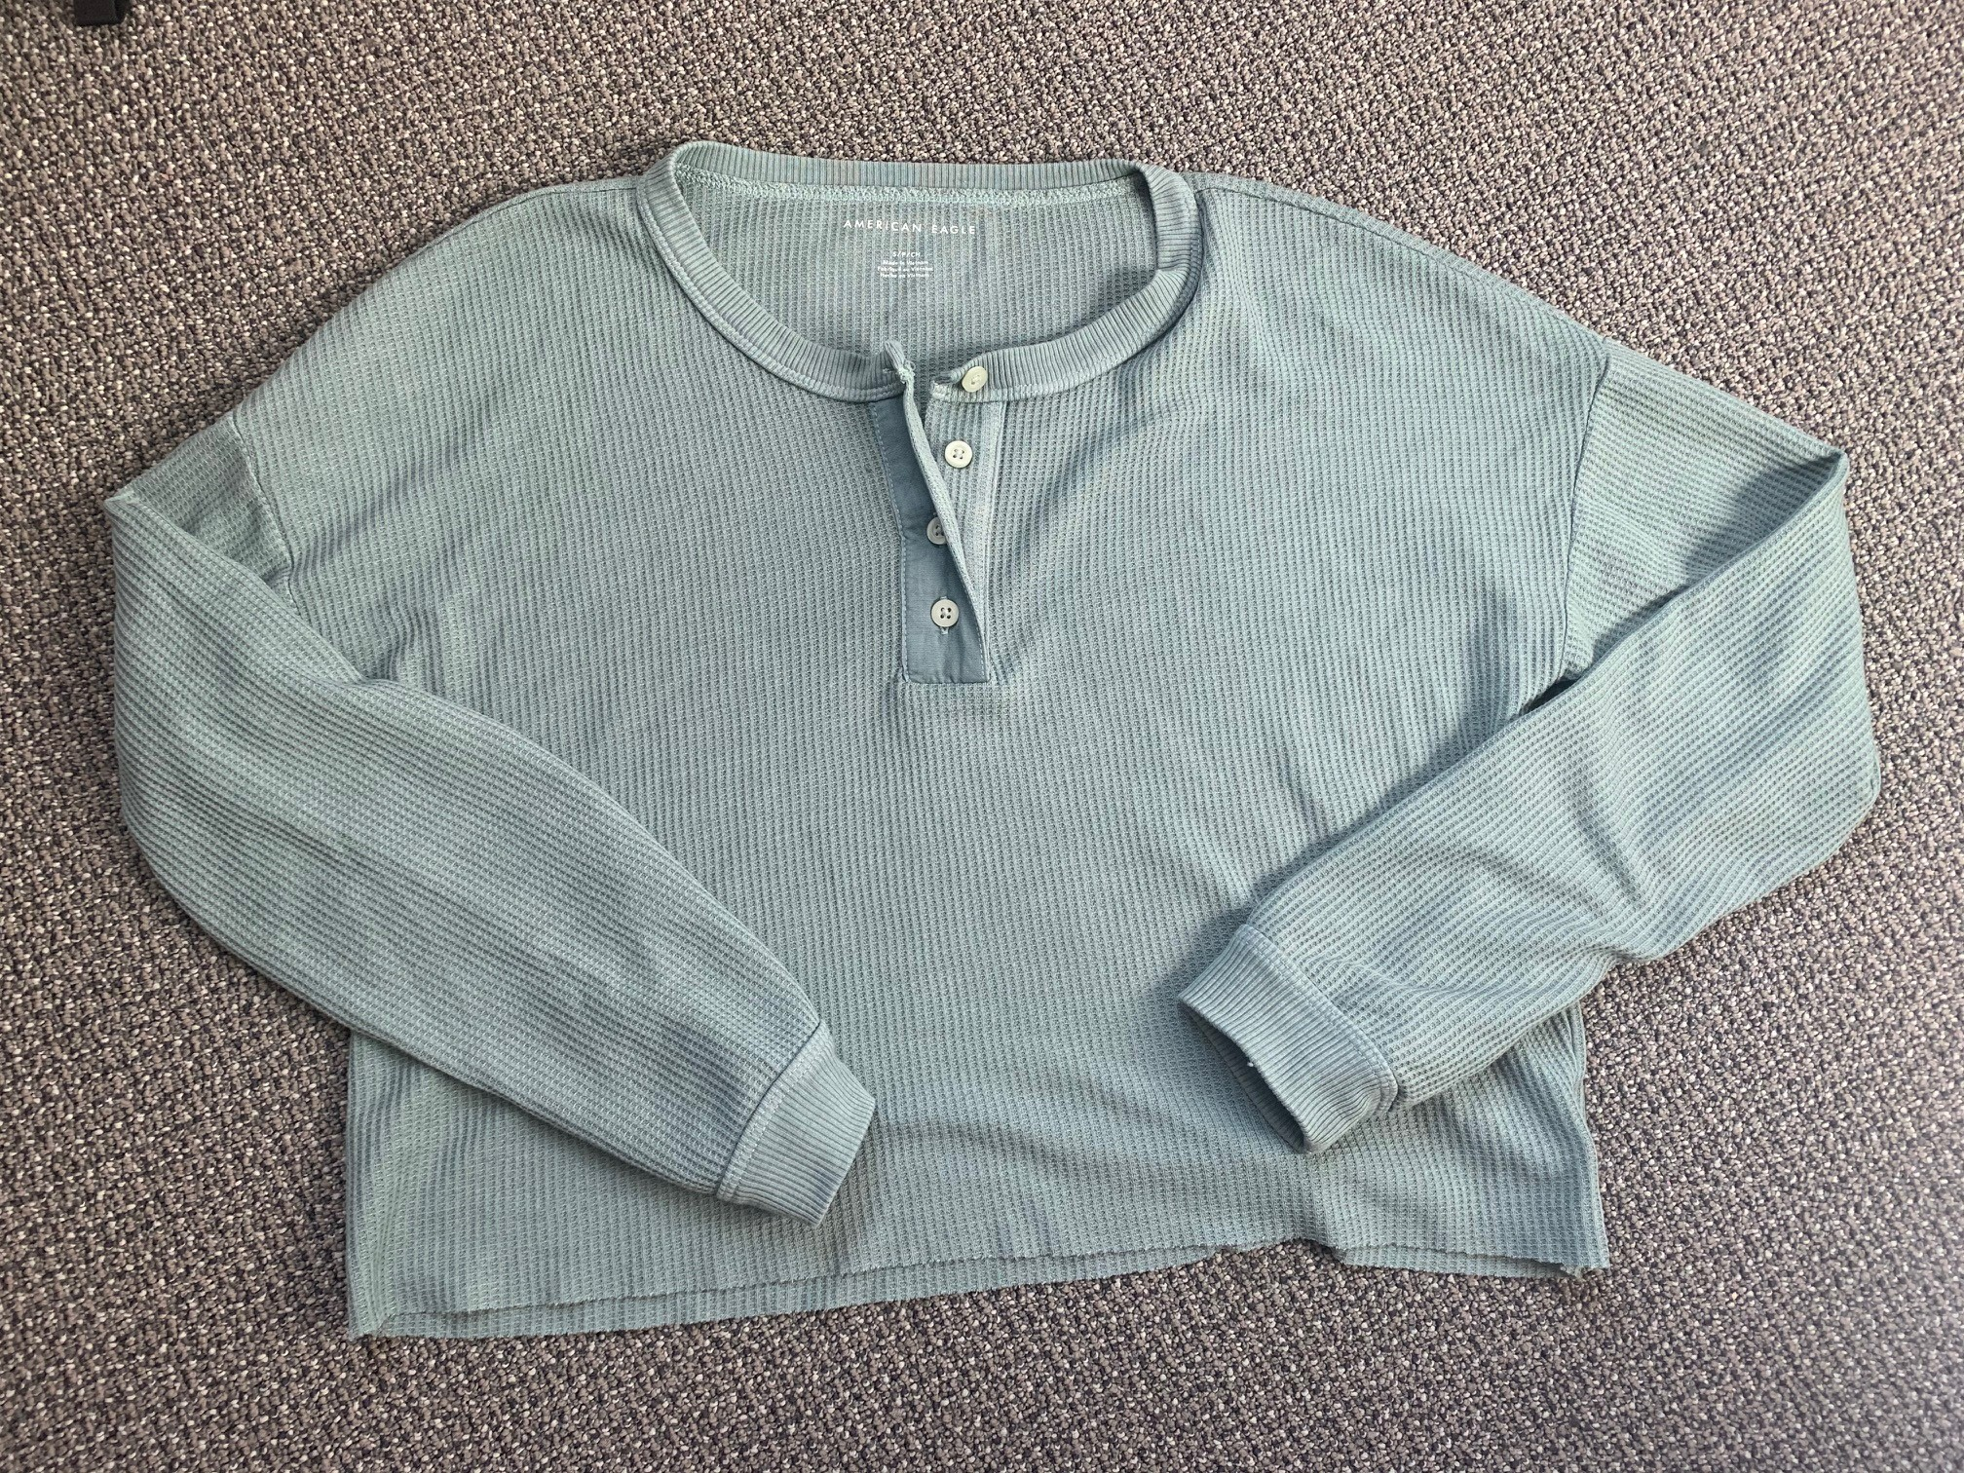
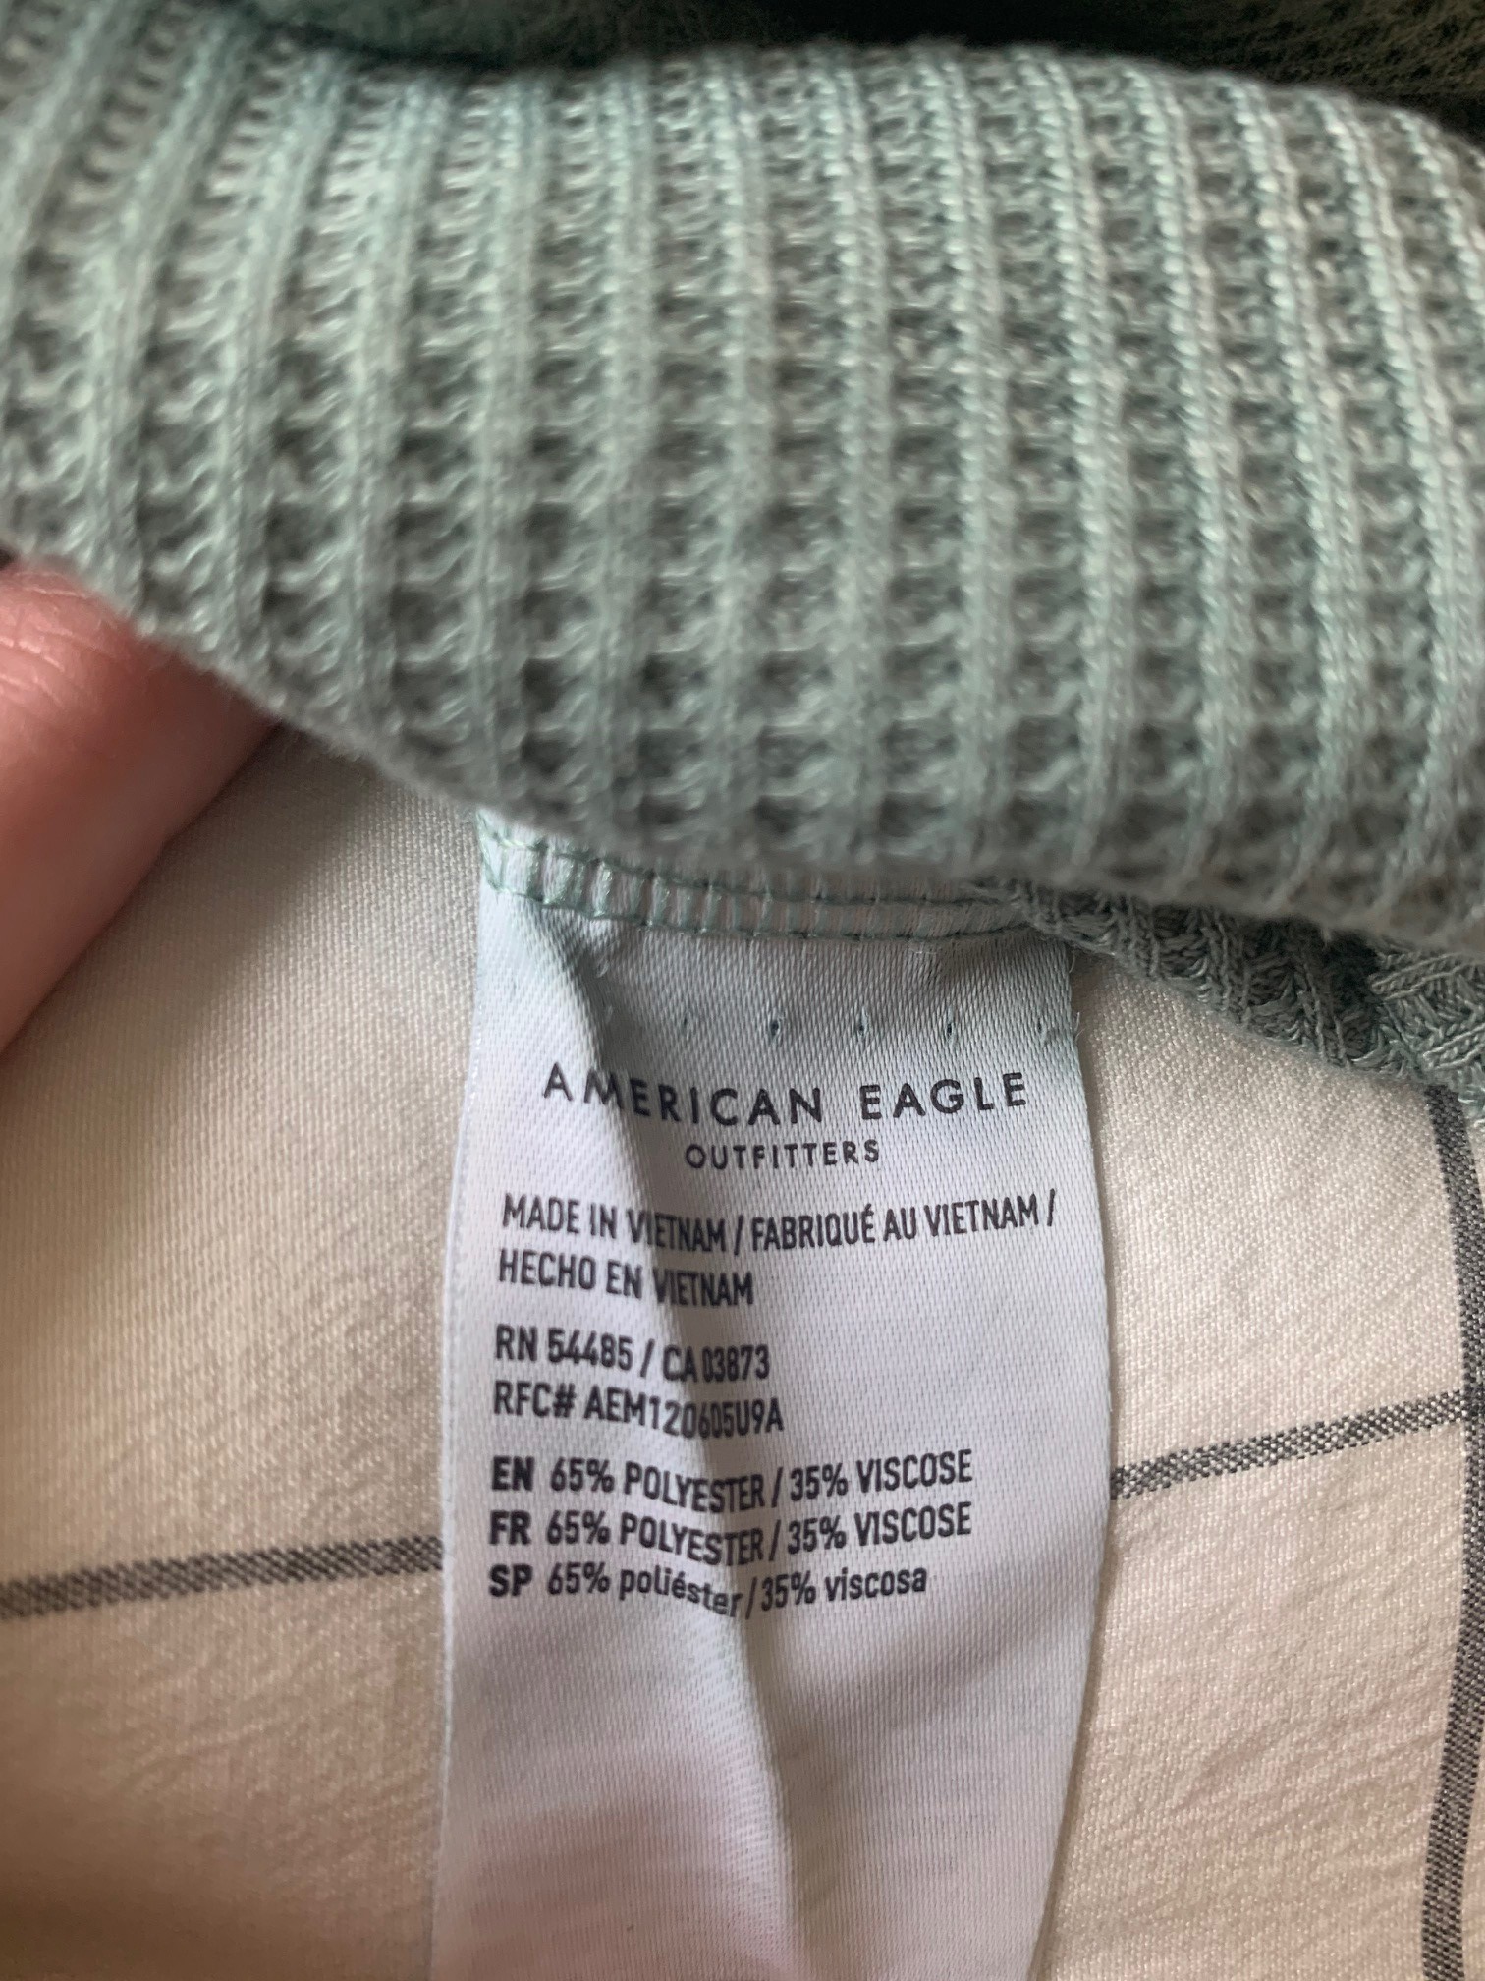
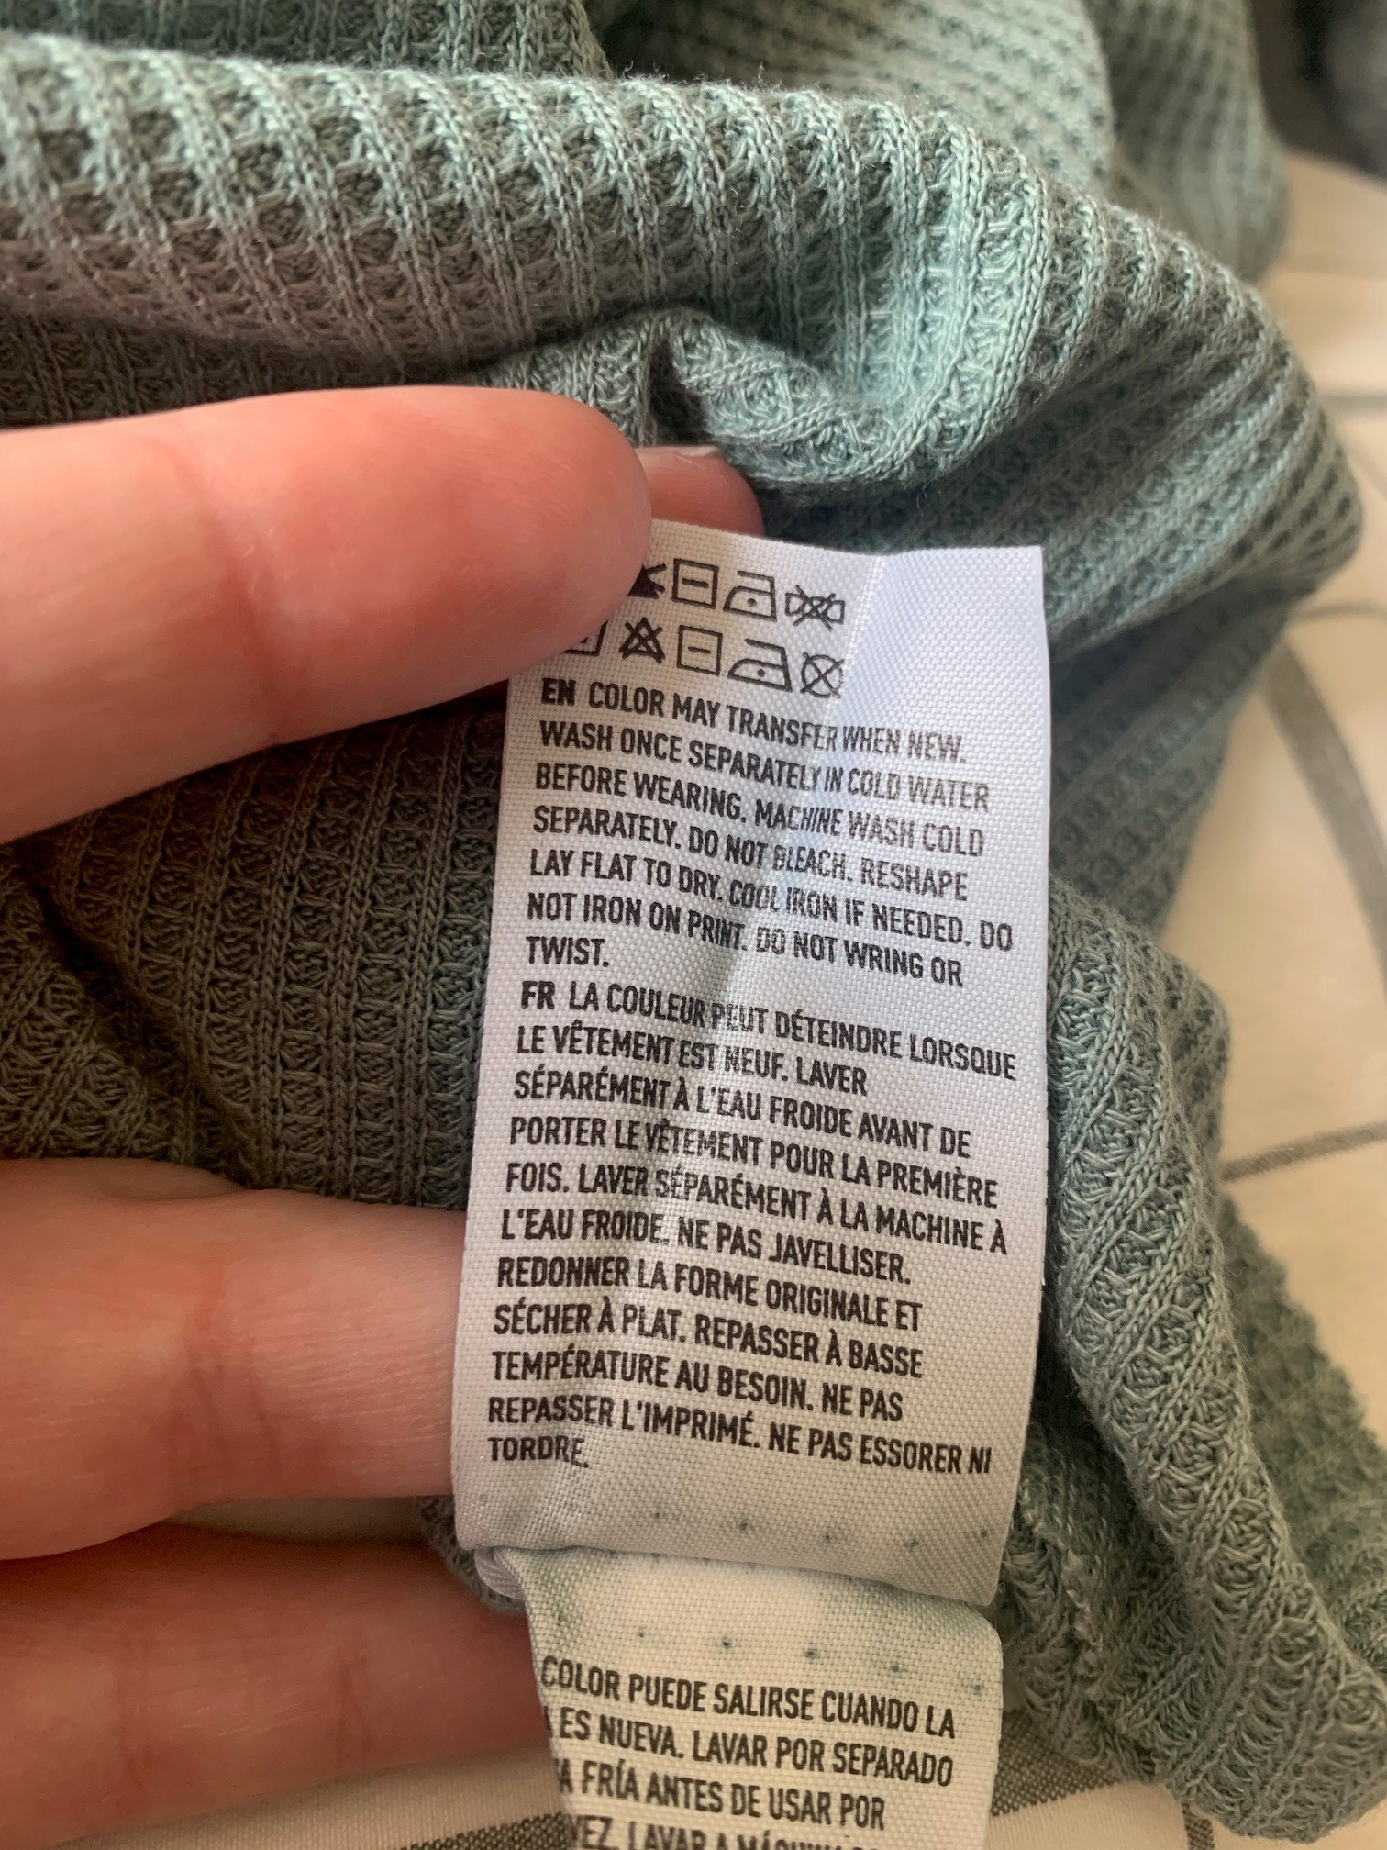
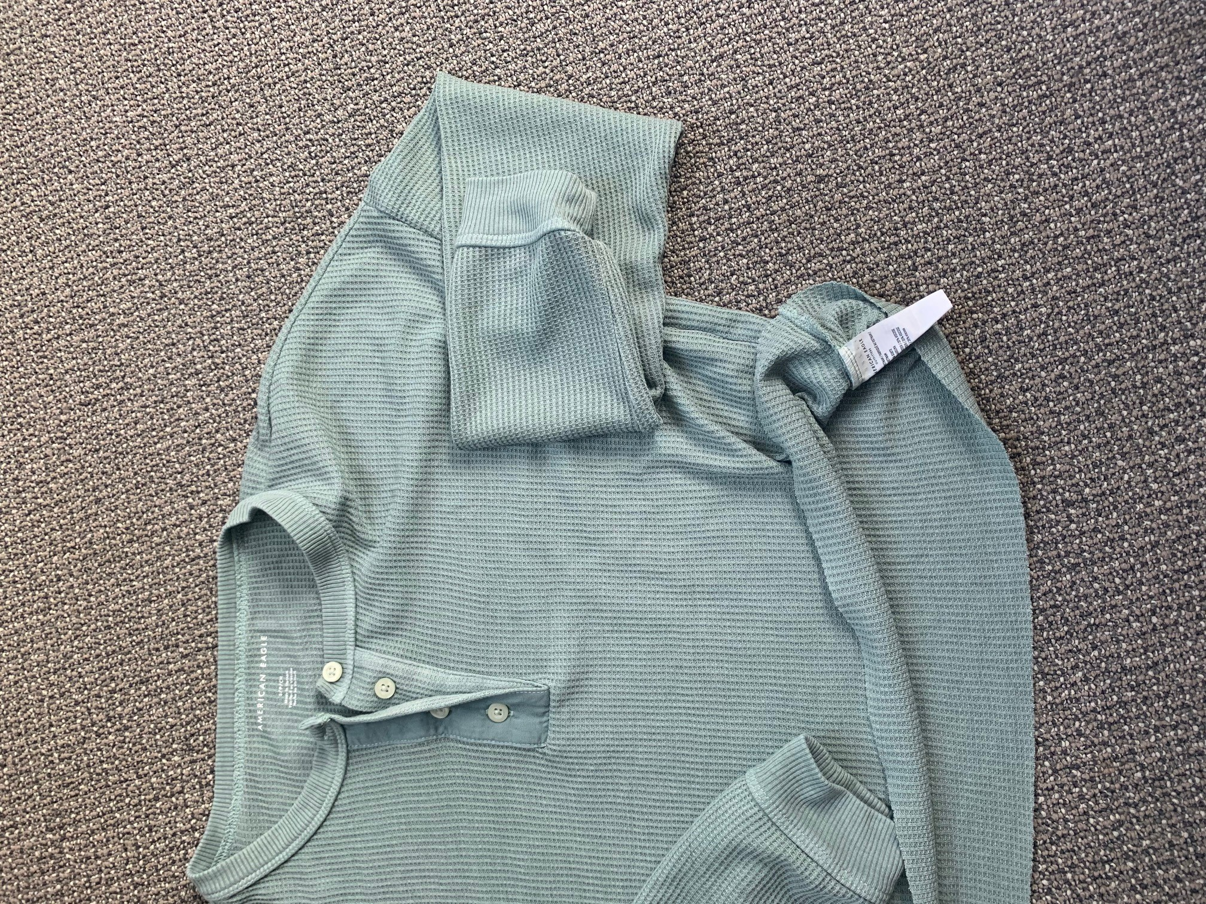
Point of Sale Evaluation
I purchased this shirt from American Eagle for $19.99
I like the shirt because it is soft and very comfortable
I purchased it in a size small
It is made of 65% polyester, 35% viscose
Made in Vietnam
Care: machine wash cold separately, do not bleach, reshape and lay flat to dry
There is only one set of tags that is located in the bottom left seam

Slide 3
Measure
Before first wash:
Body Length- 17 ¾”
Chest width- 20”
Bottom width- 20 ½”
Cross shoulder- 23 ½”
Cross front- 22”
Cross back- 21 ½”
Armhole along curve- 6 ½”
Sleeve length from AH- 19 ½”
Sleeve length from CB- 27 ½”
Muscle- 6”
Sleeve opening- 3 ½”
Sleeve cuff height- 1 ½”
Neckline circumference- 19”
Back neck width- 25”
Front neck drop- 3 ½”
Back neck drop- 0”
Neck Trim height- 1”
Bottom hem width- N/A (raw edge)
Between 1st and 3rd wash:
17 ¾”
19 ¾”
20”
23”
21 ½”
21”
6 ½”
19 ¼”
27 ½”
6”
3 ½”
1 ½”
19”
25”
3 ½’’
0”
1”
N/A
Between 2nd and 4th wash:
17 ¾”
19 ¾”
20”
23”
21 ½”
21”
6 ½”
19 ¼”
27 ½”
6”
3 ½”
1 ½”
19”
25”
3 ½”
0”
1”
N/A
After the 5th wash:
17 ¾’”
19 ¾”
20”
23”
21 ½”
21”
6 ½”
19 ¼”
27 ½”
6”
3 ½”
1 ½”
19”
25”
3 ½”
0”
1”
N/A

Slide 4
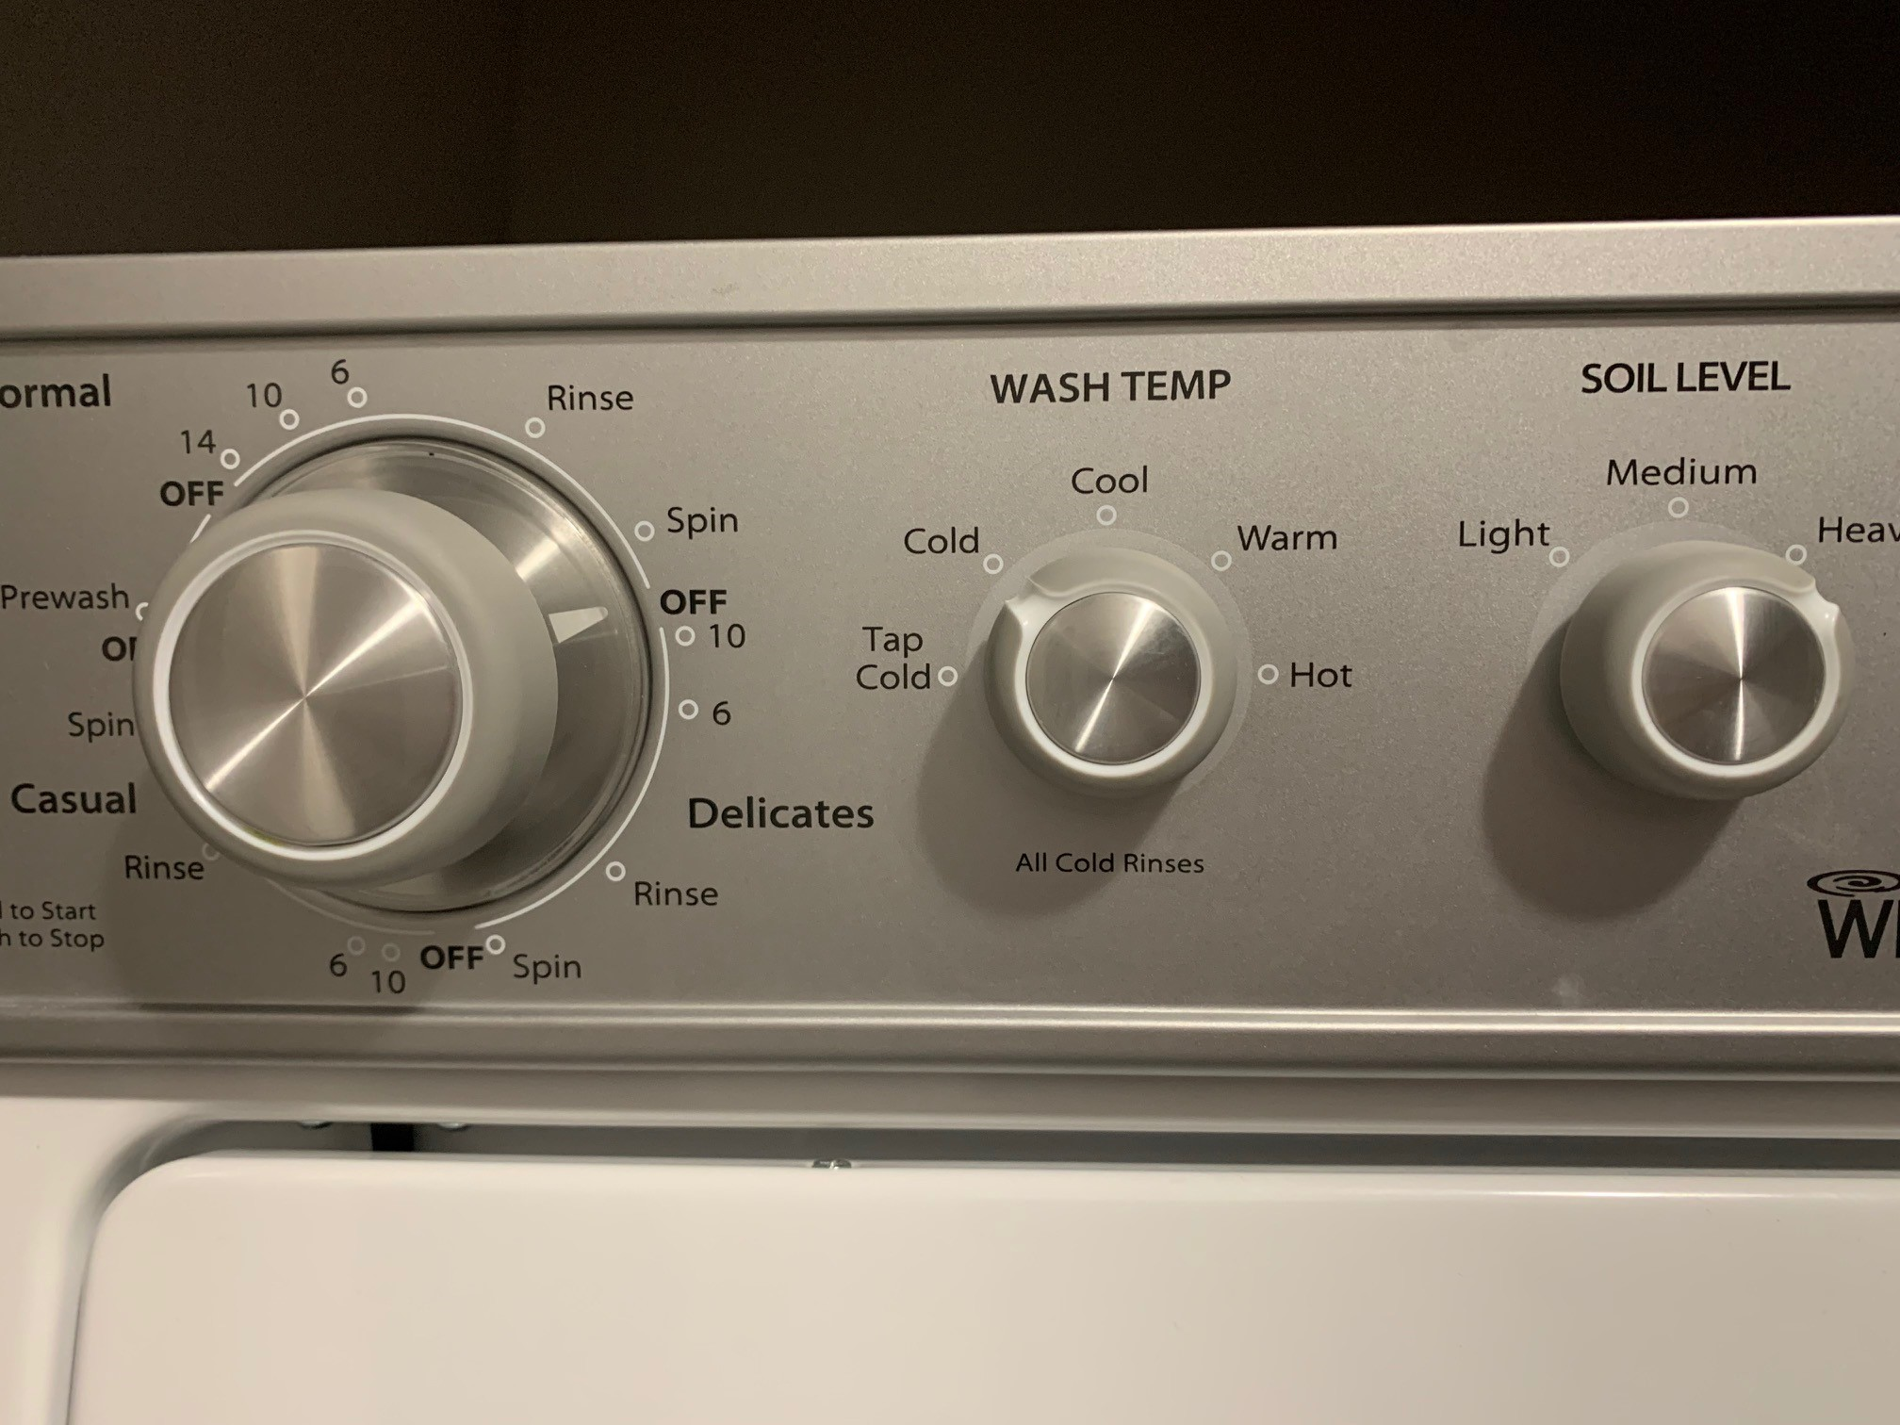
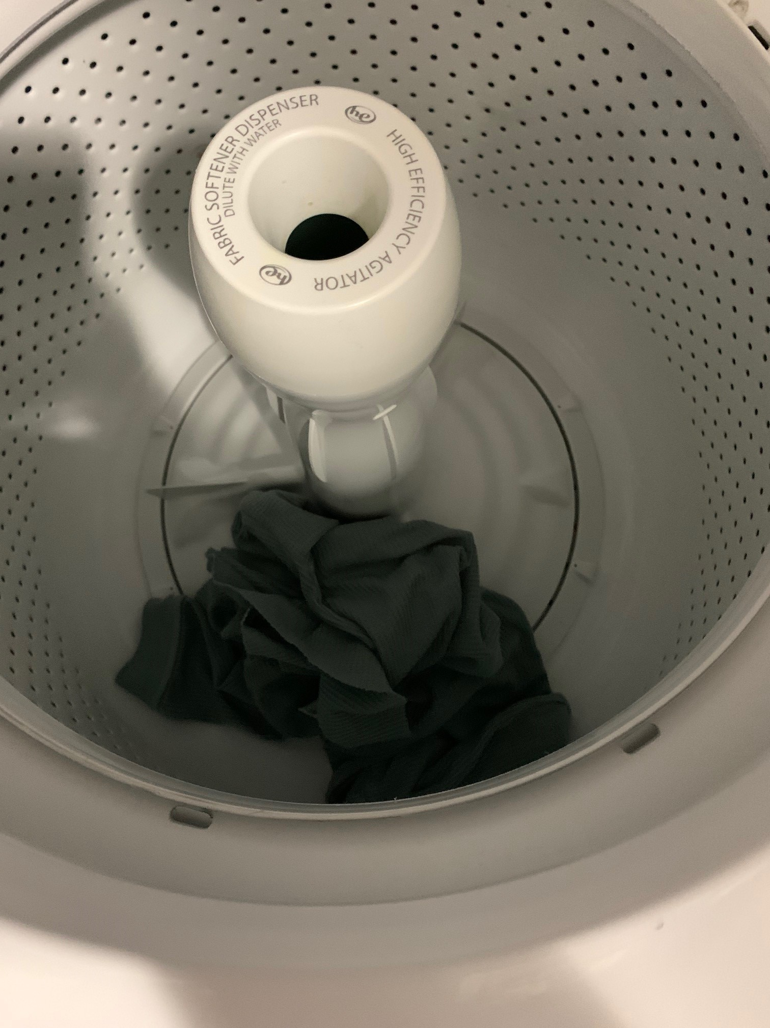
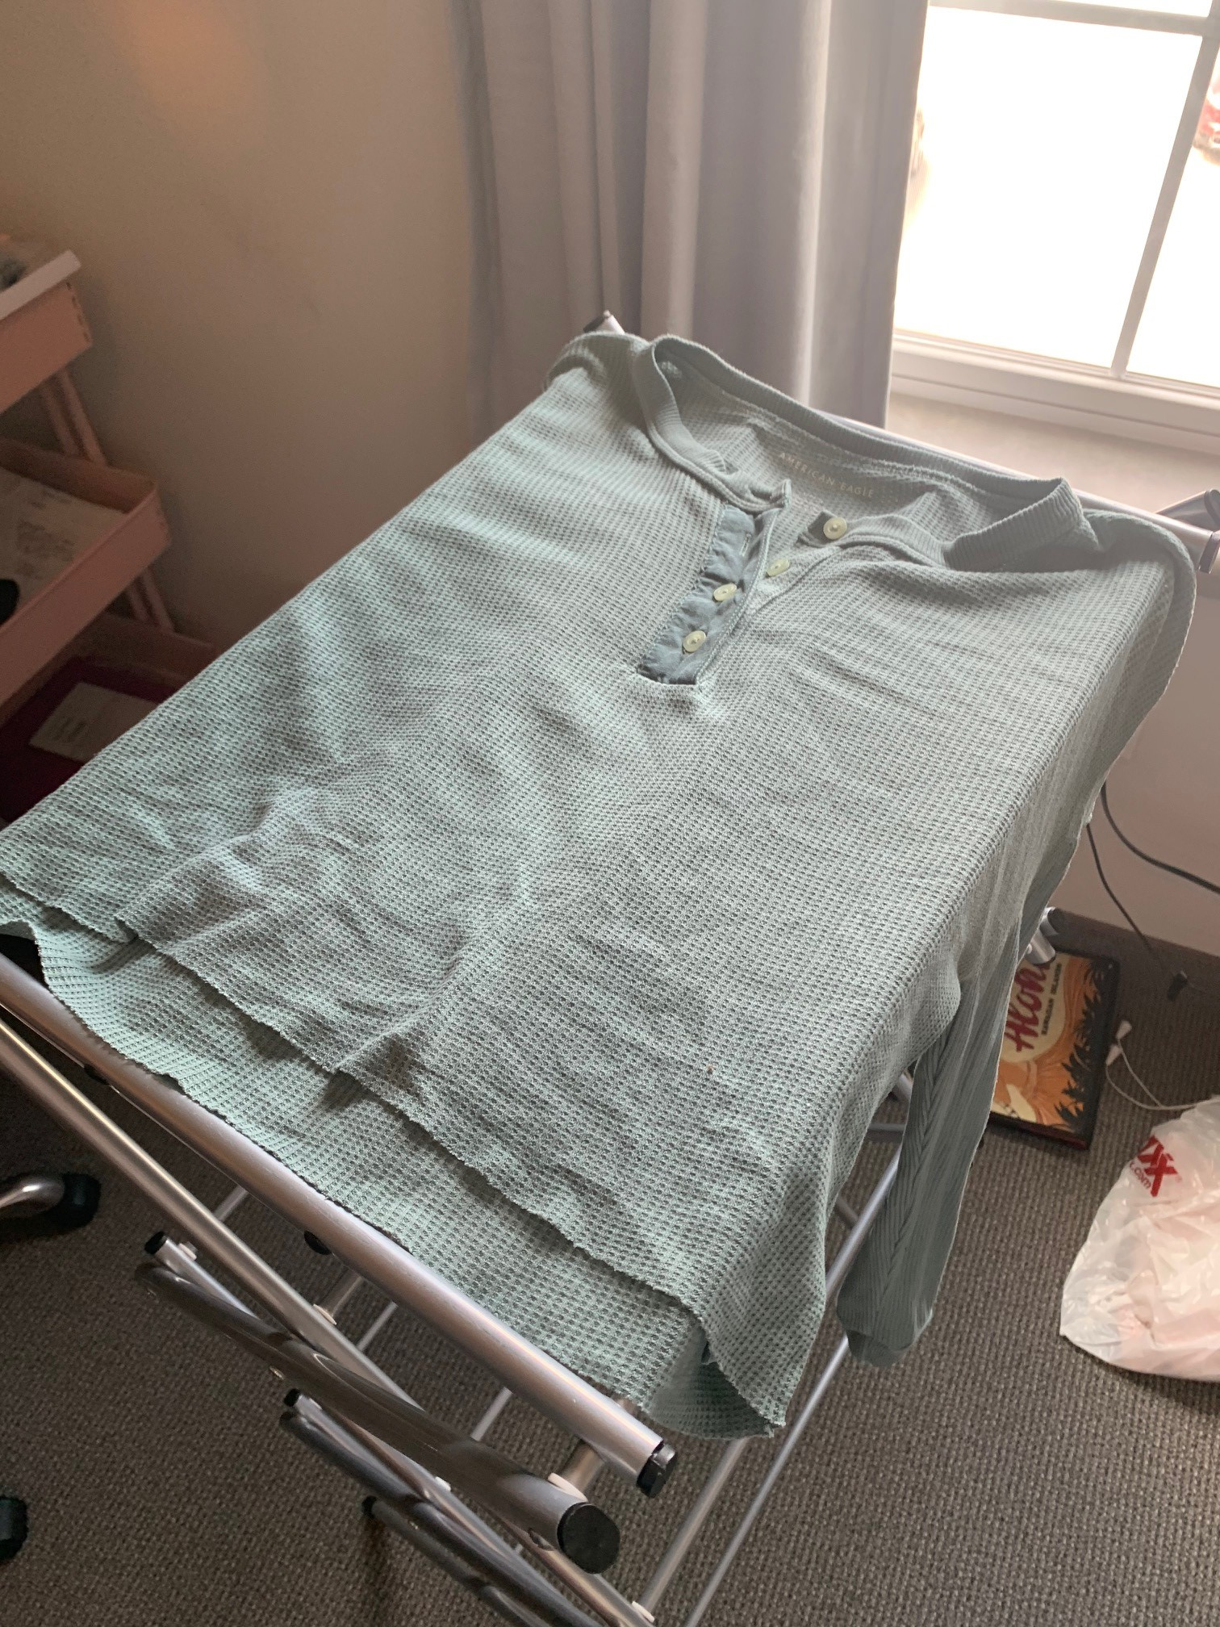
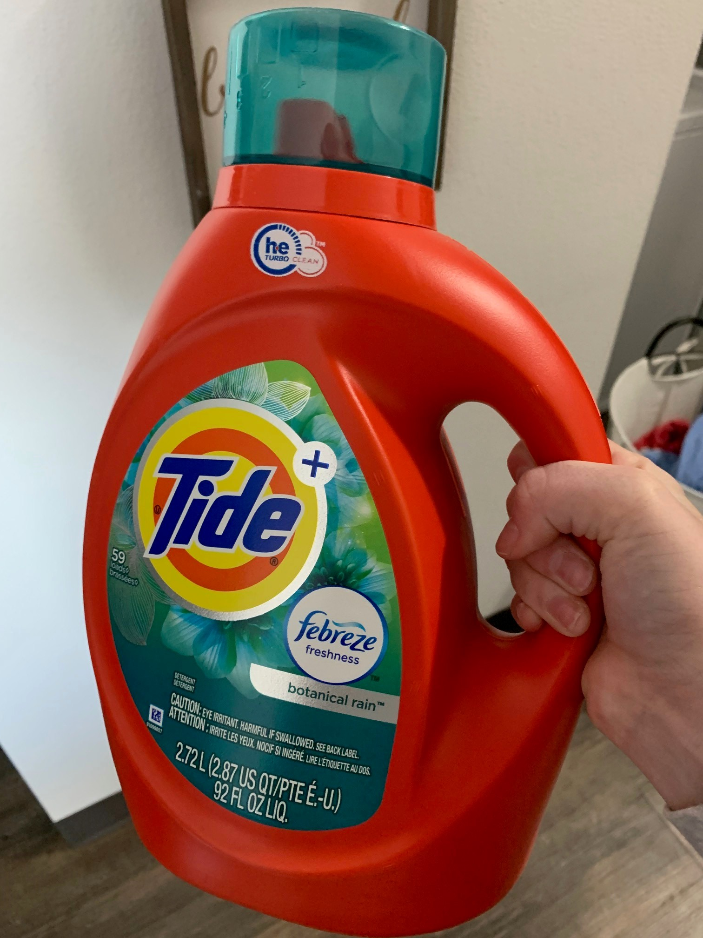
Laundering
Date wore: 3/20/21
Date Laundered for first time: 3/23/21
Process: The care instructions say to wash alone the first time you wash it. I did that and washed it on cold like it said to. I used tide laundry detergent and laid flat to try (These steps were repeated for washes 2-5, except the garment was washed with other clothes after the first wash)
Appearance change: overall nothing changed about the appearance of the top. There were no seams coming undone or anything wrong that you can see with a naked eye. It may not be as soft as it was before I washed it, but it was not a massive difference.

Slide 5
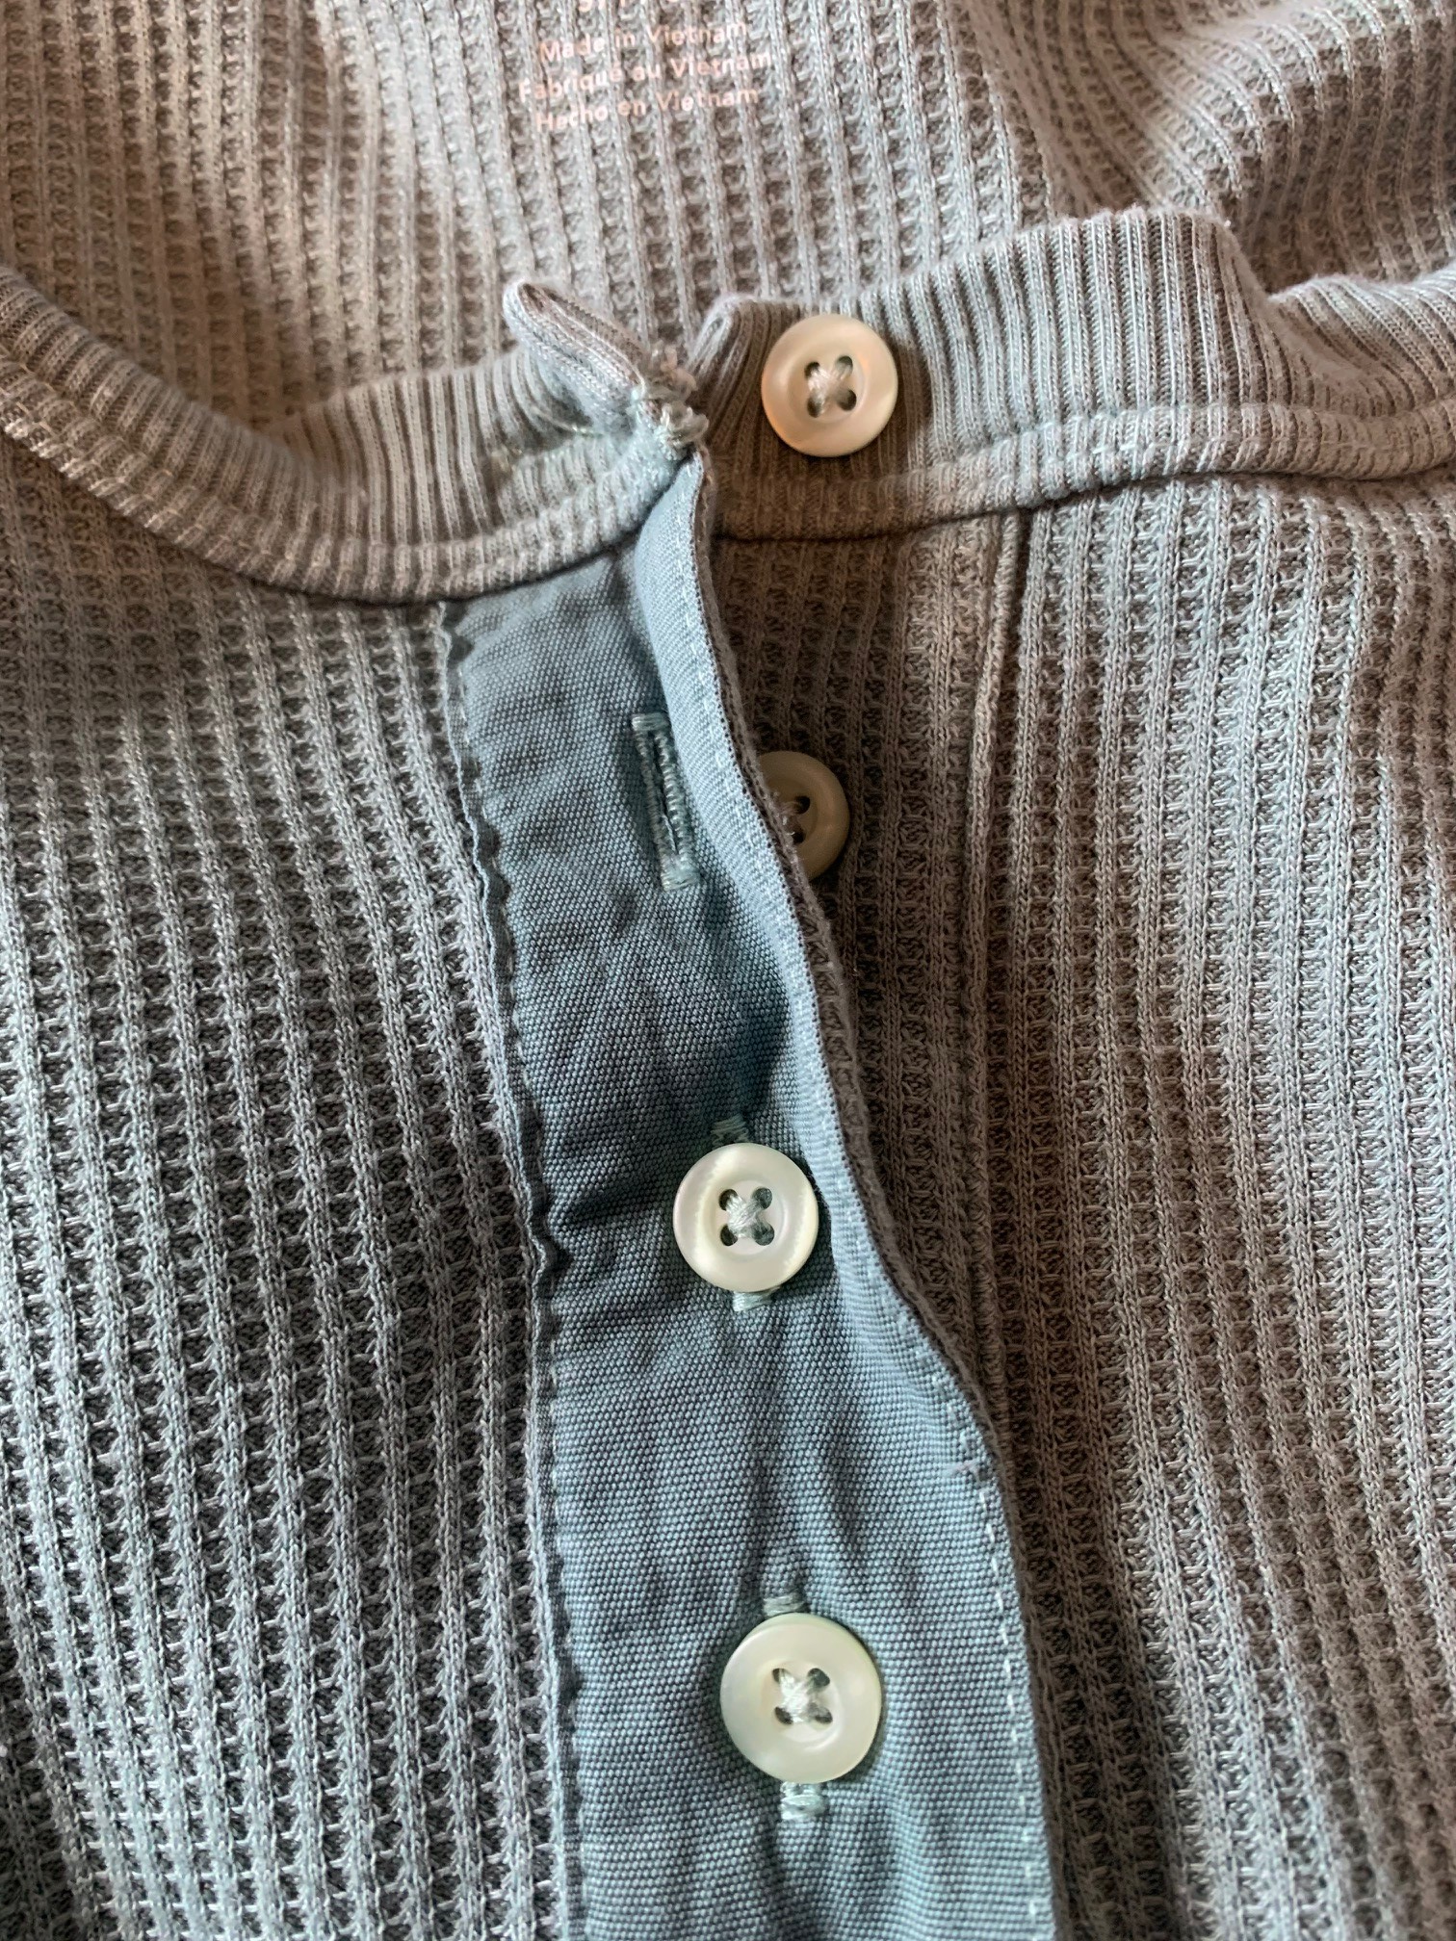
Laundering cont.
After the second wash, the fabric started to wrinkle by the buttons
As you can see in the picture the fabric is folded and does not lay flat like it did
I washed the garment with the same steps every time
The more I washed it, the more wrinkles that appeared
After the 5th wash, the garment almost felt softer and more worn in, which I love

Slide 6
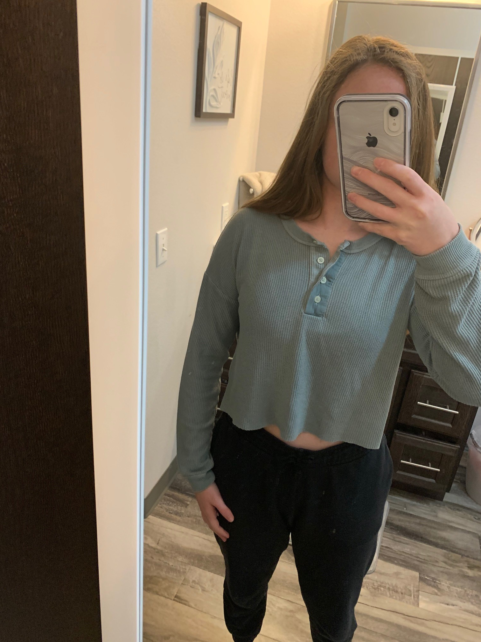
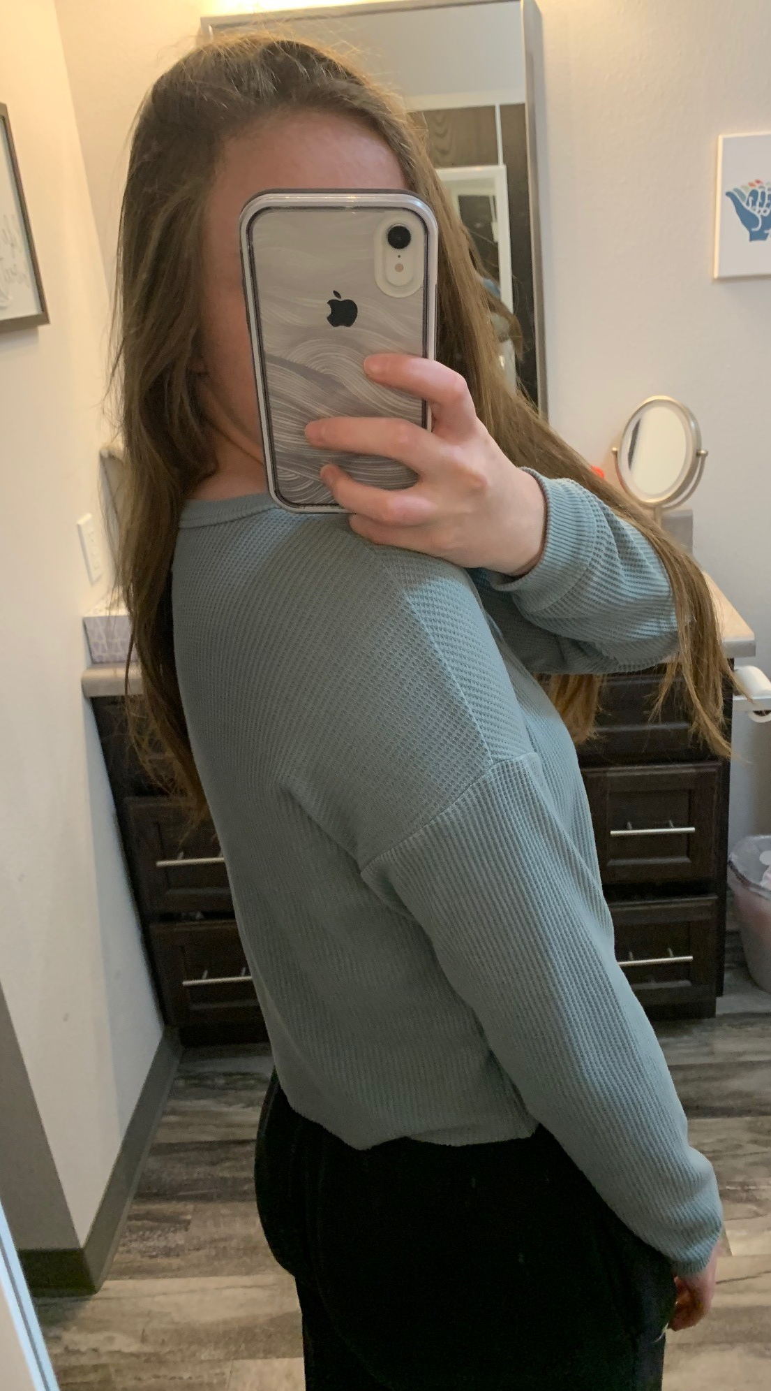
Fit
This shirt fits me well and is comfortable. It is meant to be cropped that is why it does not go as far down as a normal t shirt. The garment has a lot of ease and will move with my body. It is not restricting at all. The shirts balance is correct because it hangs the same on all parts of my body. The construction lines match the desired silhouette. The garment was cut on the grain of the fabric because it is not twisting or turning after I wash or wear it.

Slide 7
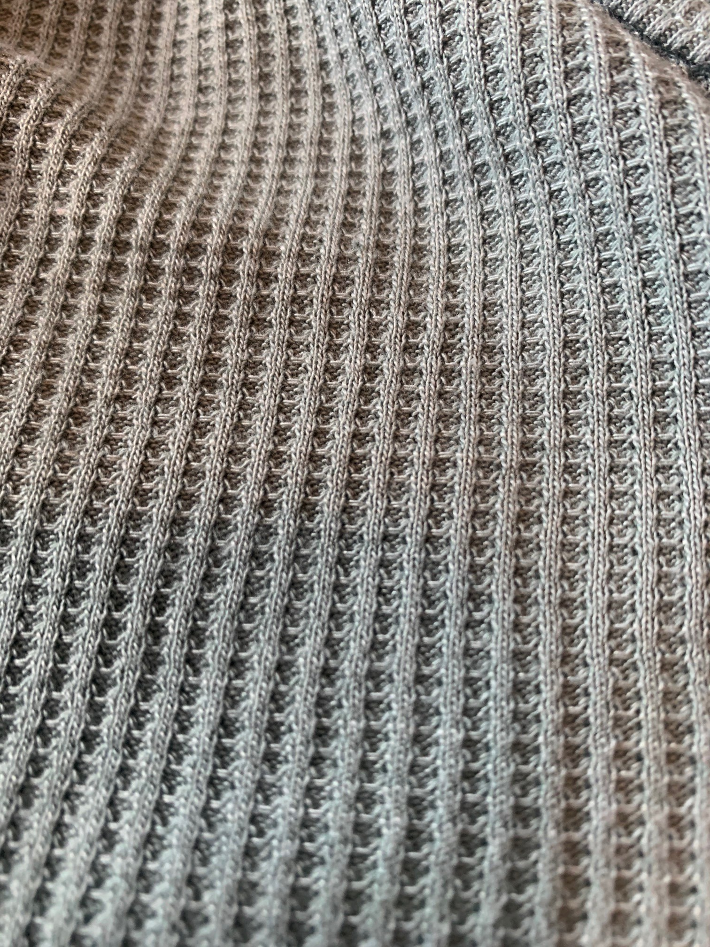
Fabric
The fabric is free of flaws
The appearance of the fabric is compatible with the design and end use. It is a soft flexible material that is good to just lounge in.
After two washes, the fabric started to fade a bit, but it did not transfer onto other clothing articles that it was washed with
The hand of the fabric is very good for its use. It is soft and comfortable to wear
The fabric is dimensionally stable for the most part, it did shrink a little but not enough to be noticeable while wearing
The grain line of the fabric is true, it does not twist or turn after washing or wearing

Slide 8
Fabric cont.
The fabric is abrasion resistant; it protects the skin, and it can withstand the wear and tear of wearing the garment out and about
The fabric itself does not wrinkle easily, but after wash two the neckline (by the buttons) became wrinkly and did not lay flat. Other than that, the fabric does not wrinkle easily
The fabric is absorbent. It will soak up liquid, which means it is not water resistant
The fabric does not have good wicking ability. Since it is absorbent, that means it will attract any liquid to it and not wick it away
The care for the fabric is a but more intense than normal fabric. You must wash it on cold and not put it in the dryer. Letting it air dry takes more time and effort.
The finishes on the fabric are permanent and do not wash away.

Slide 9
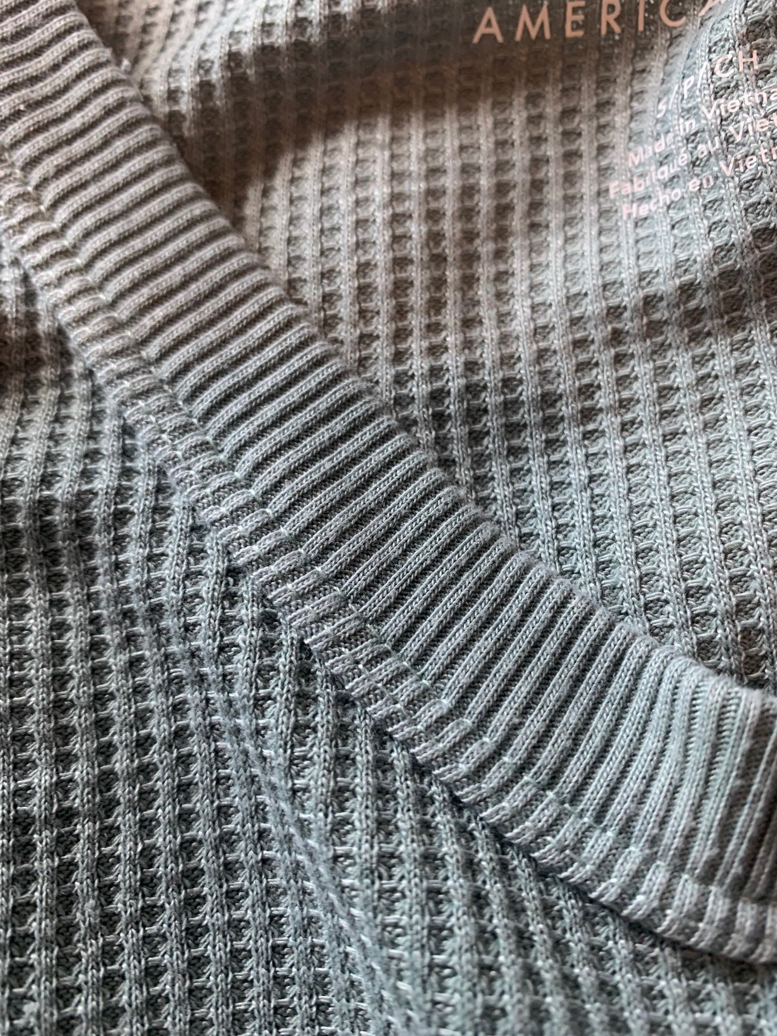
Trim
The trim on the garment is compatible with the item. The trim is the exact same color as the rest of the shirt
The trim is stitched in place
I think the trim will be able to withstand the wear on the garment for a very long time. The only thing that would be questionable is the buttons, just because they are buttons, and they can easily fall off
The trim is very comfortable, and you do not even realize it is there

Slide 10
Trim cont.
The trim color matches the color of the shirt perfectly
The labels are placed so they do not irritate the wearer. The labels are in the side seam of the shirt, so they won’t bother you. I am happy they are not behind the neck because that can be irritating
I believe that the care label will remain legible for the life of the garment because it did not even smear after one wash
The tread is as strong as the fabric, but it is not too strong to cause tearing in the fabric

Slide 11
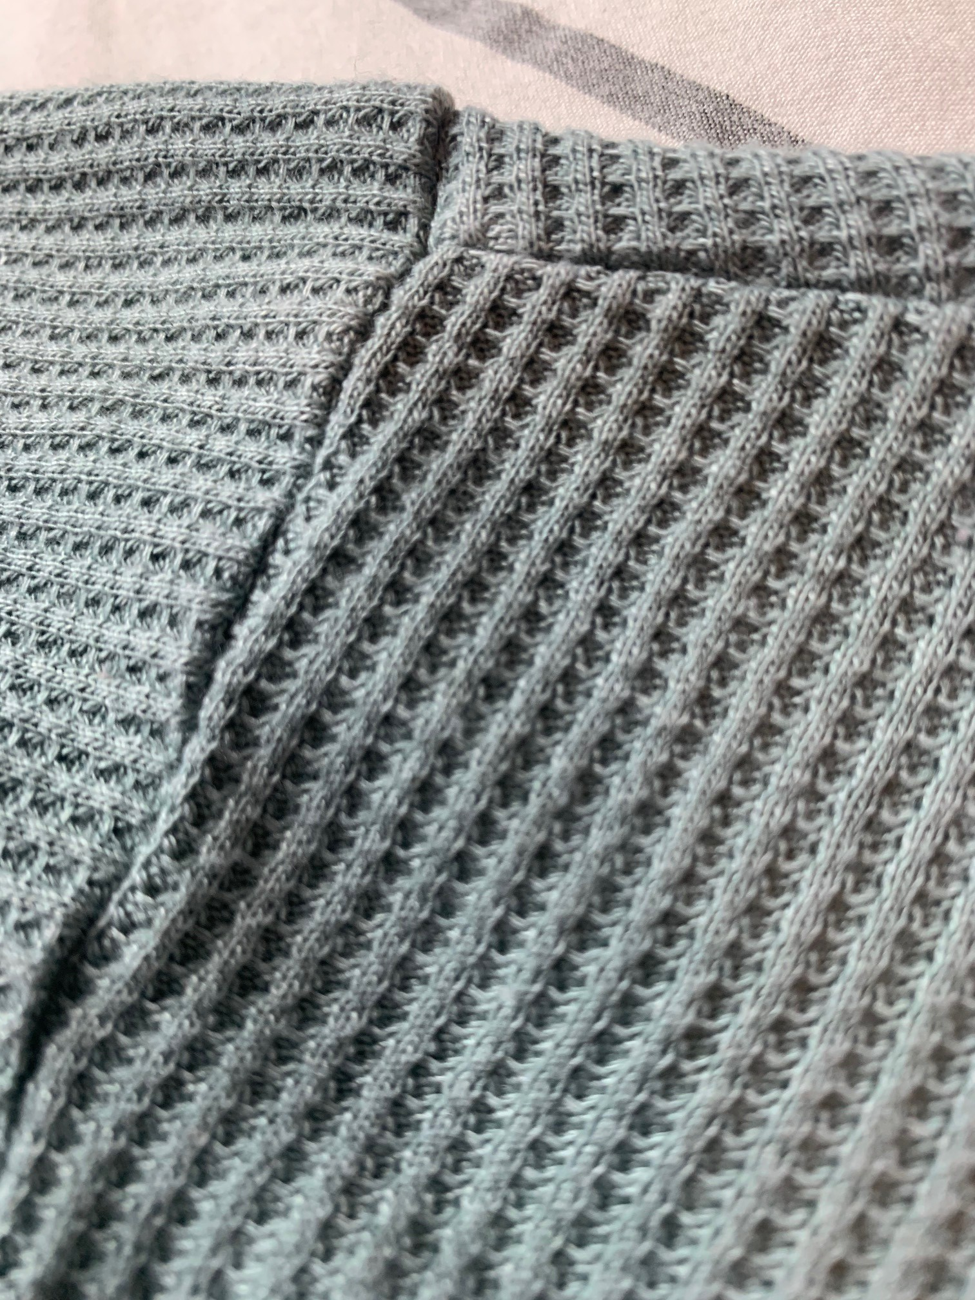
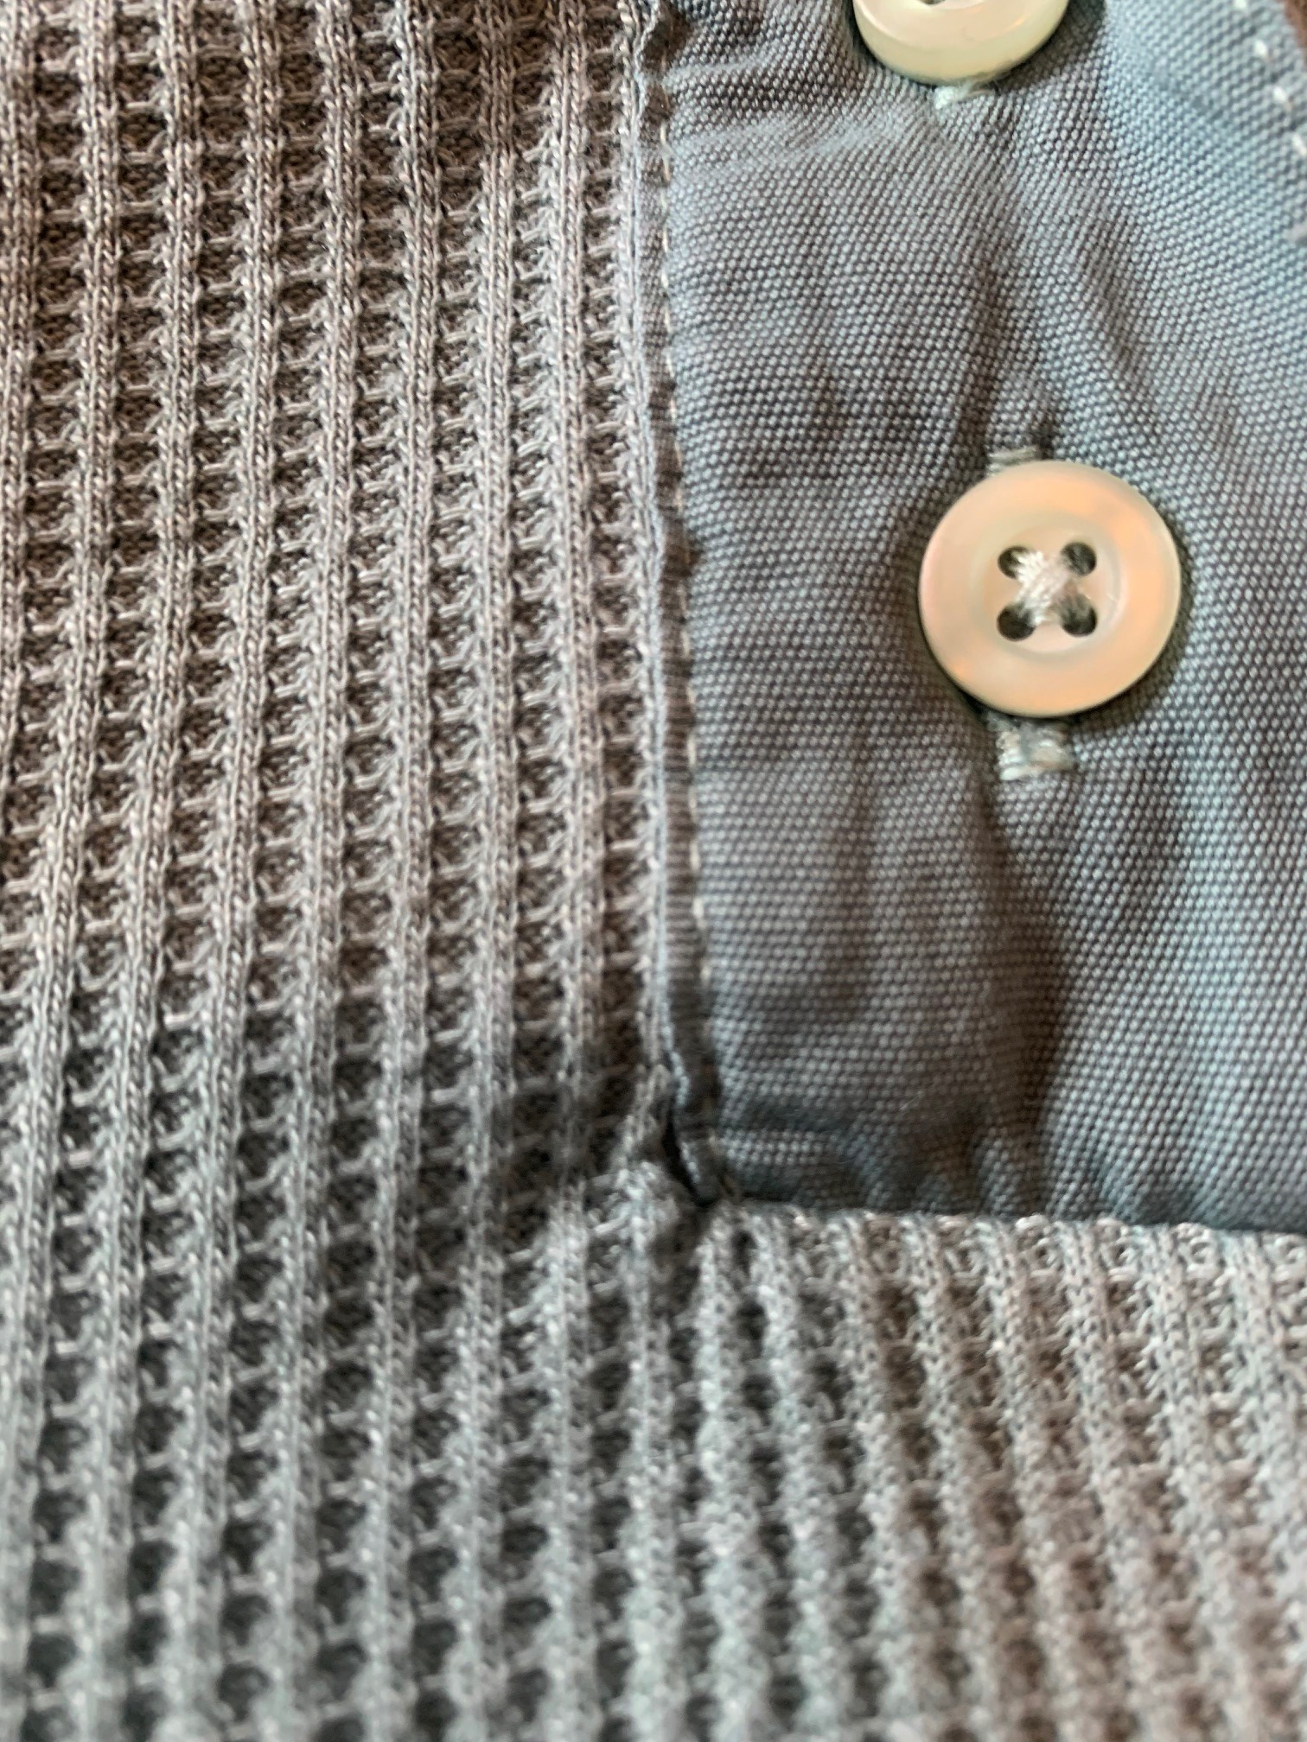
Stitches
The stitches do cause a bit of puckering (shown in the image to the right)
The stitches create seams that resist grinning
The stitches are extensible and are not too tight for the fabric
The stitches are very comfortable when the garment is being worn. They are not itchy and uncomfortable
The stitches are neat and placed accurately
I have not had to trim any extra long threads that were left on the garment

Slide 12
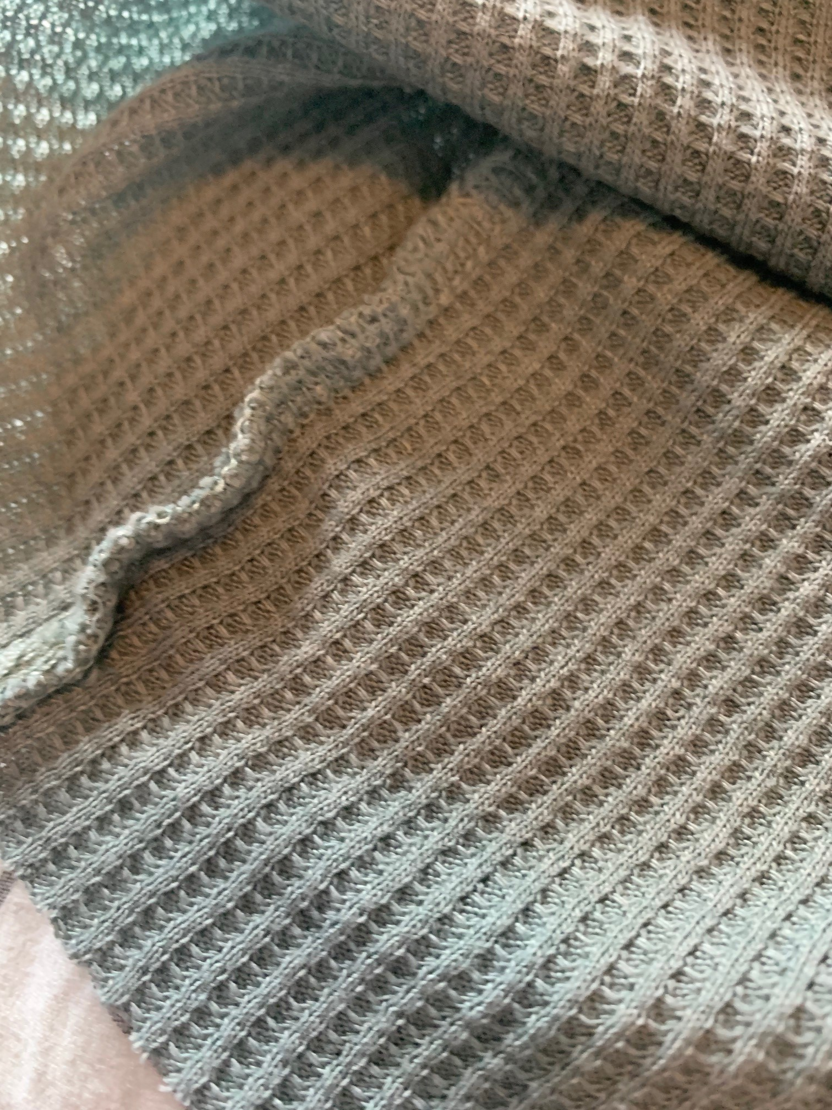
Seams
The seams and edge treatments are appropriate to the fabric and end use of garment. The raw edge on the bottom of the top makes sense with the fabric
The seams for the most part are nonbulky and avoid puckers. In the bottom picture you can see a bit of puckering in the seam on the shoulder
The stitches are placed accurately on the seam line
The seams that are in a high stress area (shoulder) are reinforced by a surger

Slide 13
Conclusion
Overall, I am happy that I purchased this shirt from American Eagle. For the price of $19.99, I think it lived up to expectations. I would not pay more than $25 for something like this because there was a bit of puckering and wrinkling after several washes. I do like the construction and ease of the shirt. It is very comfortable, and I feel like I can wear this top daily. The color is very pretty and did not fade a lot. I like the worn in feeling of the shirt that was created after washing it. After washing it and measuring it, I found that it did shrink just a tad bit. That does not bother me though because it did not affect the overall look and feel of the garment. There were no major issues that I ran into during this experiment, and I really enjoyed the process!

