Slide 1
Stitches and Seams Visual Dictionary
Hannah Knight

Slide 2
Stitches-101: Single thread blind stitch
Description: No stitch visible on the bottom or outside of sewn product
Common application: Blindstitch hemming, felling, making belt loops

Slide 3
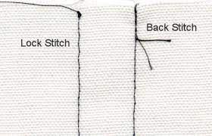
Stitches- 301: Lockstitch
Description: Stitch formed by a needle thread passing through the material and interlocking with a bobbin thread with the threads meeting in the center of the seam. Stitch looks the same top & bottom.
Common Application: Topstitching, single needle stitching, straight stitching

Slide 4
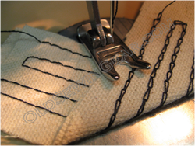
Stitches- 401: Chain stitch
Description: Stitch formed by 1-needle thread passing through the material and interlooped with 1-looper thread and pulled up to the underside of the seam.
Common Application: Single needle chainstitch- main seams on wovens

Slide 5
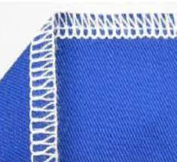
Stitches- 512: Mock safety stitch
Description: Stitch formed with 2-needle threads and 2 looper threads with the looper thread forming a purl on the edge of the seam. 512- right needle only enters the upper loop. Stitch does not chain-off as well as 514 stitch
Common Application: Seaming stretch knits, wovens

Slide 6
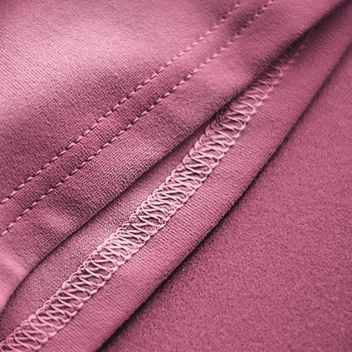
Stitches- 602: 2 Needle 4 Thread Coverstitch
Description: Stitch formed with 2-needle threads, a top cover thread and a bottom looper thread
Common applications: Binding A shirts, infants clothing, etc.

Slide 7
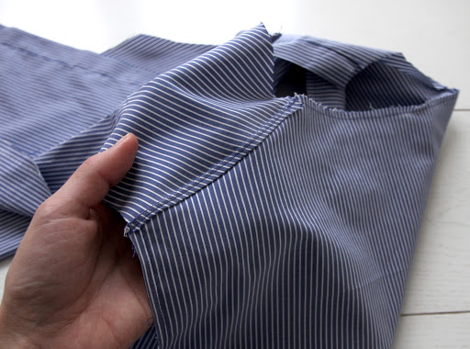
Seams- LSe 1.22.01 Yoking
Description: a seam in leather or cloth made by extending a cut or folded edge over a cut edge to the width of the seam allowance and stitching in place
Common application: seaming yokes to back on shirts or blouses in one operation. Not as common as SSq

Slide 8
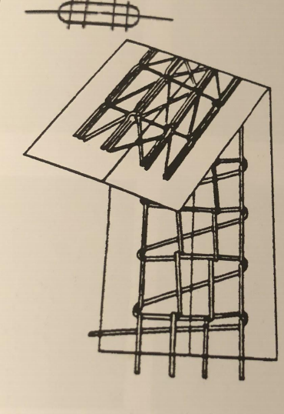
Seams- FSa 607 Needle Cover Stitch
Description: Flat seams are used for athletic wear and made on machinery that cuts and butts fabric together before stitching web stitches
Common Application: Used for seams on close fitting garments such as athletic apparel, shapewear, and underwear

Slide 9
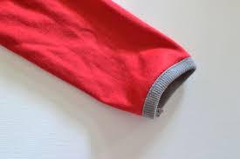
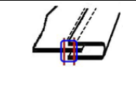
Seams- BSa 3.01.01 Binding (selvage edge binding)
Description: each of the raw edges in its seam allowances enclosed in a strip of fabric, lace, or net binding that has been folded in half lengthwise
Common Application: setting collarettes and sleeve binding undershirts, etc. Usually sewn with a 602 or 605 coverstitch

Slide 10
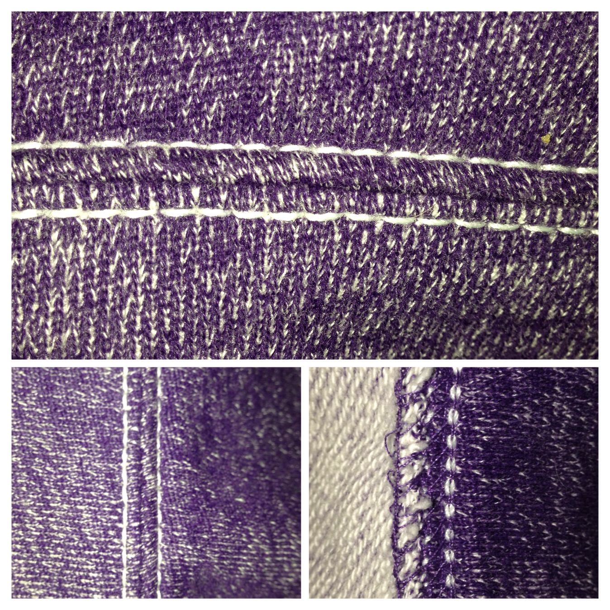
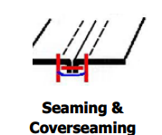
Seams- SSh 4.04.01 Seaming and coverseaming
Description: The superimposed seam is achieved by two or more separate pieces put together. This is one of the most common methods of seaming
Common application: for cover seaming knit top, undergarments to reinforce the seam and give it a decorative appearance

Slide 11
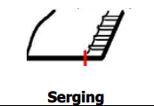
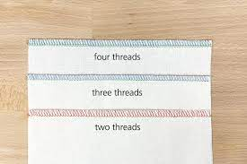
Seams- EFd 6.01.01 Serging
Description: An edge finish refers to the final hem you apply on the edges of a garment. It adds to its aesthetic and prevents the garment from fraying on the edges
Common Application: serging pants panels, flys, facings, etc.

Slide 12
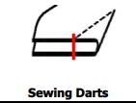
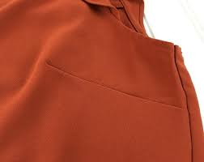
Seams- OSf 6.05.01 Sewing darts
Description: Ornamental stitches include embroidery and darts
Common application: Dart panel on slacks, chinos, blouses, etc.

Slide 13
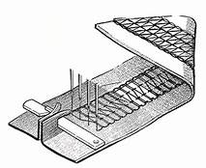
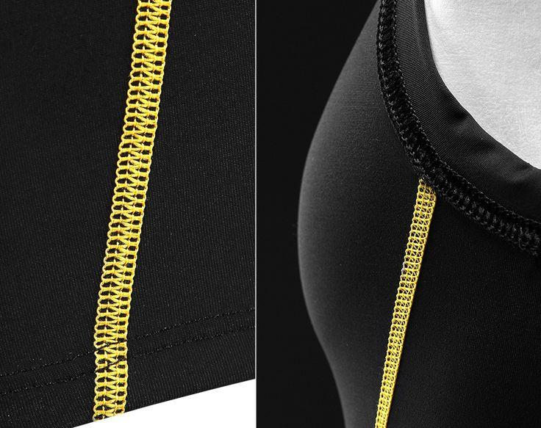
Seams- FSa 4.01.01 Flatseaming
Description: Stitch formed with 4-needle threads, a top cover thread and a bottom looper thread. Preferred over 606 stitch because machines are easier to maintain
Common Application: Flat Seaming Underwear, Fleece, Exercise Wear, etc. Generally sewn with a 607 stitch.

Slide 14
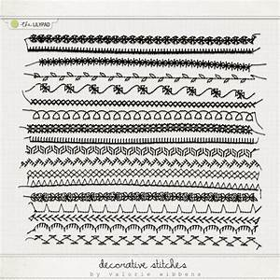
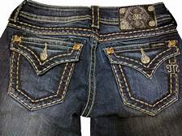
Seams- OSa 5.01.01 Decorative Stitching
Description: Specify Design Pattern with dimensions of stitch location
Common Application: Decorative Stitch Back Pockets on Jeans; Saddle Stitching

