Slide 1
Macho Marketing
The Chubby Cactus
Fall 2021 IMC Campaign

Slide 2
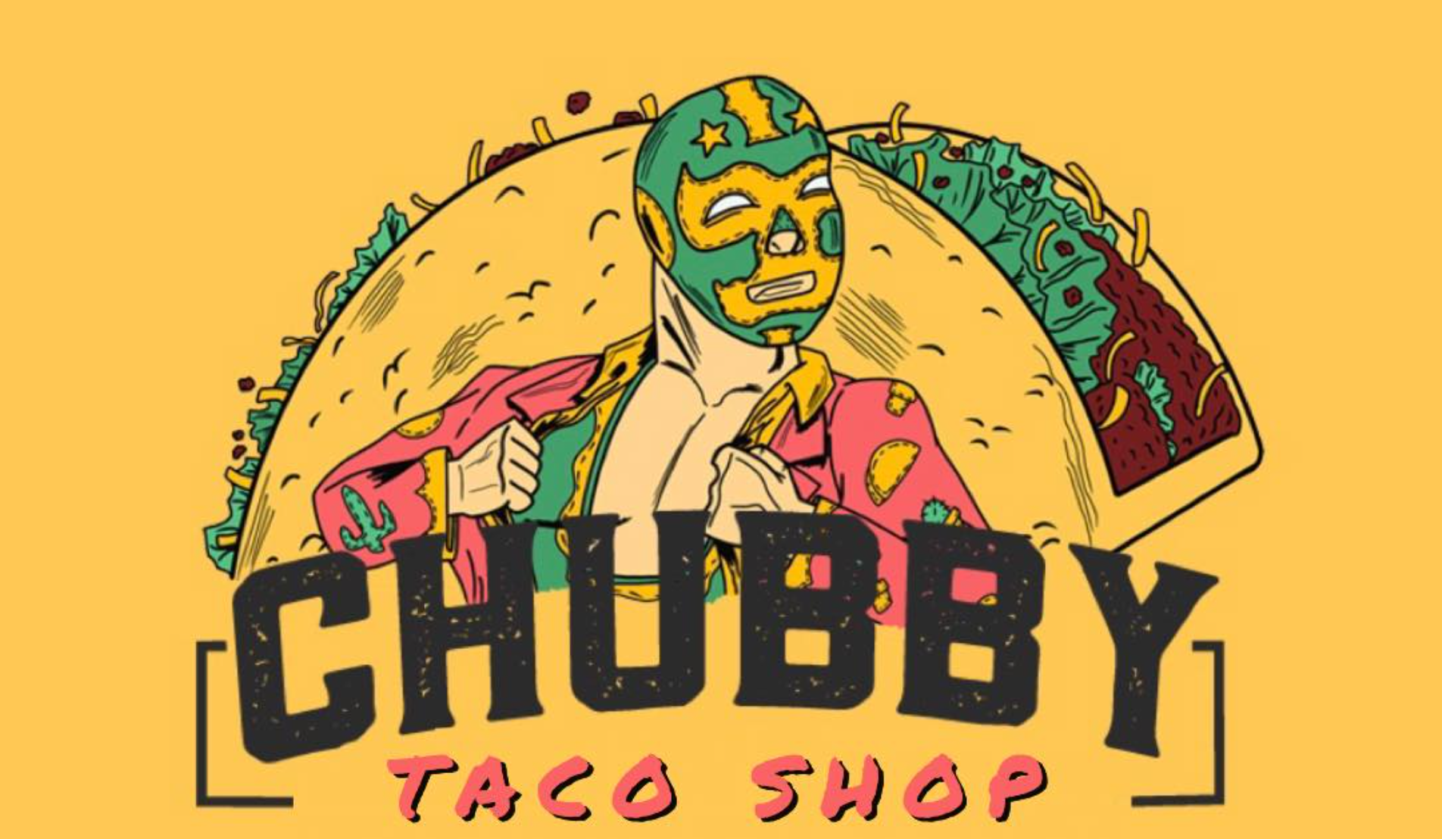

Slide 3
Table of Contents
Agency Introduction 4
Client Introduction 5
Executive Summary 6
Marketing Plan
Swot Analysis 8
Marketing Strategy 9-10
Competitive Strategy 11-13
Objective 14
Marketing Objective IMC Campaign 15
What will our IMC Objective do and why is it sustainable 16
Target Audience 17-18
Creative Brief
Brand attributes 20-21
Key Consumer Benefit 22
Creative Strategy: Approach and Appeal 23
Creative Strategy: Tone and Theme 24
Creative Strategy: Visual and Verbal 25-26
Campaign Tagline 27-28
IMC Campaign
Campaign Overview 30
Campaign Flow 31
Alternative Media 32
Public Relations 33
How? Community Involvement 34
Sales Promotion 35
Internet Marketing: Social Media 36
Social Media 37
Internet Marketing: Website 38-39
Advertising 40
Out of Home: Billboard 41-42
Conclusion
Budget 44
Schedule 45
Works Cited 46

Slide 4
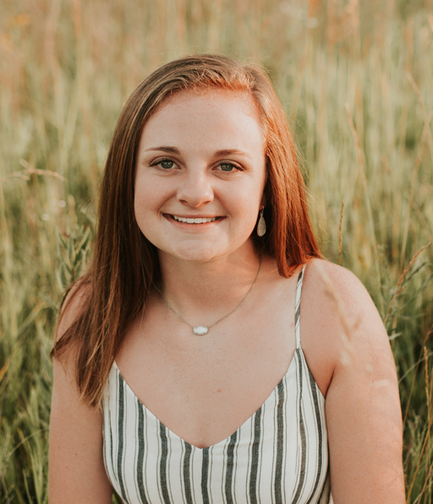
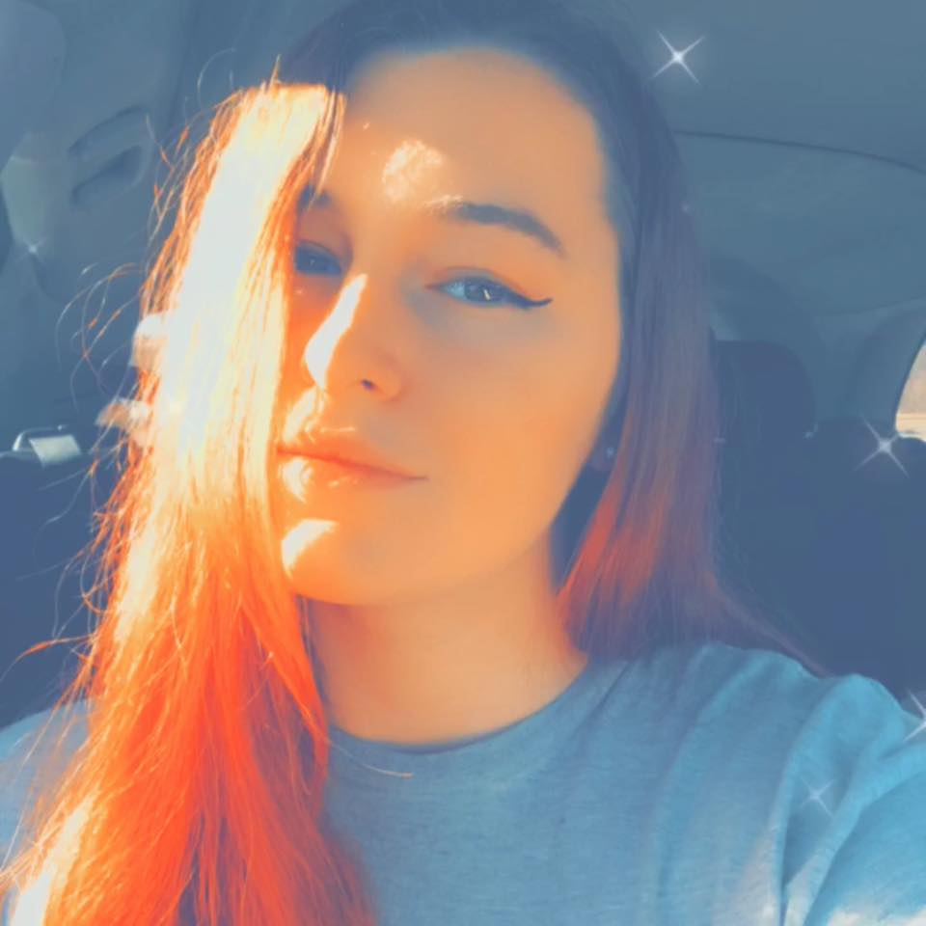
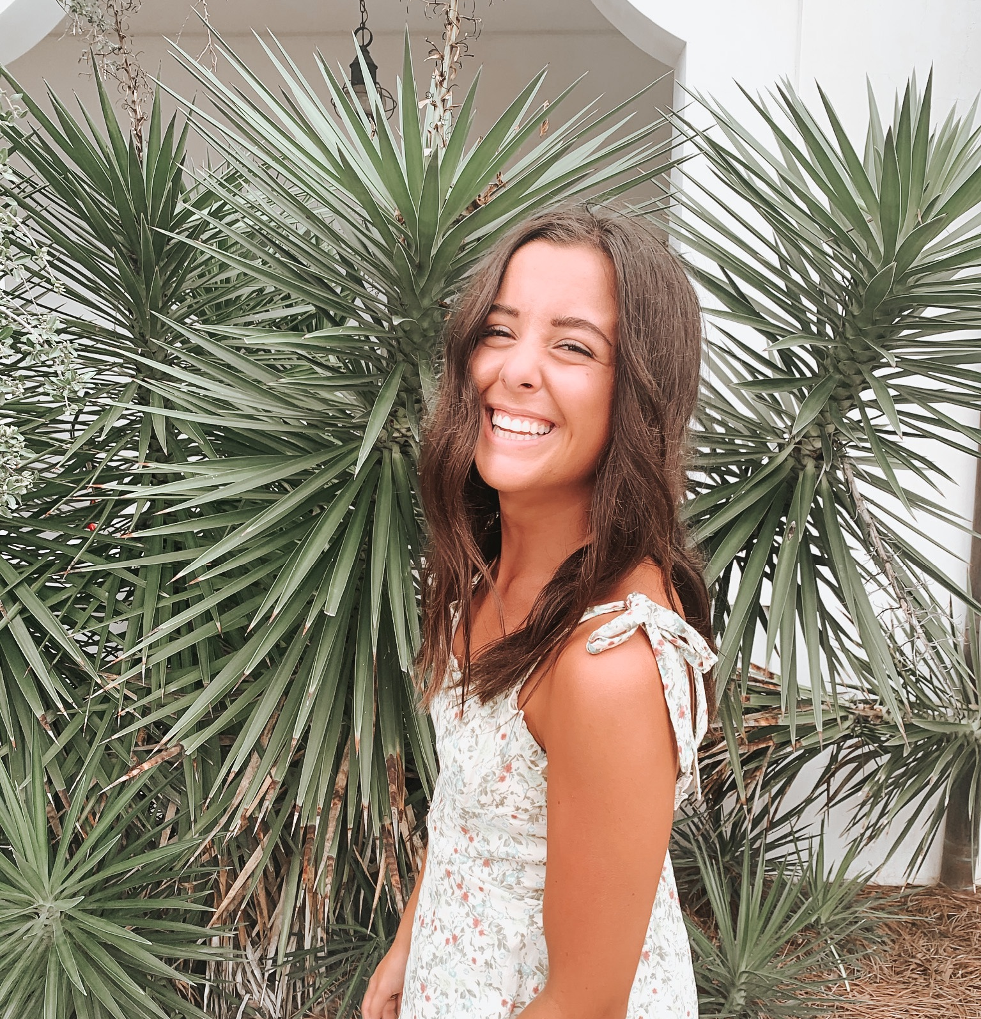
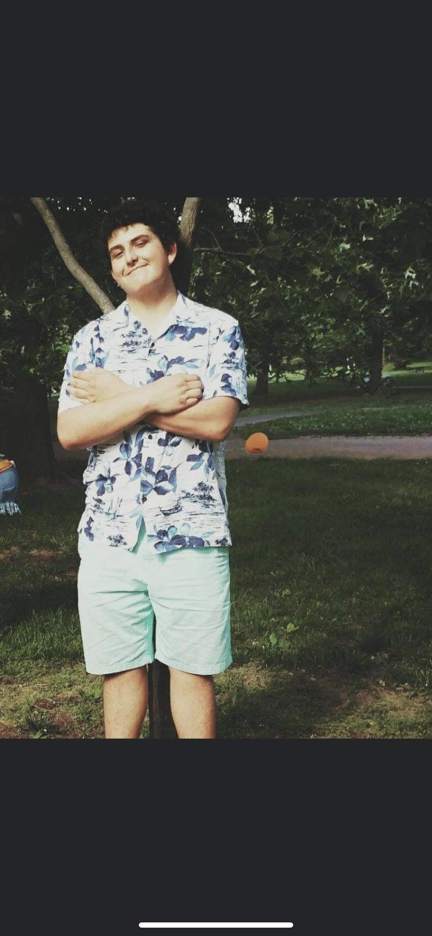
Agency Introduction
My name is Hannah Knight. I am a senior majoring in fashion merchandising with a minor in marketing. I love to spend my time outdoors or with friends! I am so happy to be a part of the Macho Marketers!
The Macho Marketers are a top rated marketing agency located in Springfield, Missouri. Our team consists of five college students that have a passion for advertising. We love to get to know our clients on a personal level, so that we are able to produce the best, most effective advertising plan for our customers. Listening to the needs of the company is our top priority here at Macho Marketing. Integrating the knowledge of technology we have as part of gen z, with classic advertising methods, makes us the top agency in the area.
My name is Veronica Davis. I am a senior at MSU pursuing my General Business Bachelor's degree. I love to practice photography in my free time and also enjoy to explore new destinations when I can.
My name is Riley O’Connor. I am a senior at MSU majoring in organizational communications with a minor in marketing. In my free time I enjoy spending time with my friends and family or getting outside and exercising!
My name is Michelle Bahena. I am a senior at MSU majoring in Marketing, Advertising and Promotions. My hobbies include sewing, swimming, hiking, and crafting. I’m exciting to work alongside this team.
My name is Eric Schaefer. I am a senior pursuing my degree in Marketing Management. I am a nature lover and major St. Louis Blues fan. I’m excited to be a part of this great team!

Slide 5
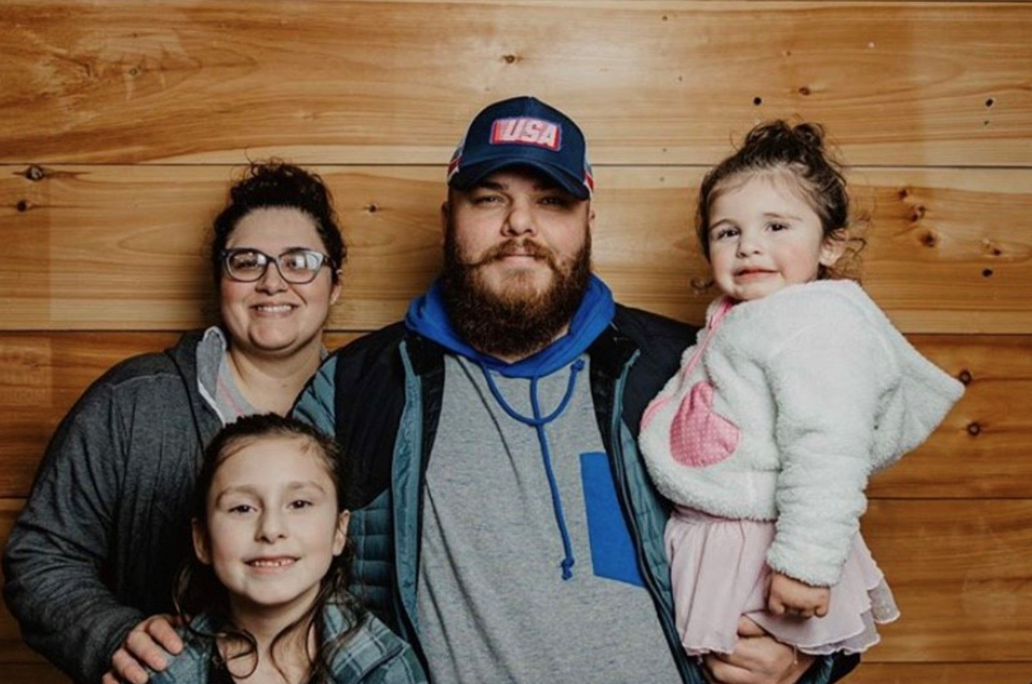
Client Introduction
Ricardo Hernandez is the owner of The Chubby Cactus. He grew up in Mexico and has a passion for bringing their street food to southwest Missouri! Ricardo says his business started Easter Sunday of 2019. He was at Nathaniel Green park with his whole family and they were asking him why he has never followed his dream and opened a taco truck(12). His father had an old roofing trailer and they fixed that up and it is now what customers know as The Chubby Cactus. Ricardo has a passion for food and cooking so this has always been a dream of his. Not only is ricardo the owner, he is also the chef! He is in that trailer working hard hours after hours to give springfield the yummy, authentic street style mexican food he has promised. Ricardo has a wife who helps him come up with menu items and recipes. He also has two little girls that are pictured here.

Slide 6
Executive Summary: Let’s Taco Bout It
Through building a website, social media, taco tuesday, and a billboard this campaign will increase the Chubby Cactus’s social media following with millennials and foodies in the Springfield, MO area. This plansbook provides all the details for developing and implementing this campaign and is divided into four sections:
Marketing Plan: Includes an industry overview, current marketing strategy, competitive analysis, campaign objective, and target audience research.
Creative Brief: Outlines features and benefits, creative strategy, and the campaign tagline.
IMC Campaign: details strategy and creative output for the promotional channels being used in this campaign.
Conclusion: Provides a breakdown of the budget and a schedule.
This IMC campaign is designed to encourage Springfield area millennials and foodies to choose The Chubby Cactus Taco Truck and experience a cuisine like none other.

Slide 7
Campaign pt 1
Marketing Plan

Slide 8
SWOT Analysis
Strengths
Delicious and quality food. Skilled and knowledgeable staff on genuine Mexican cuisine. A well known reputation in the food truck community.
Weaknesses
Small truck leads to less room to store food produce. Difficult for some people to visit due to hours. No set schedule and determined location for people to plan in advance to visit. Limited staff = longer wait times
Opportunities
Hire more staff with appropriate training to cut down on wait times. Purchase a larger “trailer” to operate out of or build a brick and mortar to store produce in larger quantities causing less sell outs. Build/purchase a building for brick and mortar to have a more defined schedule as well as a definite location, this will help to increase visitation and sales.
Threats
Other food trucks (mexican cuisine) coming into the area selling similar products or stealing recipes, other food trucks could mean potential need to adjust prices to offset any difference that may cause loss in customers. Negative press (bad reviews) could drive sales down.

Slide 9
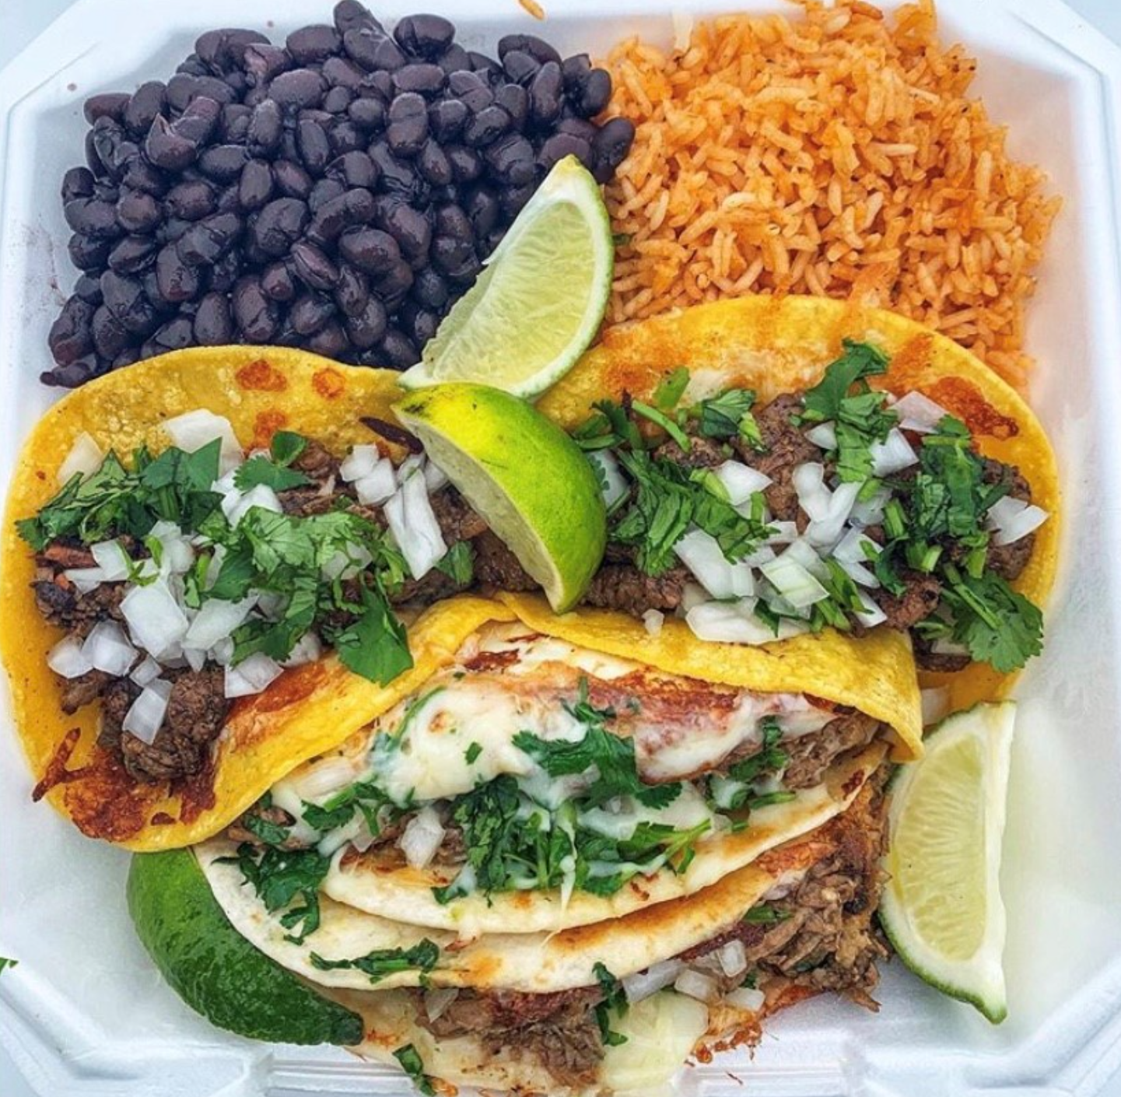
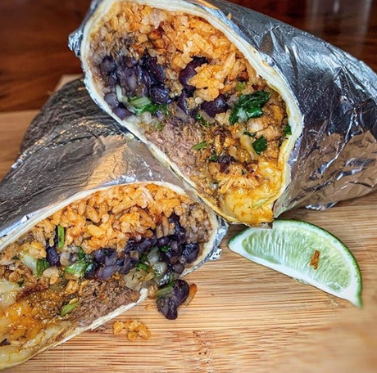
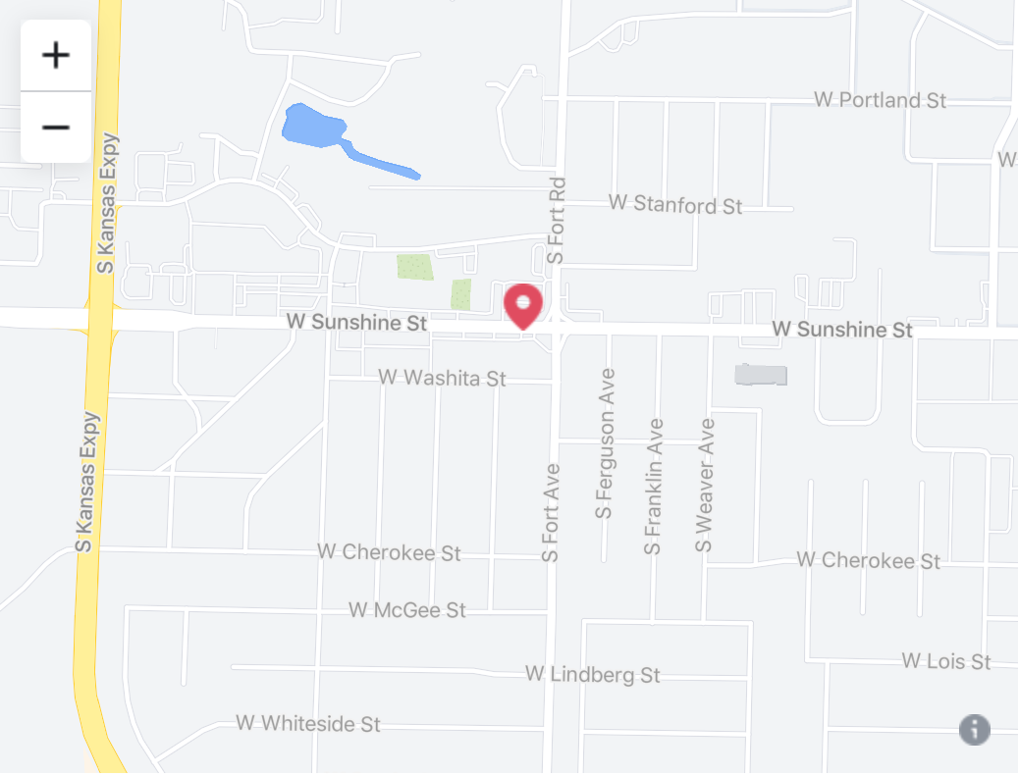
Marketing Strategy
Product
The product that we are marketing is the experience and the food that the Chubby Cactus has to offer. The menu consists of a range of tacos, quesadillas, and burritos with your choice of chicken baja, carne asada, veggie baja, or beef barbacoa. You can add onion, cheese, and cilantro to any of these, as well as two different sauces. The Chubby Cactus offers sides of spanish rice and black beans. They also do offer some drinks, including some authentic mexican drinks.
Place
The Chubby Cactus is located on Sunshine and Fort. A brick and mortar store is currently being built in Branson, MO.

Slide 10
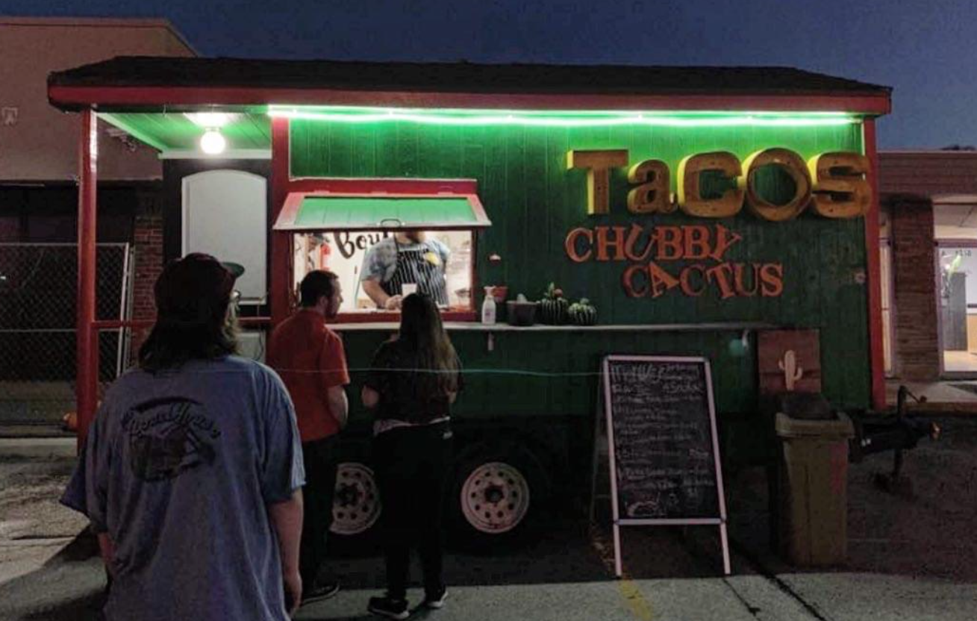
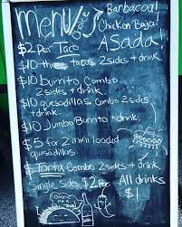
Marketing Strategy
Price
The price of food varies between items. Their tacos are $2/taco or you can get three tacos with two sides and a drink for $10. The burritos and quesadillas come with two sides and a drink for $10. Single sides cost $2 and all drinks are $1.
Promotion
We plan on taking advantage of our digital marketing platform which is how we will reach a majority of our target audience. How we plan to do this is through the use of social media. Some ideas we have are doing an instagram giveaway where we will giveaway a free meal for two. You enter the contest by having people post our page on their instagram stories, and also tag as many people you can in the comments on our post. This way we will gain traffic into their instagram page and more people will become familiar with the name. We aim to do a majority of our promotions through the use of social media, as it is the easiest and cheapest way to reach our target market.

Slide 11
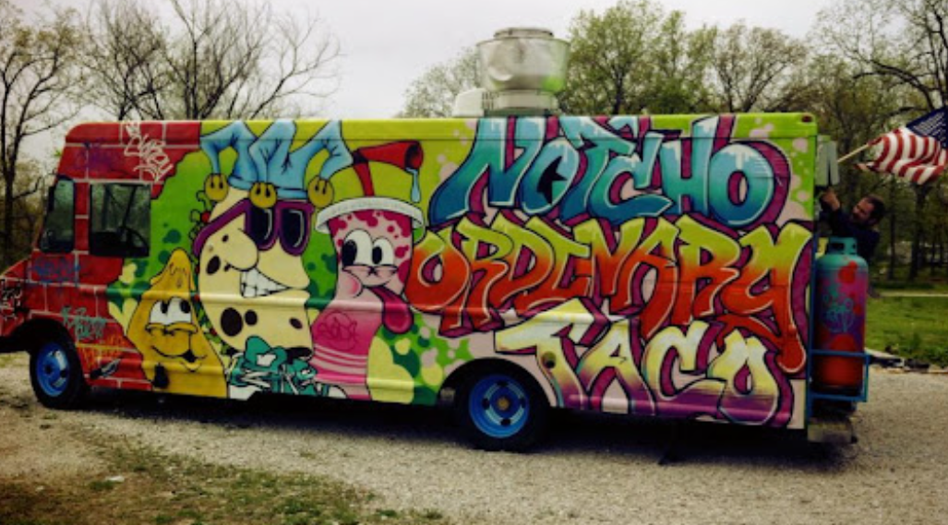
Competitive Strategy
Not’cho Ordinary Taco
Not’Cho Ordinary Taco is a local food truck in Springfield selling an authentic Mexican cuisine style. Their menu offers products including tacos, fajitas, empanadas, and desserts, subject to occasional change. Not’Cho Ordinary Taco has made extroardinary efforts to display their menu and pricing in comparison with The Chubby Cactus as their information has been difficult to find. Not’Cho Ordinary Taco also has a greater presence and following, both in Springfield and online as they’ve been around for almost nine years. Additionally, they have earned a rating of 4.9 stars based off of 287 reviews. Chubby Cactus opened in 2019 and has a lower following on social media with a rating of 4.9 stars based off of 54 reviews
Online Presence:
Not’Cho Ordinary Taco has a big social media presence in comparison with Chubby Cactus. Their social media features delicious images of their products, mascot, and graphics of events. They have a following of 9,686 on Facebook, 1,632 on Instagram, and 31 on Twitter. In comparison, they have more followers on all accounts; however, Chubby Cactus does not have a Twitter account, an opportunity for growth.
Pricing:
Not’Cho Ordinary Taco has a pricing range of $$ listed on their social media. Based on their information displayed on their menu, their prices range from $6-$11. Not’Cho Ordinary Taco also offers catering services, private lunches, and private lunches. The Chubby Cactus offers lower prices than Not’Cho Ordinary Taco, with their range being $2-$10.

Slide 12
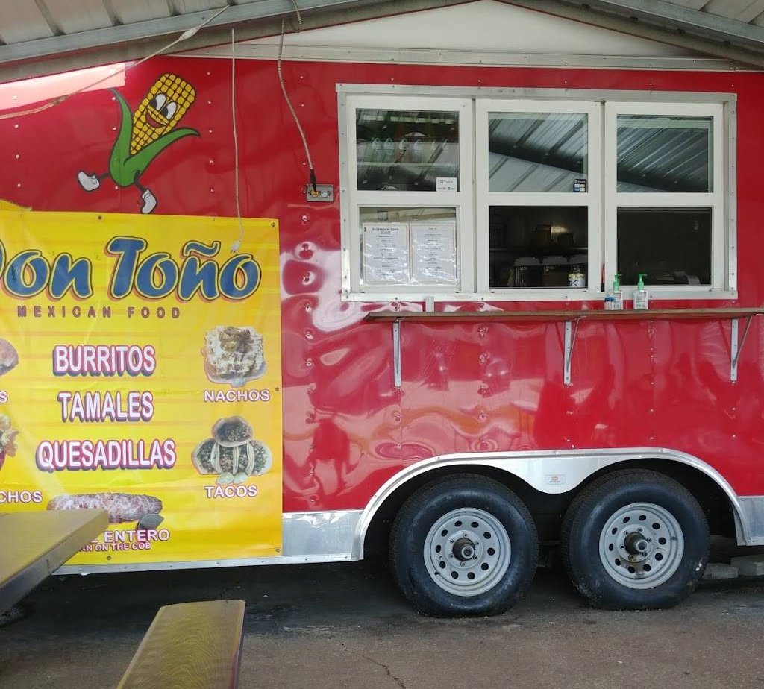
Competitive Strategy
Don Toño
Don Toño is a local food truck in Springfield offering a Mexican cuisine style including Mexican style corn on the cob, tortas, burritos, quesadillas, nachos, dorinachos, tamales and more. Don Toño does offer a wider variety of food than The Chubby Cactus. Again, Don Toño has done a better job of displaying their information including products and pricing. However, the Chubby Cactus is performing better by comparison on social media presence. Chubby Cactus also has a higher rating in comparison with Don Toño's 4.7 stars based off of 92 reviews.
Pricing:
Don Toño’s pricing listed on their Facebook is $, on par with Chubby Cactus’s. Their pricing ranges from $1 to $9. Their price range is very similar to The Chubby Cactus, which has a range of $2-$10.
Online Presence:
The Chubby Cactus has a greater online presence and following in comparison with Don Toño. Don Toño has minimal activity on Instagram with a total of nine posts and no activity in almost three years. Their Facebook features minimal postings on their products, it seems to be used primarily for copy text postings. Certainly, The Chubby Cactus is performing better on social media than Don Toño with a variety of postings including product images, memes, and promotional graphics. Don Toño has a following of 1,786 on Facebook and 94 followers on the inactive Instagram account.

Slide 13
Competitive Strategy
Chubby Cactus has fallen behind in its social media presence. In comparison with Not’Cho Ordinary Taco, Chubby Cactus could be doing better and should focus efforts on growing their platforms. This could also be due to Not’Cho Ordinary Taco being around longer as it was established about six years before Chubby Cactus. However, in comparison with Don Toño, they are doing better in terms of its following and content.
The Chubby Cactus should create a unified and concise message to promote to customers and use to advertise themselves. Overall, their social media ranges a lot in its postings including memes, product images, and promotional graphics. Their social media seems to be missing unity and consistency. Improvement could be made to create a concise image and message for consumers.
3 Goals for The Chubby Cactus
Chubby Cactus should work to increase its social media presence including creating a unified concise message.
Chubby Cactus should focus on displaying their products and how they fit with their target audiences’ lifestyles.
Chubby Cactus should make additional efforts to display their offerings, pricing, and information.

Slide 14
Objective : Increase Social Media Following
Our Goal
Raise awareness for The Chubby Cactus. We believe that by raising awareness of The Chubby Cactus, we can effectively create more business for them as their product speaks for itself. Chubby Cactus is way less active on social media compared to our competitors such as Not’Cho Ordinary Taco. To achieve our goal of increasing Chubby Cactus’s social media presence we will do a promotion where customers are given a voucher for a free taco if they can show proof that they follow you on social media.

Slide 15
Marketing Objective IMC Campaign
We want to achieve a realistic goal. Our goal is in the next 5 weeks to get Chubby Cactus 2,300 more facebook followers, 300 more instagram followers, and to start a presence on twitter, working towards 100 followers.
All of these numbers were determined because they are realistic as long as The Chubby Cactus introduced their promotional plan correctly. Twitter is the platform that we are least focused on, as all of their competitors do not have a large Twitter presence, if any at all. According to workmacro.com, the average followers on Instagram for a personal account is 150, and for a business account can be upwards of 1,000. For large growing businesses they often surpass 10,000. For Chubby Cactus, 2,300 gained instagram followers would be realistic as it would put them around 5,000 which is well above the amount of followers that other local businesses such as Black Sheep and Aviary Cafe.

Slide 16
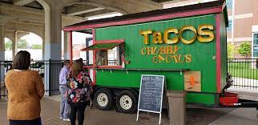
What will our IMC Objective do and why is it sustainable?
As a food truck, The Chubby Cactus is not built to be a big business. Part of the appeal of a food truck is that it is a small family-owned truck. We believe that by increasing their social media presence to the specific numbers we stated would be good for business as it will increase the people who know about Chubby Cactus, as well as the people who actively consider going there to eat. As we often see with small businesses that blow up on the internet, such as Tik tok, often times those businesses can not handle the demand of the internet in such a short amount of time. Not only is our goal feasible, but it keeps the environment of the food truck feeling local and family owned.

Slide 17
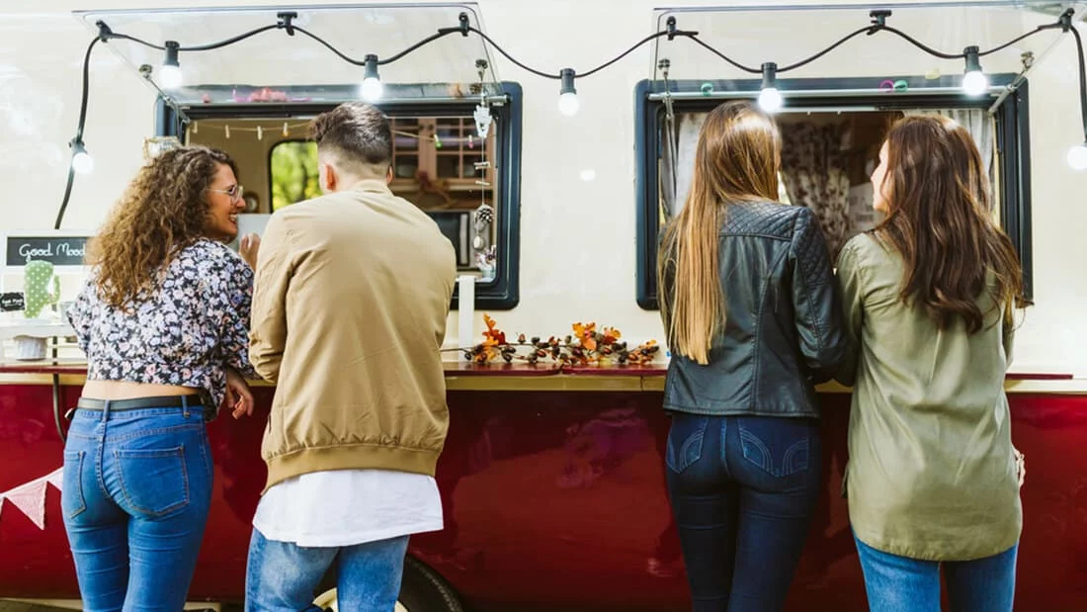
Target Audience
Impact of Millennials in the economy(3):
Millennials are now the largest living adult generation and have immense buying power. It was estimated that in 2020, millennials spent $1.4 trillion. 34% of millennials have a bachelor's degree or higher, which surpasses both the silent generation and the baby boomers. This means that the power millennials hold in the current economy is huge.
The target audience for this campaign are millennials, especially single, that are local to Springfield. It is a proven fact that millennials are more likely to support a food truck than any other generation(1). We want our campaign to target millennials and get them excited to try new food trucks. We want to encourage single millennials to go on dates at The Chubby Cactus, and make an adventure out of trying new food spots. Millennials have a desire to try new things, and a food truck like The Chubby Cactus is the perfect spot for a new, fun, and unique date night.
Springfield, Missouri Facts(2):
Population: 168,568
137, 181 are adults
Population increase annually: 0.2%
Median Age: 33.1
Percentage of single adults: 60%

Slide 18
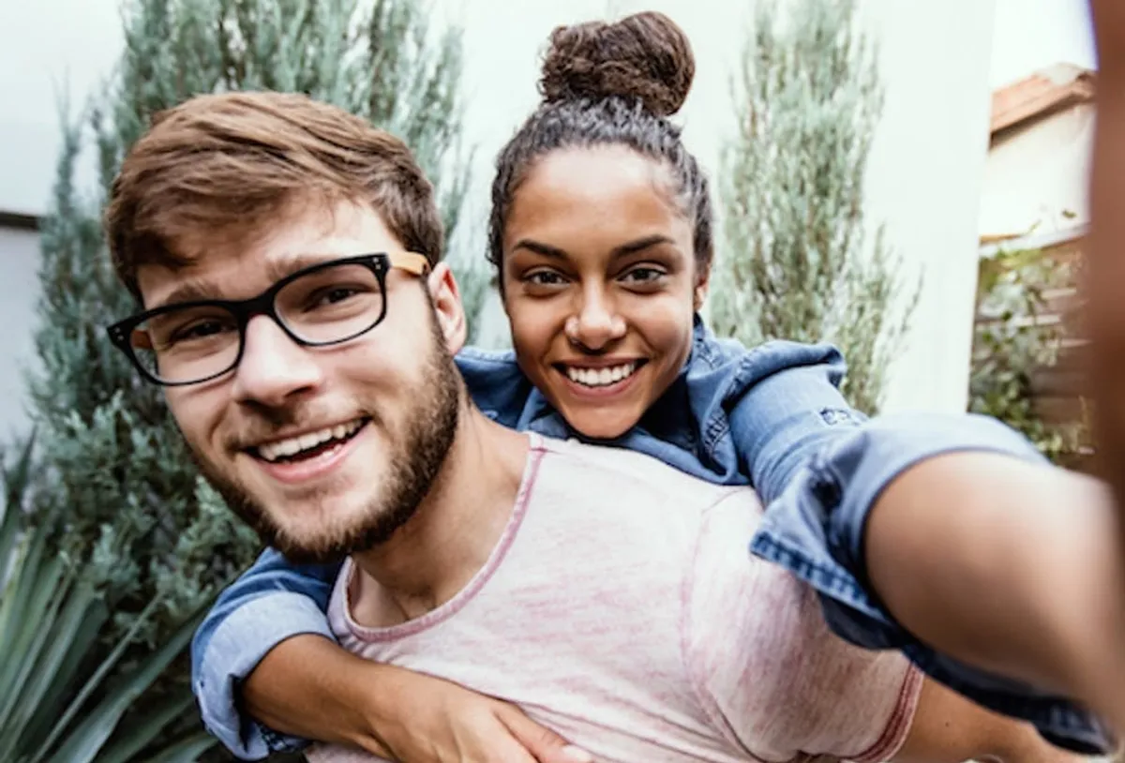
Target Audience
Millennials impact on social media(4):
79% of millennials use social media multiple times a day
33.1% of Instagram users in January 2021 were millennials
70% of millennials trust brands that post videos about their products
Target Audience Profile
Meet Mark and Alyssa, they are in their late twenties and met on a dating app. They both have college degrees and work full time jobs. They are always checking their social media to see what is going on in the world. These two are always excited to try the newest and trendiest things in town. This couple makes the perfect customers for The Chubby Cactus!
Why Single Millennials Specifically?
The Chubby Cactus welcomes people of all ages to come and enjoy their delicious mexican cuisine, however singles are more likely to enjoy the atmosphere than a family. It is tougher to get your family together and go sit down to enjoy dinner at a food truck, however if you are on a date with another person, the atmosphere may be perfect for you. The walk up style, with places to sit and eat makes for a perfect set up for a date. It is not too formal where it is intimidating, but you are still receiving that amazing food you were craving.
Using social media to reach our target market:
As the facts stated above, millennials have a large impact on social media. Posting on social media constantly, talking about the products and promotions on a daily basis will help The Chubby Cactus get through to the target audience. Being interactive on all social media accounts will help our target market gain trust with our business.

Slide 19
Campaign pt 2
Creative Brief

Slide 20
Brand Attributes
Features
Benefits
Meals on Wheels | The Chubby Cactus Taco Truck has the capability to relocate to a parking lot near you, allowing a wider group of people the opportunity to try this delicious food. This also allows for simple and quick access for any catering needs.
Locally Owned | The Chubby Cactus Taco Truck is delighted to be able to serve its local community. Ricardo, the owner, works very closely with staff and customers to create a happy, comfortable environment that welcomes and remembers returning customers.

Slide 21
Brand Attributes (Continued..)
Features Benefits
Brick and Mortar Restaurant (Coming soon) | With the new addition of the Chubby Cactus Taco Restaurant coming soon to a location near you, you can expect to see wait times cut down, leading you to get your amazing food much quicker, as well as enjoy the fun comfortable atmosphere that would be perfect for quick lunch plans or date night dinners.
Delicious Food with authentic mexican cuisines | Ricardo, the owner, moved from Mexico at 14 years old and fell in love with the authentic Mexican recipes. He developed the desire to share the deliciousness with others around him and has perfected the recipes over time.

Slide 22
Key Consumer Benefit
“This truck slings some seriously addictive tacos, dripping with juice from tender slow-cooked meats and packed with flavor.”
Based on our research of our target audience (millennials and foodies), we believe that the key consumer benefit to emphasize in our IMC campaign is that The Chubby Cactus Taco Truck is the best business to get delicious authentic mexican cuisines. Small local food trucks and restaurants are ideal lunch/dinner spots for millennials and foodies alike, they often go out searching for local food that creates a cultural experience. While picking up a delicious meal they can experience a small taste/look at Mexico’s culture.
“This traveling truck’s flavor game is insane, especially in the not-really-a-taco-but-close-enough fried dipped mini quesadilla”
*The Chubby Cactus Taco Truck has been listed in 417 Magazine twice as one of the best taco trucks in springfield.

Slide 23
Creative Strategy : Approach and Appeal
Approach: Objective(Growth)
As our target audience is millennials, we plan to target areas where they know best, social media sites. Our plan is an objective and growth plan, as we plan to grow the social media following of Chubby Cactus on all social media sites. Social media growth will effectively drive in more business, as many people share pages with their friends and more people learn about Chubby Cactus.
Appeal: Logical/Emotional
We chose a mix of a logical and emotional appeal. As our target audience is millennials and foodies. We chose this because not only do people make logical decisions on what they like about a place pertaining to service and quality of food, but they also can have an emotional appeal that draws them into a place as well. Our target audience is heavily influenced by ration and emotion, as they tend to make decisions based on emotions versus societal traditions.

Slide 24
Creative Strategy: Tone and Theme
Tone
Single millennials all want something to do on a Friday or Saturday night. Nothing could be more perfect than taking an adventure to The Chubby Cactus with your exciting first date! This is exactly why we want the tone of our campaign to be adventurous and exciting; to motivate single millennials to get out there and try something new. Creating adventures in your own town can be some of the most fun and memorable times, that’s why we want to encourage all the foodies and millennials just looking for a fun night to stop by The Cubby Cactus because they sure won’t regret it!
Theme
We decided that the campaign theme for the Chubby Cactus Taco Truck campaign would be ‘Welcoming’. Our decision for this is based on the fact that almost every person in life has experienced going into a store or restaurant and not feeling welcomed, the staff may be being rude or unhelpful, the food might be poorly made, or the building layout is chaotic and hard to navigate. The Chubby Cactus Taco Truck and campaign knows how important it is to leave a good lasting impression on customers (millenials and foodies), with social media at everyone’s fingertips it can quickly turn into a bad situation. We would like to invite all types of people to try out The Chubby Cactus’s delicious food and go on an exciting tasteful adventure in the process.

Slide 25
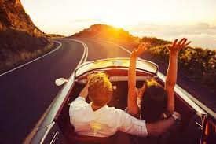
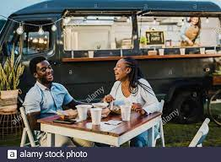
Creative Strategy- Visual and Verbal
Typeface
The tone of the campaign is excitement and adventure so the headline font will be Raleway in bold . The body copy will be Lato as it is easy to read, and looks nice and clean. The subheads will be the same font as the body, Lato, just in bold.
Raleway
Lato
Imagery
Lato (bold)
The imagery used in our campaign reflects millennials out on adventures and dates. It will have a sense of something that is new and exciting. It will feature couples enjoying each other's presence because that is what we want to happen at the Chubby Cactus. The people in the photos represent our target market, millennials.

Slide 26
Creative Strategy- Visual and Verbal
Colors
The colors we are using for our campaign are orange and teal, with accents of neutral colors like black and beige. Orange is a color that makes people want to take action and is very attention grabbing (8). This will assure we grasp the attention of the target market to make sure our message is conveyed in an effective manner. Teal, being a combination of blue and green, represents calmness, tranquility, and balance (9). These colors will come together to create a pleasing and eye catching campaign.
Copywriting
The entire campaign is all about creating an adventure for foodies to be adventurous and try food trucks, specifically, The Chubby Cactus. The copy should include words like foodie and adventure throughout the campaign to help set the tone. The company name, The Chubby Cactus should also be mentioned frequently. The tagline and hashtags should also be mentioned as well.

Slide 27
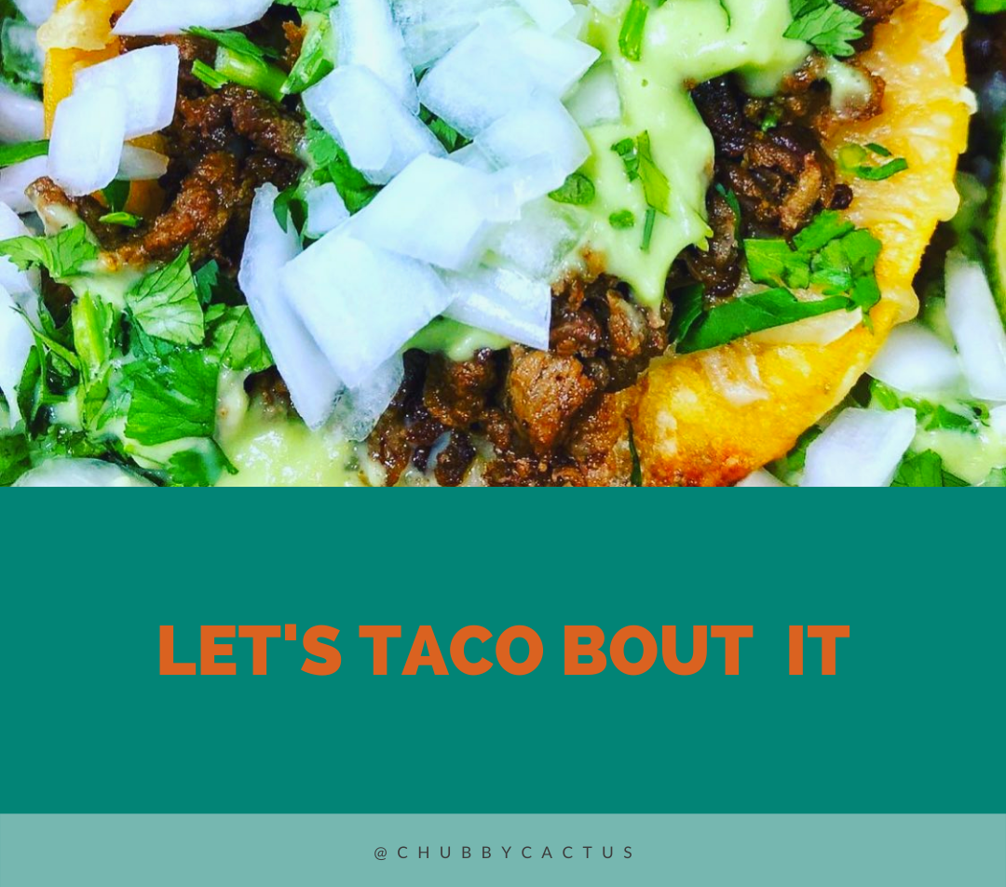
Campaign Tagline
#LetsTacoBoutIt
The campaign tagline is "Let’s Taco Bout It,” which includes a pun in the campaign while also featuring The Chubby Cactus’s product in the tagline to increase attraction.

Slide 28
Campaign Tagline
#LetsTacoBoutIt
@CHUBBYCACTUS
Creative strategy: The campaign tagline of “Let’s Taco Bout It” encompasses the creative strategy. The objective approach of growth is captured by attracting more people to try Chubby Cactus to form their own opinion on their products. The logical/emotional appeal and adventurous/exciting tone is made through conversation surrounding flavor and connections to memories made at Chubby Cactus.The welcoming nature of the campaign will be formed from people feeling inclined to try Chubby Cactus to Taco Bout the food.
Objective: This tagline ties into the objective of raising attraction by putting Chubby Cactus’s popular item in the actual tagline (taco). Anytime anyone hears or sees the tagline, there will be a craving created for Mexican cuisine, specifically tacos. What will follow our tagline? Chubby Cactus’s handle. Additionally, we intend to use our tagline as a hashtag to increase attraction, buzz, and a relation to Chubby Cactus.
Target Audience: We want our campaign to target millennials and get them excited to try new food trucks. Our tagline relates to millennials by including a pun and by including humour in our campaign we can create shareability and emotion which allows us to form a connection with our audience and increase their likeness to remember us. By using our tagline as a hashtag and encouraging conversation over Chubby Cactus’s products, customers can share their experiences to their peers.

Slide 29
Campaign pt 3
IMC Campaign

Slide 30
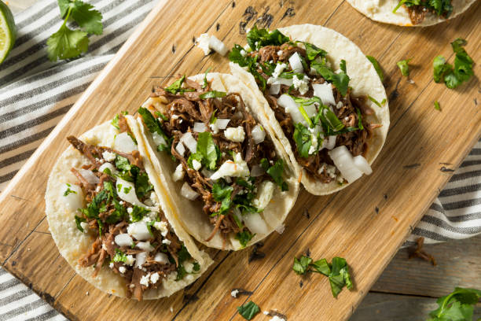
Campaign Overview
Chubby Cactus is a company that has been a food truck all its life and we are moving towards eventually turning it into a brick and mortar. We realize that Taco Tuesdays are a very popular thing, so that is why we are creating a special of double meat when you come on taco Tuesday and show us our social media page in which we will post a voucher. This will be very good for us because we will increase our presence on social media as people will tell their friends about the deals, and we will not hurt profits much as it will only be a once a week deal. We will be doing this every Tuesday, and will evaluate how much it is working for us in terms of profitability. We will also give away a free item such as a sticker or a shirt if you share our profile on social media as our goal in to increase our presence on Twitter, Instagram, and Facebook. We expect this to be a large factor in contributing to the growth of our company.

Slide 31
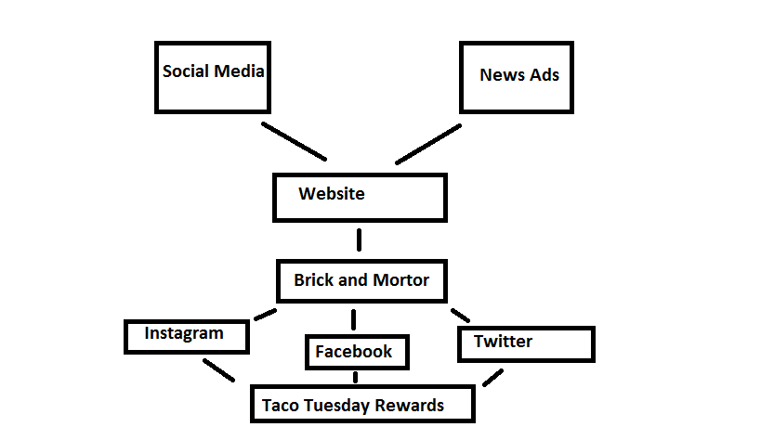
Campaign Flow

Slide 32
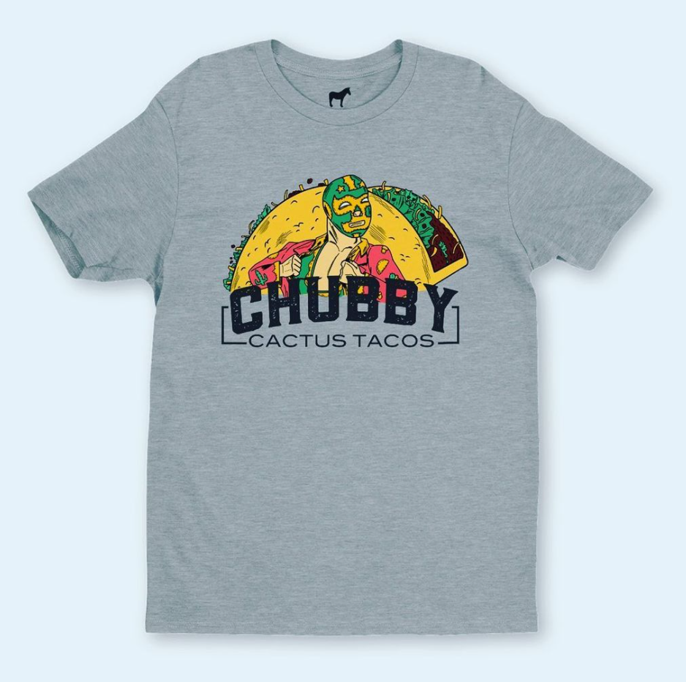
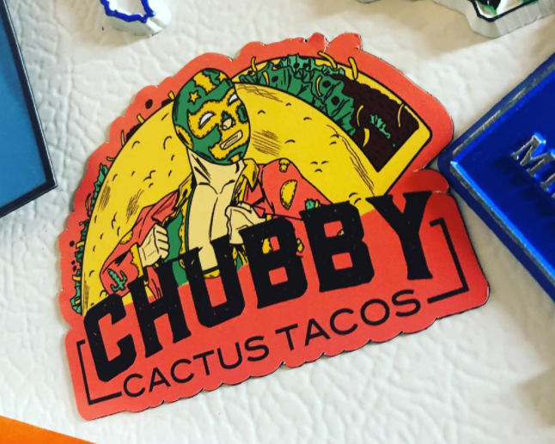
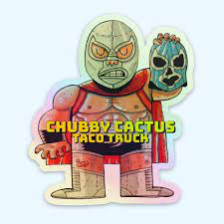
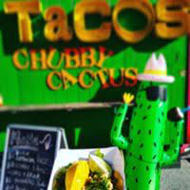
Alternative Media
Merchandise
The Chubby Cactus will be offering various forms of merchandise for the use of our alternative media. The merchandise will include t-shirts and stickers!
Mascot
Another form of alternative media that we will be using is a Chubby Cactus mascot! We will have someone dressed up in a cactus costume who will stand outside of the food truck which will gain attraction and set us apart from the other food trucks.

Slide 33
Public Relations
The central goal of public relations is to establish, reinforce, or sell a brand’s reputation. We are trying to grow Chubby Cactus and have new customers try its products and along with that comes growing a positive image of the restaurant. However, a challenge that comes with public relations is establishing this position image long-term.
Some key benefits of public relations are building a positive brand image, its low cost, high exposure rate, and it reaches consumers from non-company outlets. PR done well can be picked up on multiple media outlets creating more exposure to a larger audience. This gives a company the opportunity to have its brand name and products in front of potential customers who otherwise wouldn’t have heard of the brand.

Slide 34
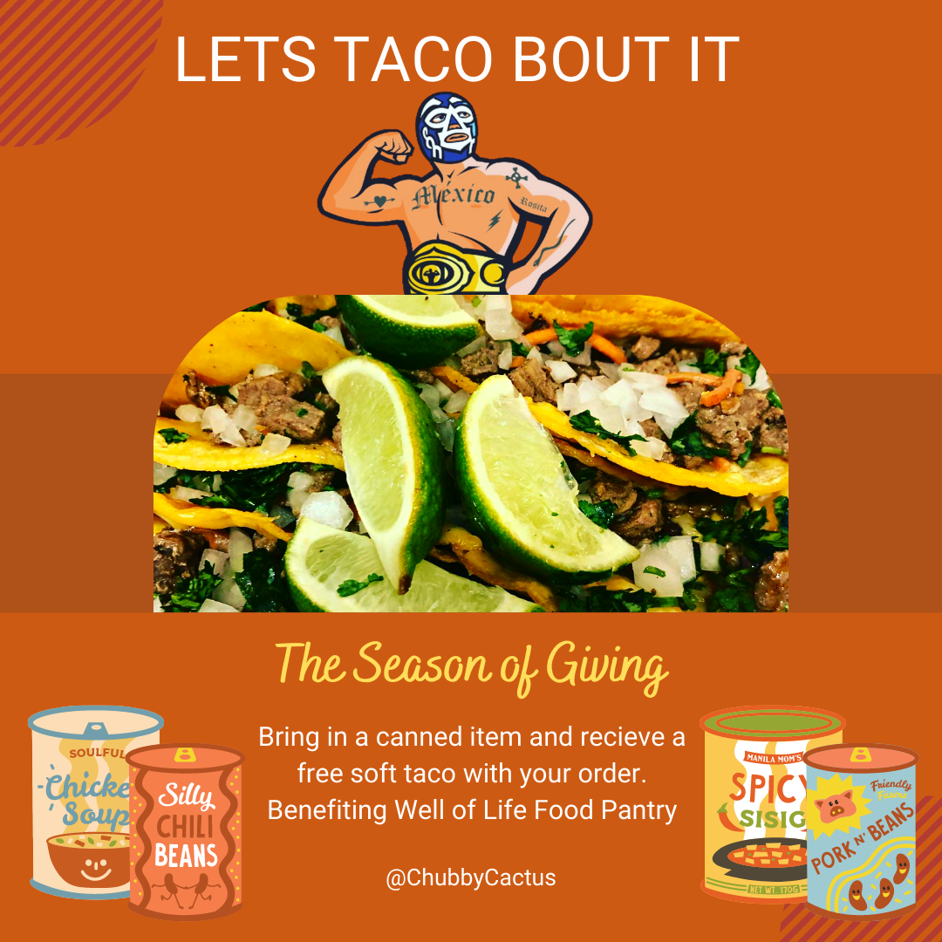
How? Community Involvement
What better way to generate goodwill than to join in the season of giving. For our form of PR, we plan to get involved within the Springfield community. Through the month of November, Chubby Cactus will hold a food drive benefiting Well of Life Food Pantry. Customers who bring in a canned item will receive a free soft taco with their order. Not only would this be low in cost to do, but it would also greatly aid Chubby Cactus in growing a positive brand image
To implement our food drive, a graphic like this would be posted on our social media and be reposted continuously on our stories. Our hashtag #LetsTacoBoutIt would be used and we would encourage our customers to Taco Bout the season of giving, their memories, and how they’re giving back this year. By interacting and engaging our followers on social media, we can increase sales, increase customer loyalty, and higher positive reviews.

Slide 35
Sales Promotion
With it being tuesday, we know customers normally still have a long couple days ahead until they begin their weekend. We are here with our Taco Tuesdays to create some mid week happiness! We will offer a voucher to anyone who shows us the social media post we make about Taco Tuesdays. With this voucher, the customer will be able to get double the meat or double the taco.
They will have the option to choose whether they would like to add a double amount of meat to their own taco, or add an extra free taco that they could share with a friend. This should help increase our presence on social media as well as word-of-mouth advertising. We also plan on giving out a sticker to all customers which contains all of our social media accounts, as this will be something that will ideally generate more followers and increase our online presence.

Slide 36
Internet Marketing: Social Media
Social Media facts and figures(6):
Over 4 billion people use social media
The average person has 8 social media accounts
57% of consumers follow brands to hear about new products and services
49% of users who follow brands unfollow due to poor customer service
The average Instagram user is on the platform 30 minutes per day
Social media is the best and easiest way to reach an audience these days. With 86% of millennials using social media, this is the most effective way to market to our audience(5). Posting the daily specials, promotions, and content that intrigues customers is important. There should be plenty of information on the page and daily/weekly posting so your customers know that your business is active on their pages. Comments and direct messages should be responded to in a timely manner. It is very important to be proactive with your social media pages for your business.
Ways to boost engagement on social media
Using our tagline as a hashtag #letstacoboutit
Creating an aesthetic for the Instagram and Facebook pages
Posting about promotions and specials
Making giveaway contests so users will share the page, gaining exposure
Being responsive in the comments of posts as well in direct messages

Slide 37
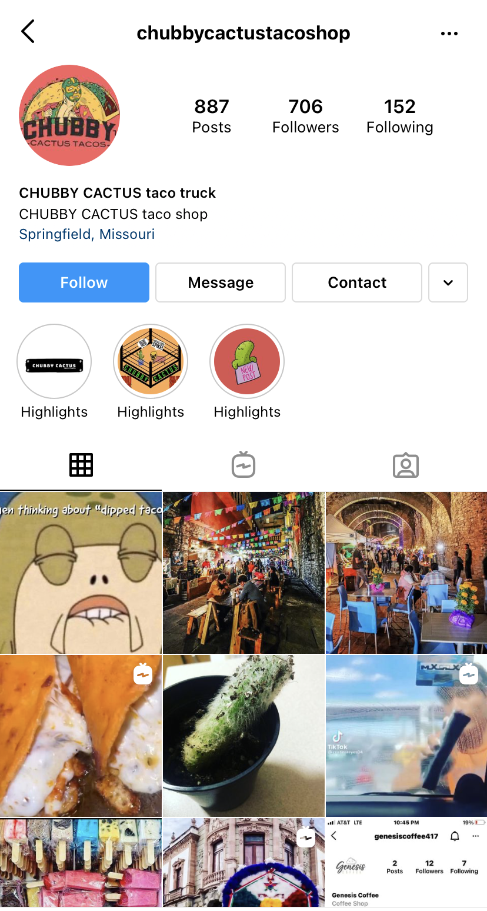
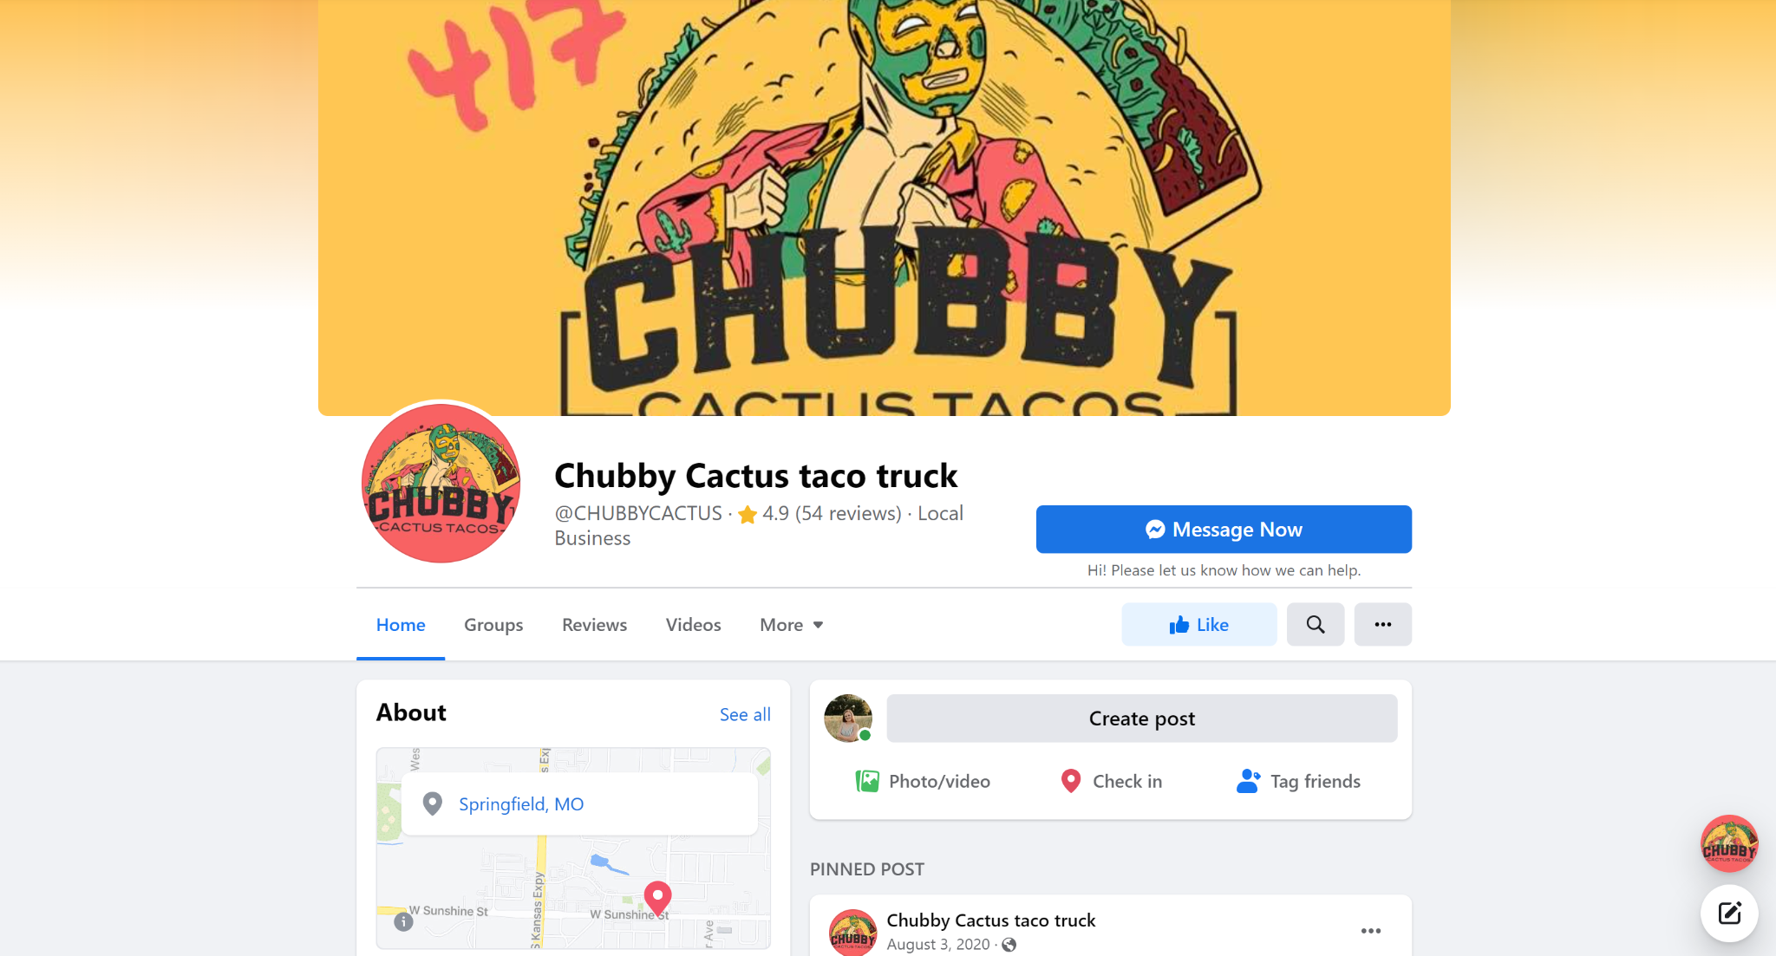
Social Media
As of right now The Chubby Cactus is slacking with their social media. Their Instagram page consists of memes and random videos that do not help their brand image. Revamping the instagram to contain content that is visually pleasing, relevant to their brand image, and posting frequently will make their presence online bigger. As for their Facebook page, that currently serves as their website, it could also use some work. They need to add their taco truck hours and location as well as the opening date for their brick and mortar store. The content needs to stay in line with their brand image and give more information about who they are as a business.

Slide 38
Internet Marketing: Website
Why use the internet?
In this day and age it is crucial for businesses to have a strong internet presence. The easiest way for consumers to gain information about businesses is through their websites. The percentage of millennials that use the internet is very high at 97%(11). This means almost all of the target market for The Chubby Cactus has an online presence.
Websites are proven to boost a company's performance by increasing credibility and generating more revenue (10). As of right now, The Chubby Cactus does not have their own website. They use their facebook page as their main source on the internet, which for a successful business is not sufficient. In order to generate buzz and create more business, it is crucial to have a visually pleasing website. A good website is filled with information about the company, contact info, their menu, and sometimes even online ordering.
Creating a website for The Cubby Cactus is a major step in the campaign. The website will include:
Information about the owner
Locations of both the taco truck and brick and mortar store
Contact information
Menu
The website will also utilize the colors that represent The Chubby Cactus throughout the campaign

Slide 39
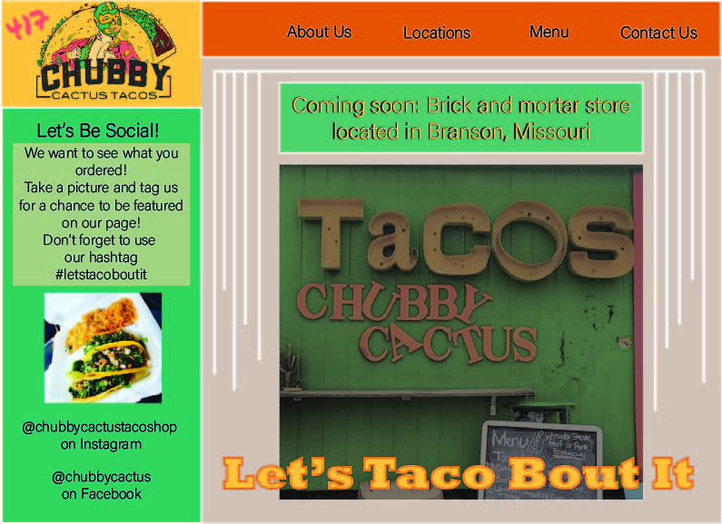
This is what a
website for
The Chubby Cactus should look like

Slide 40
Advertising : Social Media
Why Social Media?
Social Media is the fasting growing marketing tool, and is used by over half the world. We have seen that social media can be a tool used to promote business, as well as connect with new customers and handle customer objections. With over 3.5 billion people using social media, we believe that we can easily get our voice heard and our business known if we properly execute our advertising and sales promotions.
How Do We Plan on Executing This?
We will have a person run the social media pages of Chubby Cactus and have them keep high engagement by posting often with content that people enjoy, without introducing someone's social media space by overposting. We will post every tuesday about our special voucher which you can bring in to claim a free taco or double portion size on meat. This is expected to help grow our social media sites as people often come to eat with friends or family, and we hope that our social media pages will also grow our word-of-mouth advertising.

Slide 41
Out-of-home: Billboard
The final channel in this campaign is an eye-catching billboard in effort to gain attention and get noticed. Out-of-home advertisements are useful tools that support or reinforce messages sent through traditional media. A drawback of using a billboard as an out of home channel is that it can sometimes be seen as having limited message capabilities and fleeting messages, however when paired with our other well thought out channels and placed in a strategic location we will be sure to catch the eyes of hungry travelers looking for a delicious stop.
How?
Why?
Individuals will discover this billboard advertising The Chubby Cactus Food Truck roughly around coordinates 36.671390, -93.334736. This billboard will be angled so that traffic going into Branson west or popular destination Silver Dollar City can easily see this from the road, as well as guests that are leaving Silver Dollar City can also see it for a last minute local dinner solution. This Billboard will display information for potential customers to look up the business through our website and social media.
Out of home ads are effective at gaining attention and exposure. By placing the billboard next to a highly trafficked road by locals and tourists it is likely to gain massive amounts of exposure. The billboard will allow us to take a catch all approach on the target audience and expand farther out than our typical audience (Millenials and Foodies), allowing us to also invite in families, adventure seekers, etc. Another benefit to using out of home advertising for our campaign is the relative low cost vs some other channels.

Slide 42
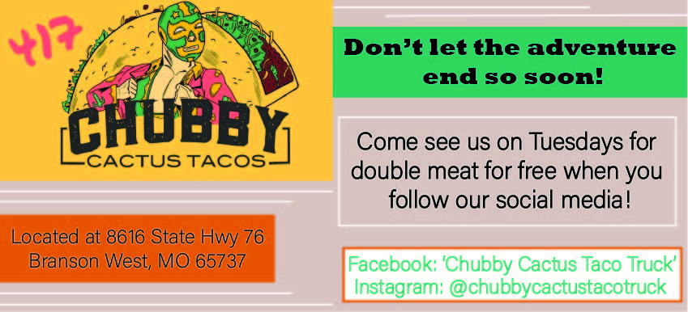
Out-of-home: Billboard

Slide 43
Campaign pt 4
Conclusion

Slide 44
Budget
Item | Description | Cost
Merchandise | $19.49 x 48 minimum shirt order (15) 50 custom stickers from Etsy (14) | $953.52
Billboard | $1,500 for 4 weeks (13) | $1,500
Total Cost |  | $2,453.52
Optional: Social Media Ads | $2,00 budgeted over 4 weeks | $2,000

Slide 45
Schedule
 | Monday | Tuesday | Wednesday | Thursday | Friday | Saturday | Sunday
Oct 25th-31st | Menu Item showcase on SM | Taco Tuesday SM posts | Menu Item showcase on SM |  | Weekly Merchandise showcase SM post | SM posts discussing food drive
Nov 1st - 7th | Food Drive begins - #letsTacoBoutIt | Taco Tuesday SM posts | Menu Item showcase on SM |  | Weekly Merchandise showcase SM post | SM posts discussing food drive | Menu Item showcase on SM
Nov 8th -14th | Menu Item showcase on SM | Taco Tuesday SM posts |  | Menu Item showcase on SM | Weekly Merchandise showcase SM post | SM posts discussing food drive
Nov 15th-21st |  | Taco Tuesday SM posts | Menu Item showcase on SM |  | Weekly Merchandise showcase SM post | SM posts discussing food drive | Menu Item showcase on SM
Nov 22nd - 28th | Menu Item showcase on SM | Taco Tuesday SM posts | Menu Item showcase on SM |  | Weekly Merchandise showcase SM post | SM posts discussing food drive coming to an end
Nov 29th-Dec5th |  | -Food Drive ends - #LetsTacoBoutIt -Taco Tuesday SM posts | Menu Item showcase on SM | Food Drive contributions announcement on SM | Weekly Merchandise showcase SM post |  | Menu Item showcase on SM

Slide 46
Works Cited
Diane Smith, Michigan State University Extension. “Food Trucks and Millennials.” MSU Extension, 30 Oct. 2020, https://www.canr.msu.edu/news/food_trucks_and_millennials.
“Springfield, Missouri Population 2021.” Springfield, Missouri Population 2021 (Demographics, Maps, Graphs), https://worldpopulationreview.com/us-cities/springfield-mo-population.
“Millennial Buying Stats All Marketers Need to Know.” Khoros, https://khoros.com/blog/millennial-buying-habits.
Pengue, Maria. “Interesting Statistics about Millennials and Social Media: 2021.” WBL, 30 Sept. 2021, https://writersblocklive.com/blog/statistics-about-millennials-and-social-media/.
Melendi, Crosby. “Generational Differences on Social Media: A Deep Dive.” FLAGSHIP SOCIAL, FLAGSHIP SOCIAL, 30 June 2020, https://flagshipsocial.com/blog/generational-differences-on-social-media-a-deep-dive.
Moran, Matt. “42 Top Social Media Statistics for 2021: Usage, Demographics, Trends.” Startup Bonsai, Startup Bonsai, 9 Sept. 2021, https://startupbonsai.com/social-media-statistics/.
What Your Follower/Following Ratio Say About Your Instagram Account. 9 Mar. 2018, https://workmacro.com/instagram/follower-following-ratio-say-instagram-account/#:~:text=The average number of followers,of your follower/following ratio.
Cherry, Kendra. “How Does Orange Influence Your Moods?” Verywell Mind, Verywell Mind, 6 Oct. 2021, https://www.verywellmind.com/the-color-psychology-of-orange-2795818.
“Describing Teal.” The Color Teal, http://homepages.neiu.edu/~jjkoss/cs300/teal.html.
Council, Young Entrepreneur. “Council Post: Why Every Business Needs a Website.” Forbes, Forbes Magazine, 3 Feb. 2020, https://www.forbes.com/sites/theyec/2020/02/03/why-every-business-needs-a-website/?sh=2d13ebfd6e75.
Staff, Herosmyth. “75 Eye-Opening Statistics on How Each Generation Uses Technology.” Herosmyth, https://www.herosmyth.com/article/75-eye-opening-statistics-how-each-generation-uses-technology.
417foodist. “Chubby Cactus Taco Truck.” 417 Foodist, 20 Apr. 2020, https://417foodist.wixsite.com/eat417/post/chubby-cactus-taco-truck.
“Billboard Advertising in Springfield, Mo in Greene County, MO.” Billboard Advertising in Springfield, MO in Greene County, MO - Rent Springfield Billboard Ads Here, https://www.bluelinemedia.com/billboard-advertising/springfield-mo.
https://www.etsy.com/market/custom_stickers
https://www.customink.com/ndx/#/next/summary

